Slide 1
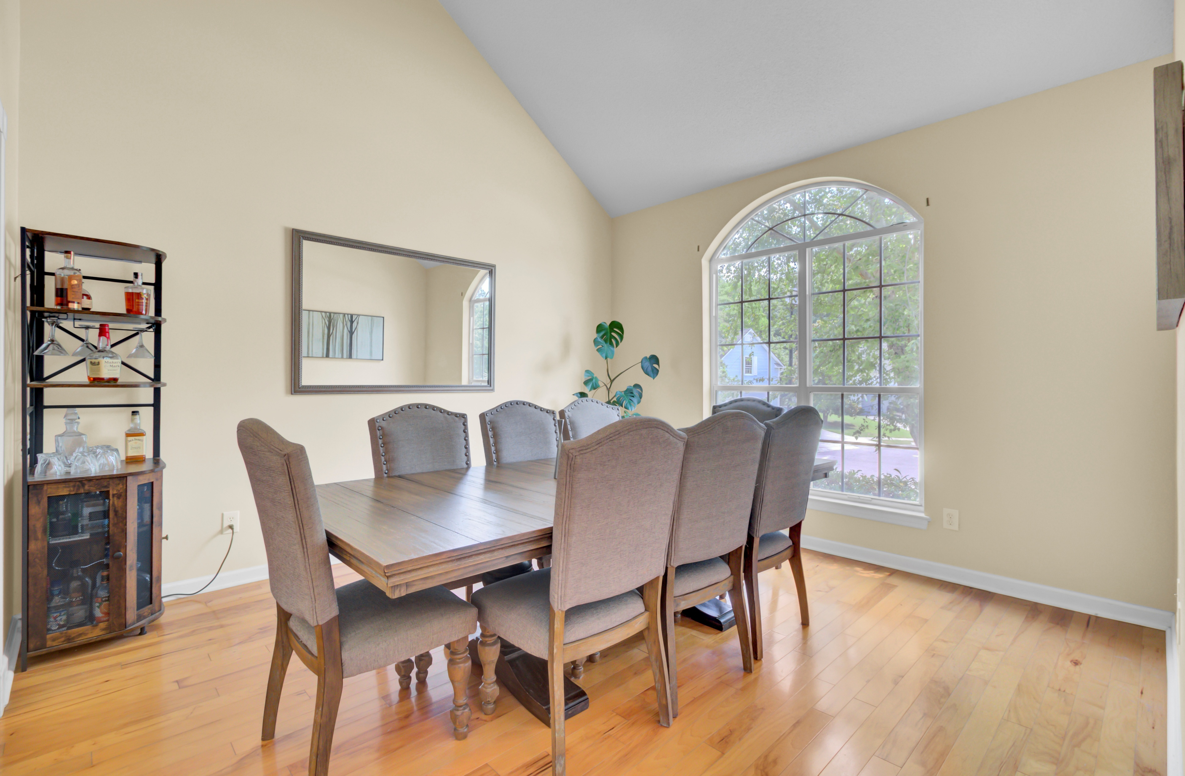
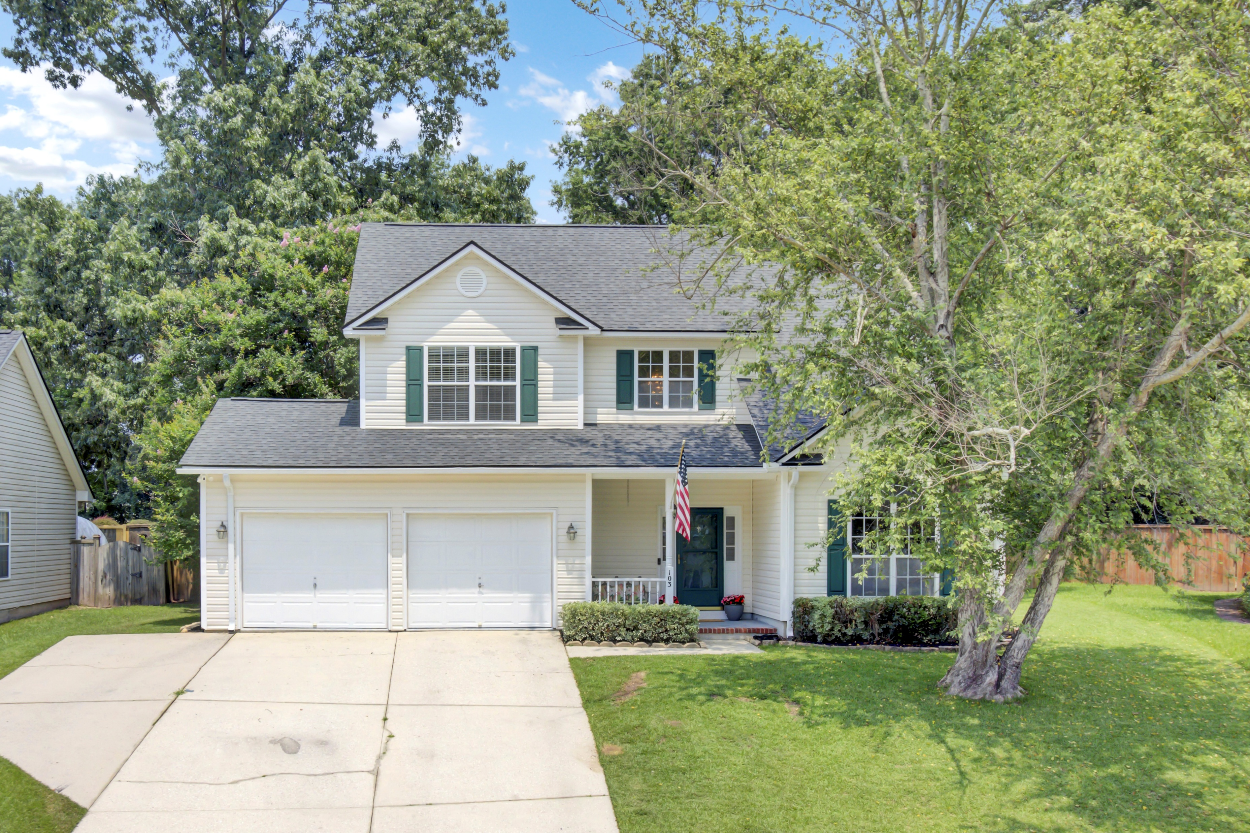
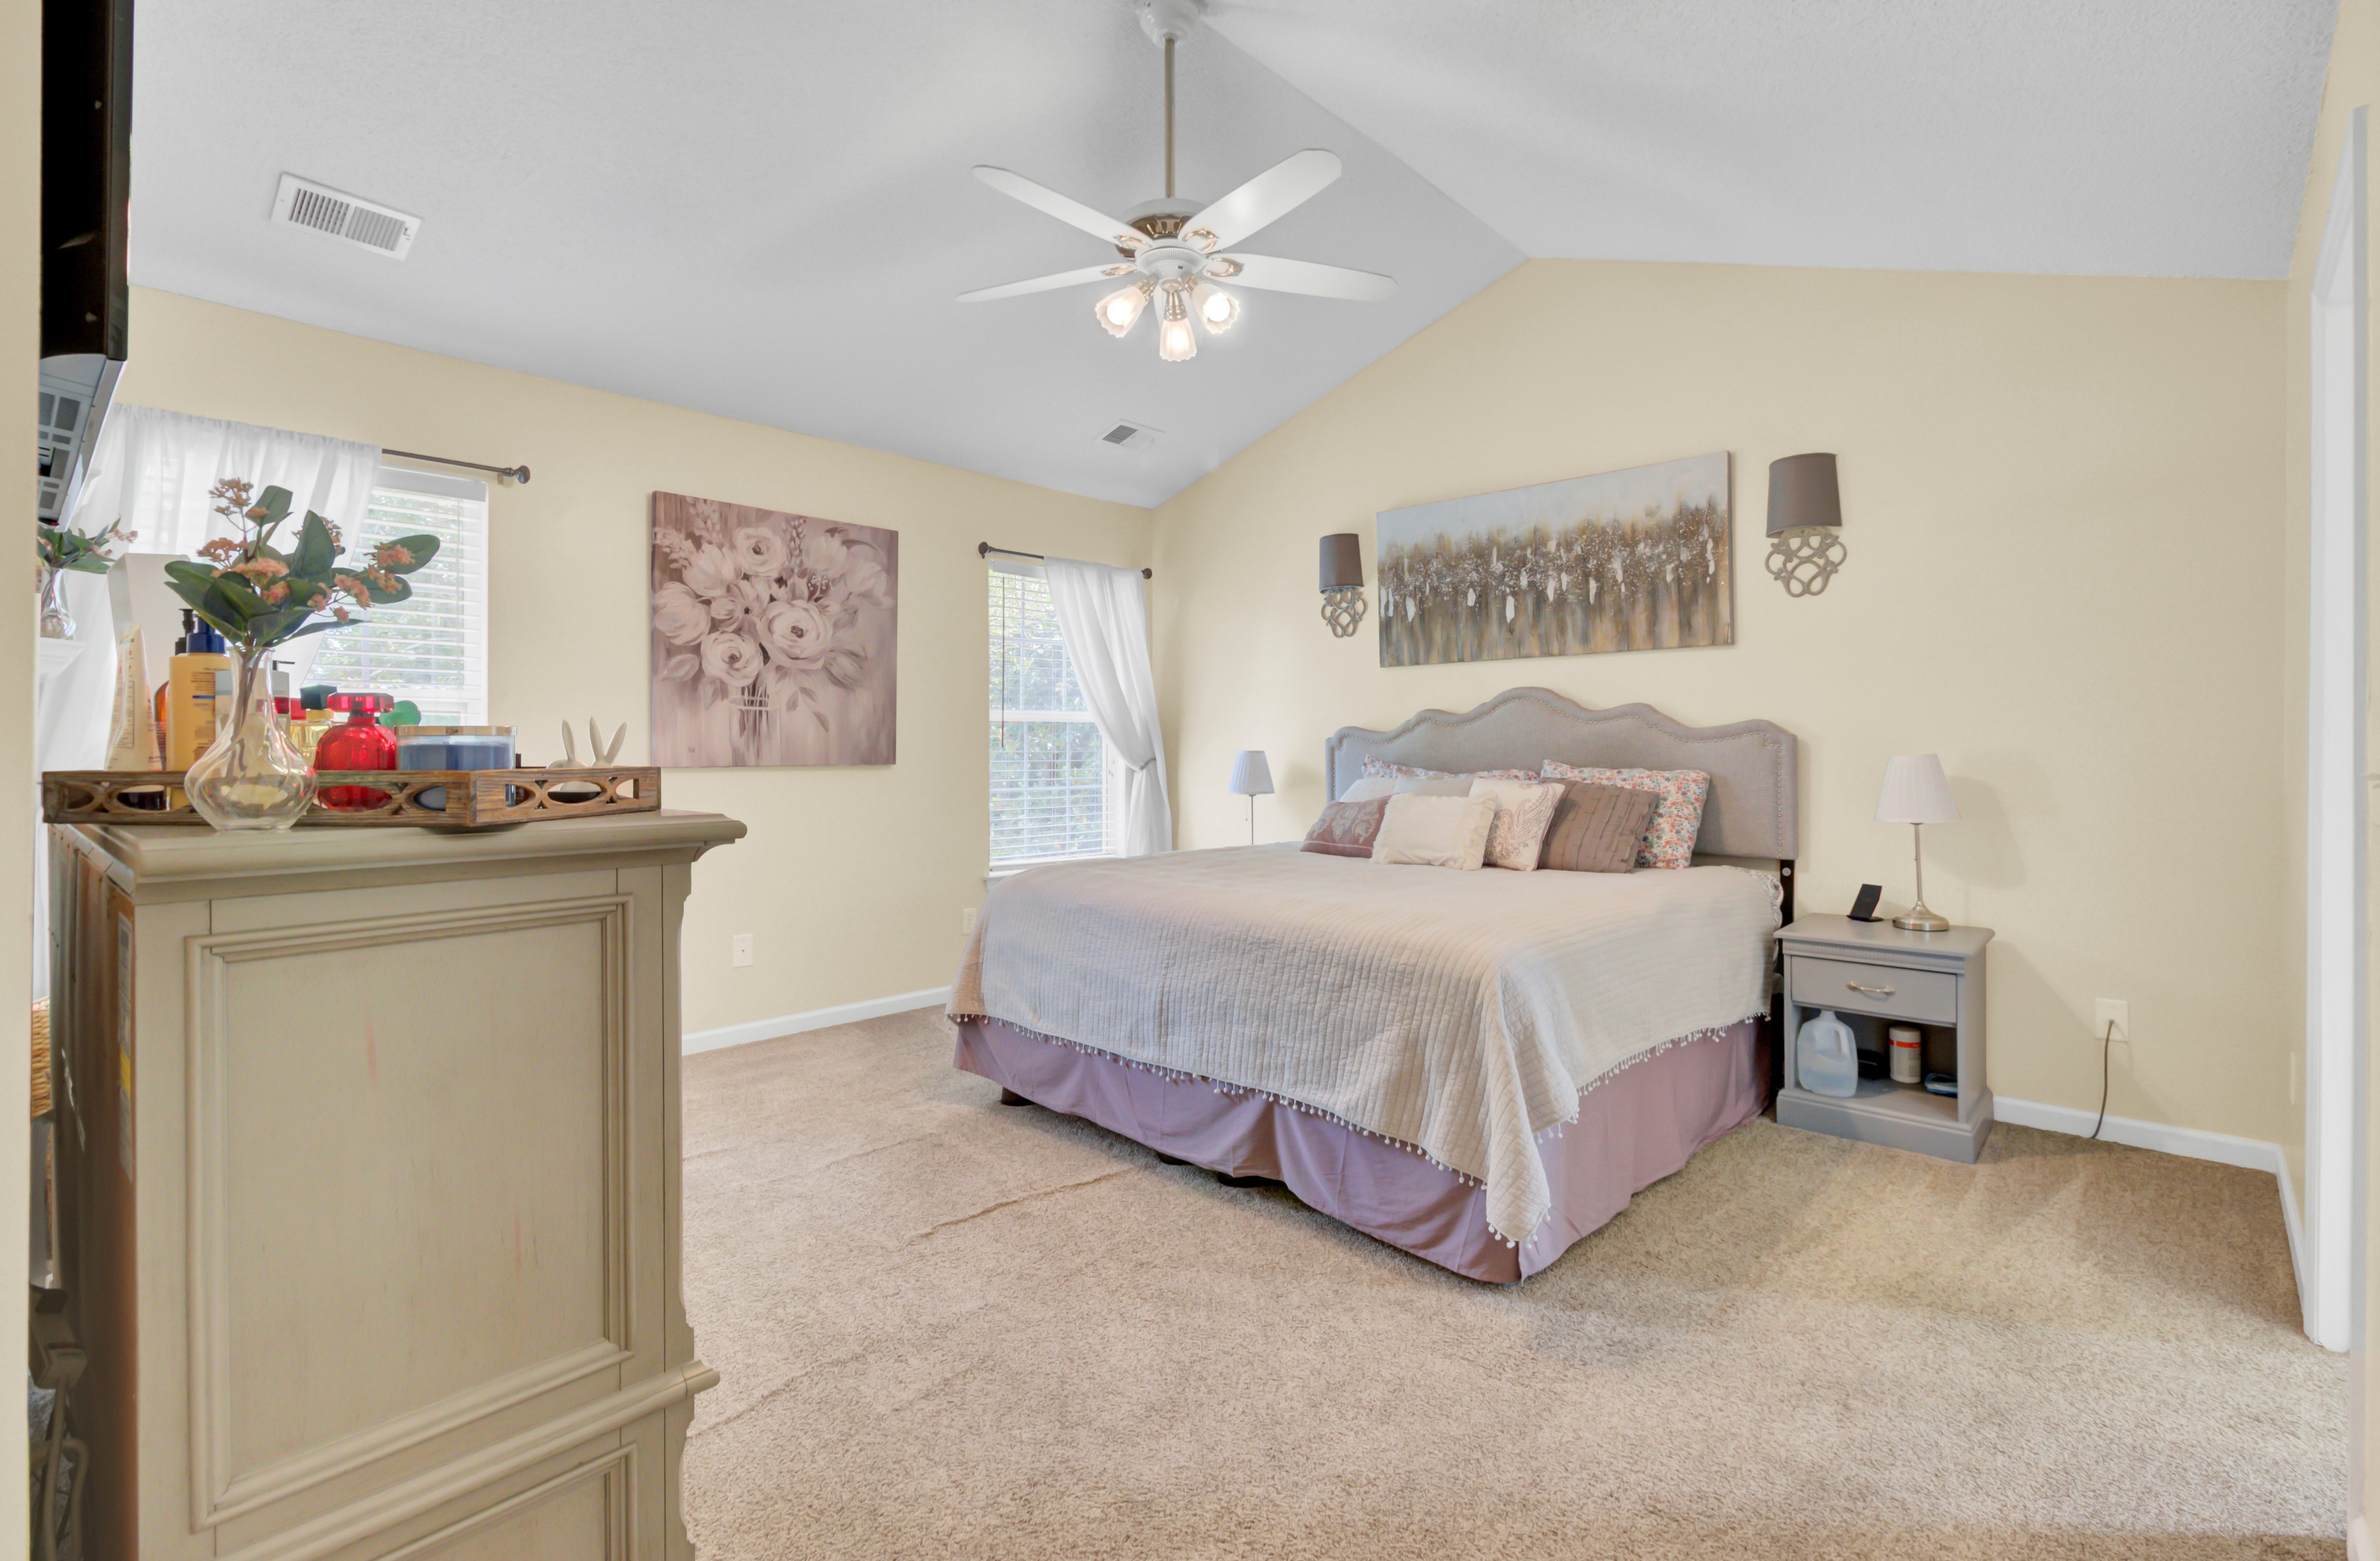
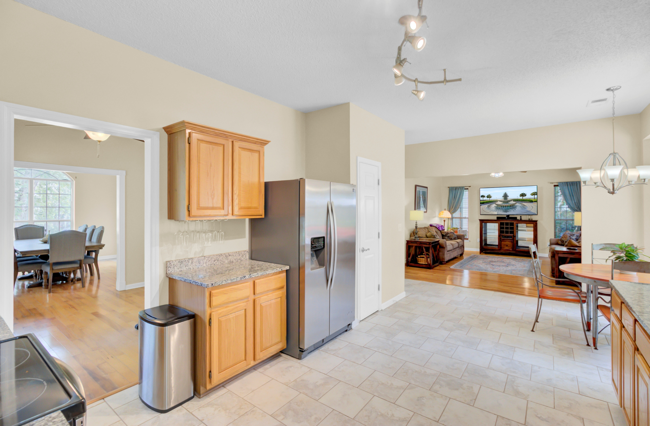
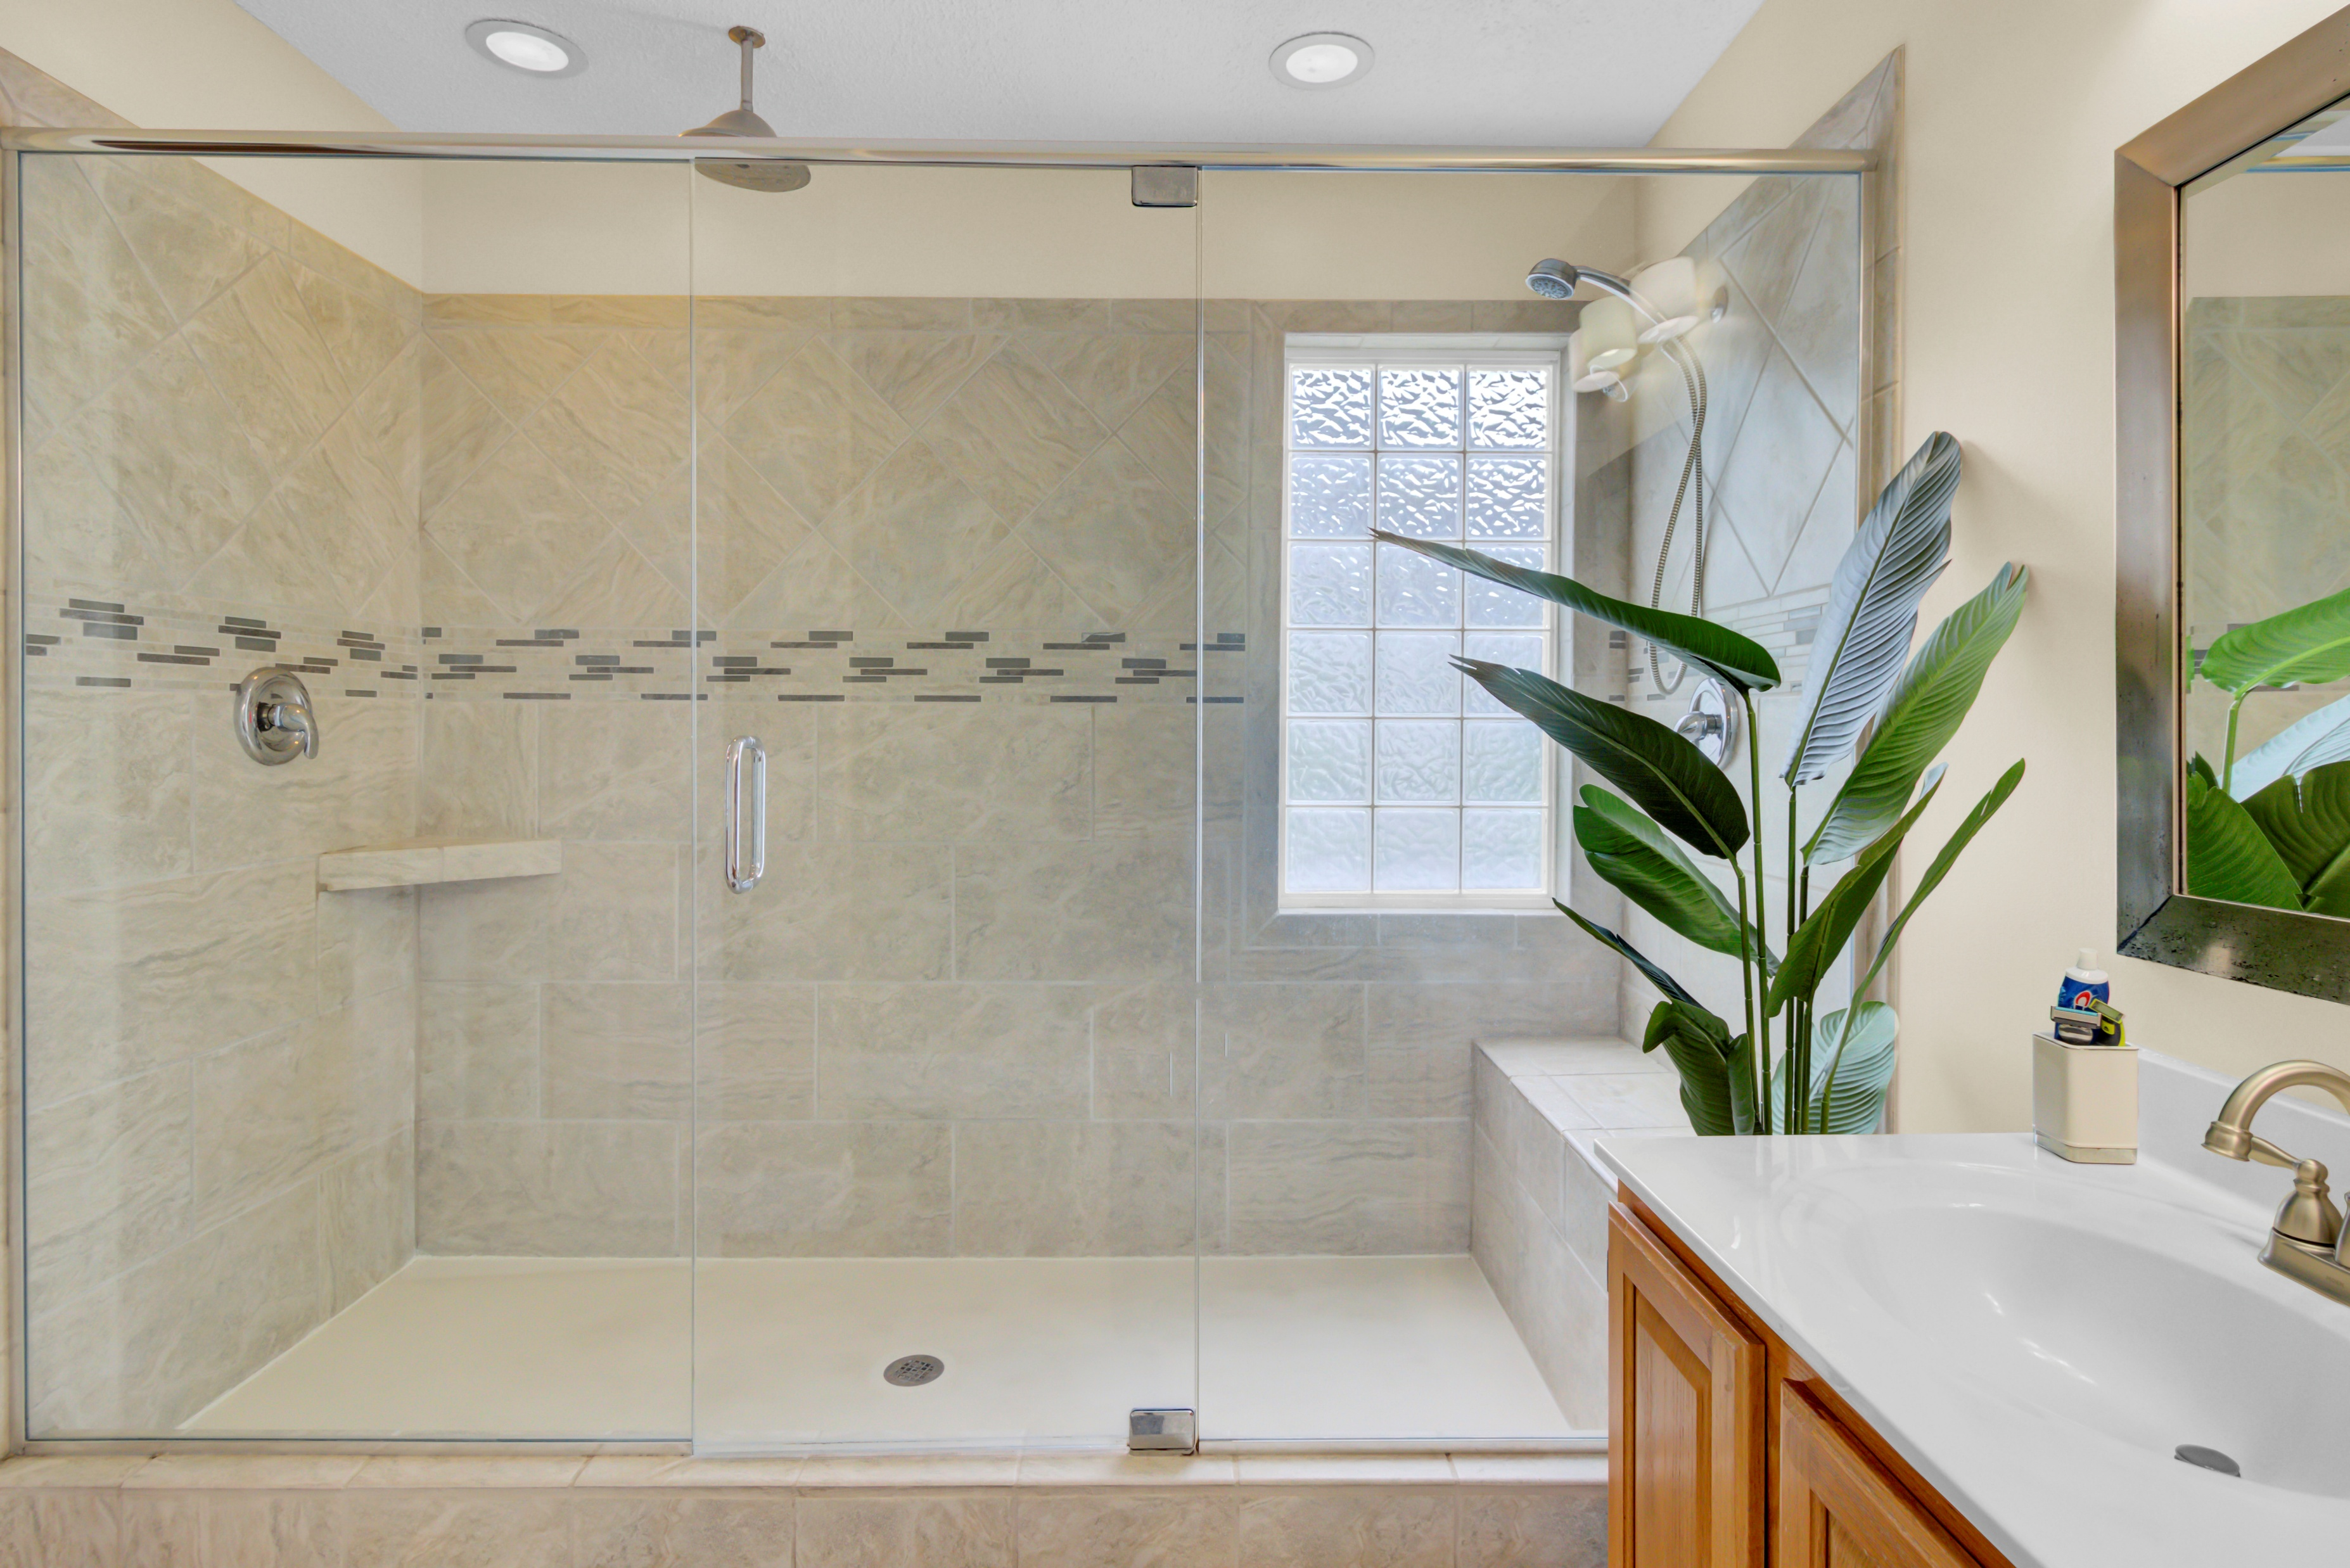
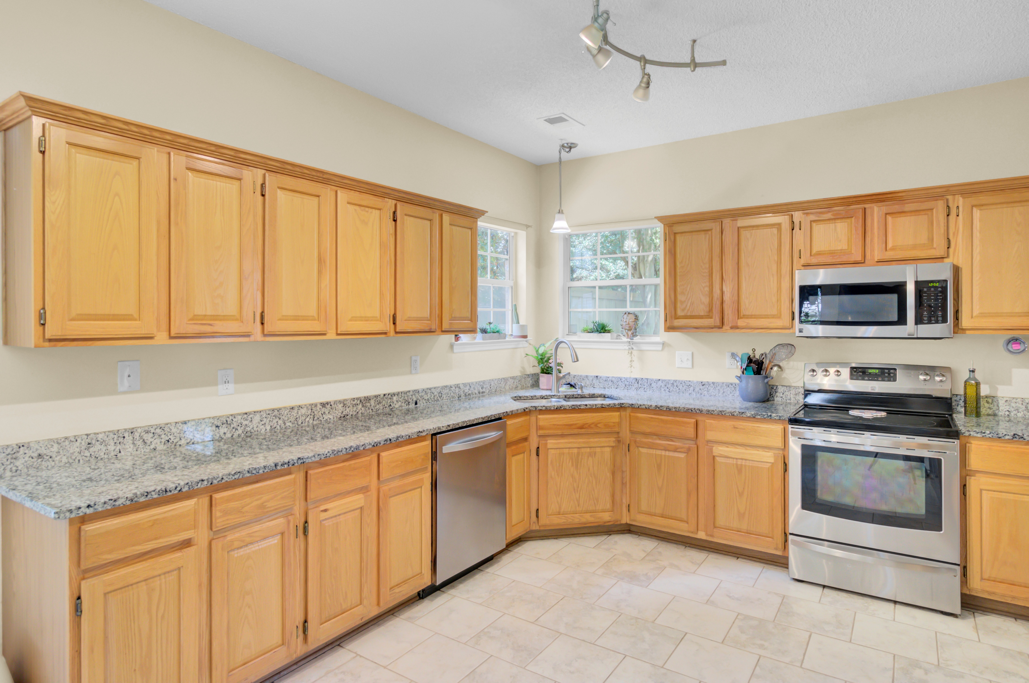



New Listing!
103 Trimley Court
Adthan Place
Goose Creek, SC 29445
MLS# 25015466 | $429,900
Video Tour
🏡 Just Listed in Crowfield Plantation – Don’t Miss This Opportunity!
This is your chance to own a beautiful 4-bedroom, 2.5-bath home in the highly sought-after Crowfield Plantation, tucked away on a quiet cul-de-sac in the charming Than Place section.
Inside, you’ll love the open-concept layout and the spacious kitchen filled with cabinetry and generous counter space—perfect for daily living and entertaining. Upstairs, all bedrooms offer great separation from the main floor. The primary suite is a true retreat, featuring vaulted ceilings, dual vanities, and a spa-like tiled shower room.
Step outside and enjoy the oversized, fenced-in backyard complete with a pergola—perfect for weekend cookouts, playtime, or just unwinding outdoors. The versatile floor plan also offers space for a formal dining room, home office, or playroom to suit your needs.
Living in Crowfield means more than just a great home—you’ll have access to lakes, scenic walking trails, pools, tennis courts, and optional golf memberships. Plus, this home is zoned for popular local schools and offers unmatched convenience.
📅 Schedule your private tour today—homes in Than Place go fast!
Video Tour
Ellen O'Neil
Broker/Owner, ABR, e-PRO, CNE
Charleston Realtor of Distinction
843-300-8530
www.EllenONeilProperties.com

