Slide 1
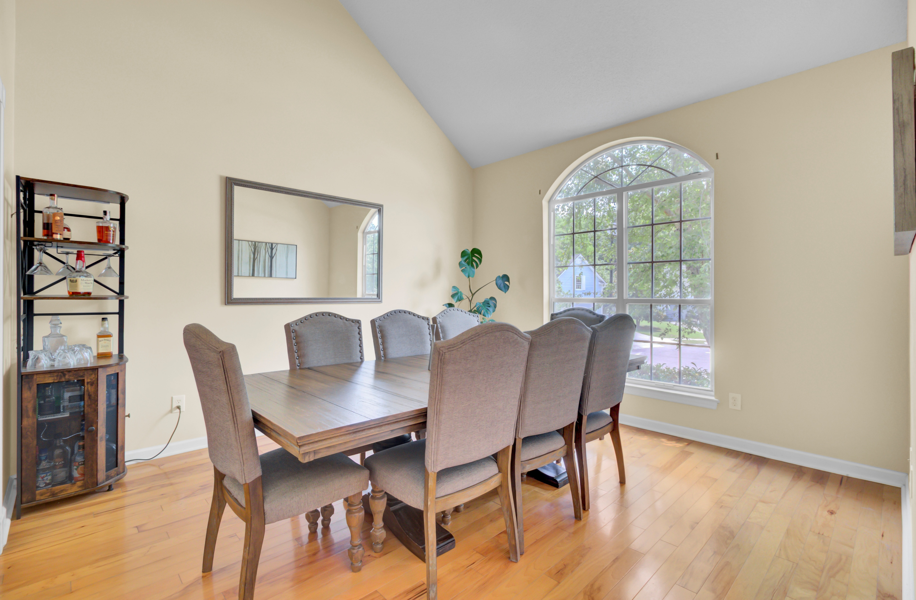
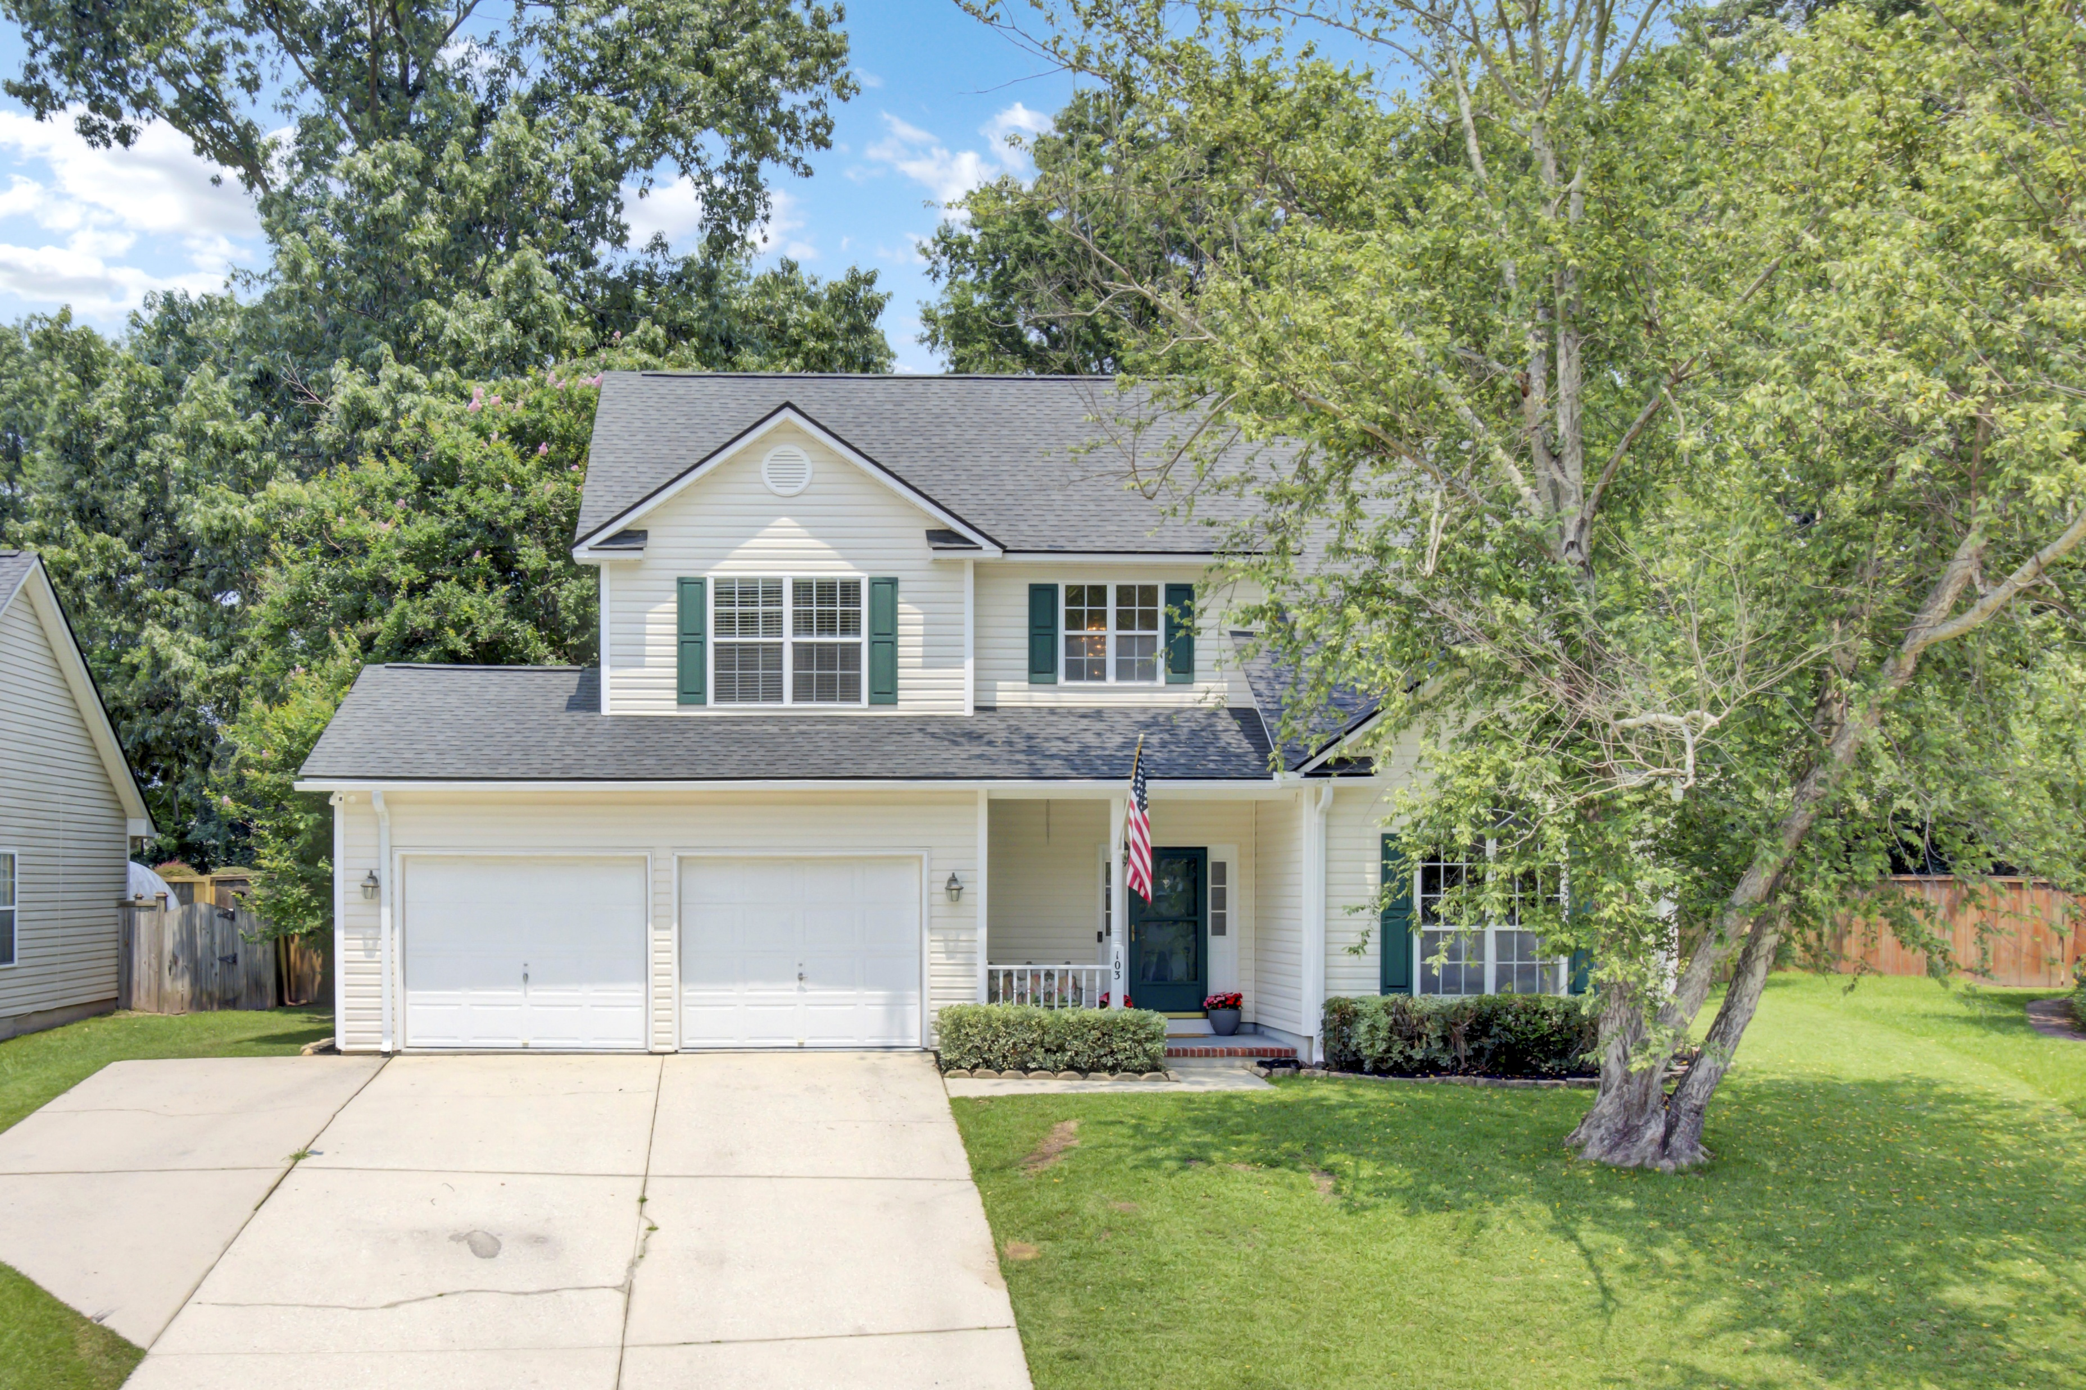
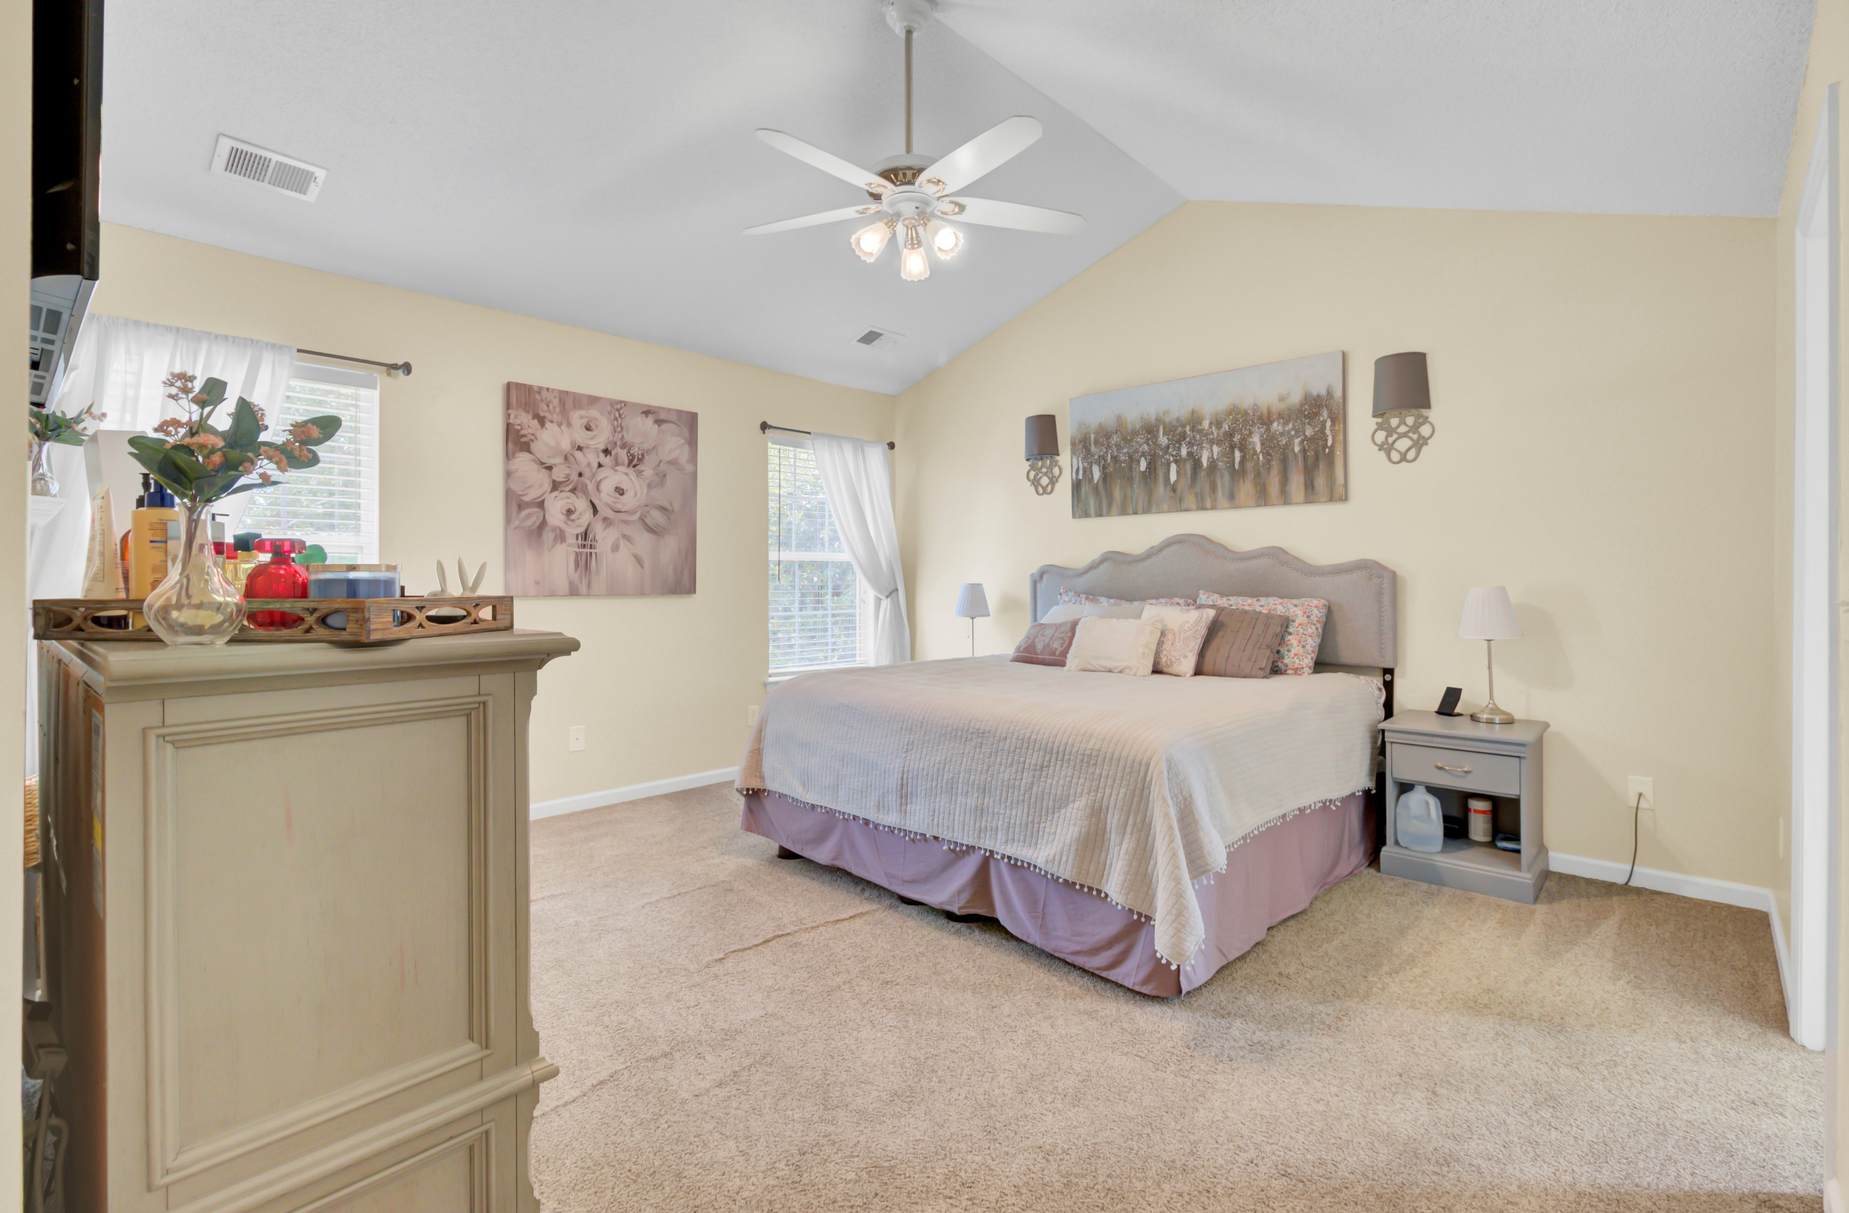
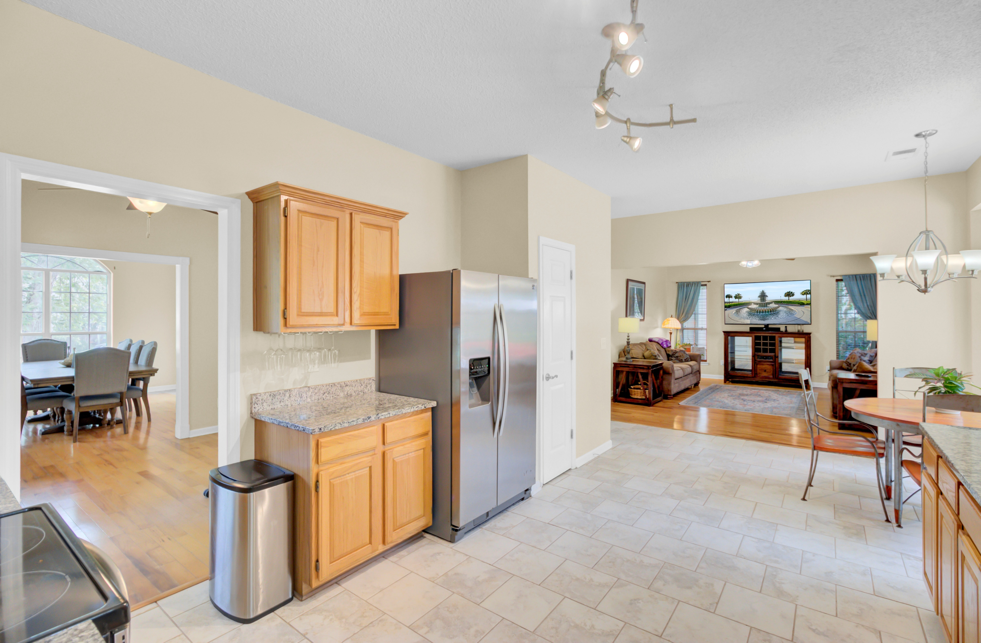
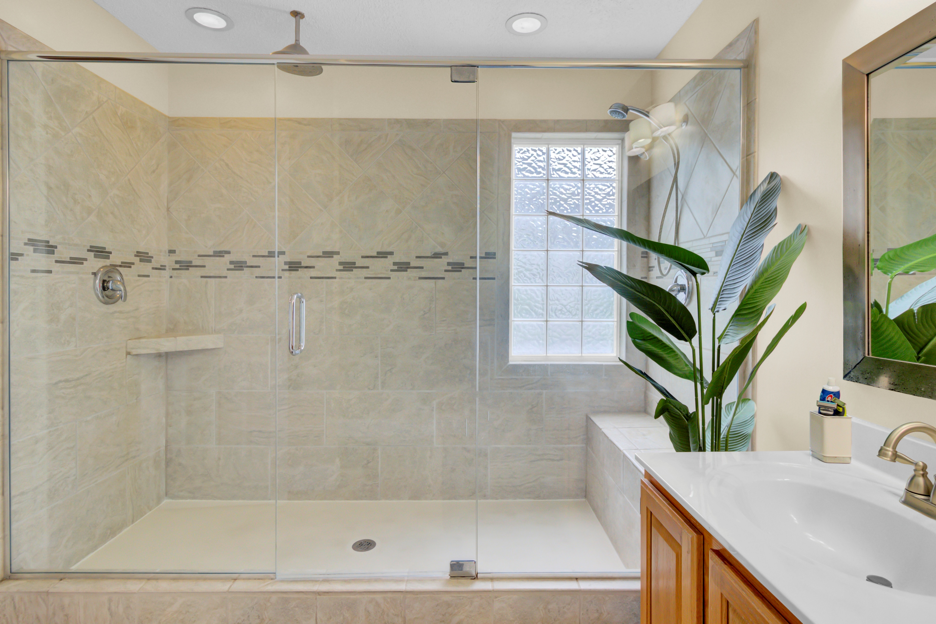
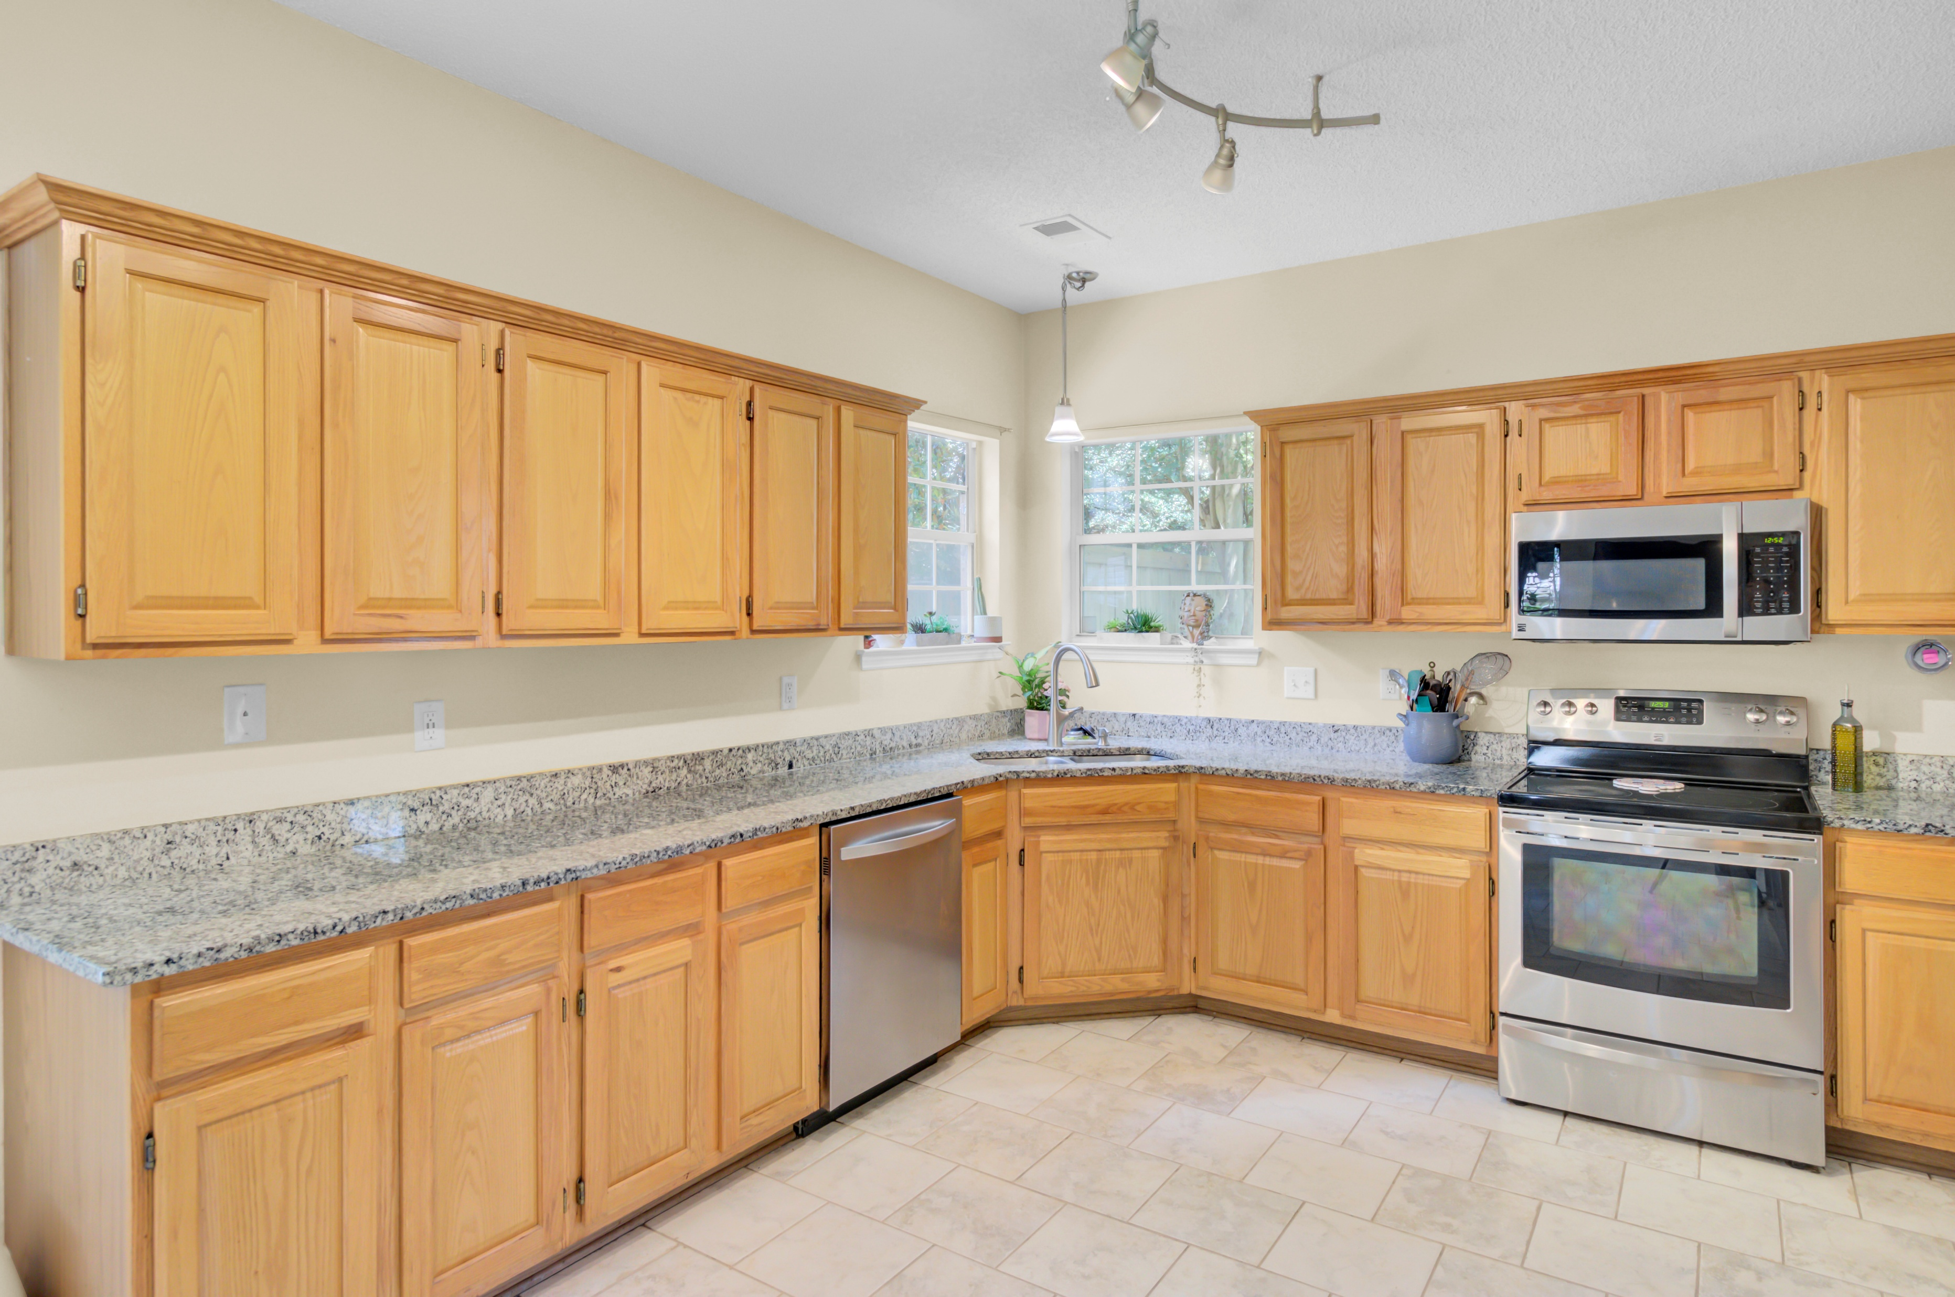
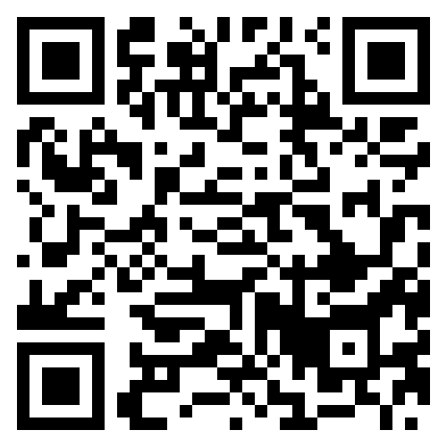


Hot New Listing and Open House
103 Trimley Court
Adthan Place
Goose Creek, SC 29445
MLS# 25015466 | $429,900
Video Tour
Just Listed in Crowfield Plantation!
This 4BR/2.5BA home in Adthan Place features open-concept living, a spacious kitchen, a huge fenced yard with pergola, and an oversized primary suite with spa-inspired bath—all on a quiet cul-de-sac!
📍 103 Trimley Ct., Goose Creek
📆 Open House: Saturday, June 21 | 10 AM – 12 PM
Don’t wait—schedule your tour today!
Video Tour
Ellen O'Neil
Broker/Owner, ABR, e-PRO, CNE
Charleston Realtor of Distinction
843-300-8530
www.EllenONeilProperties.com

