Slide 1
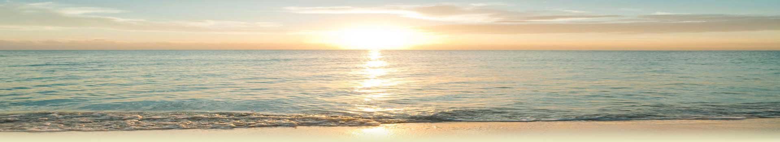

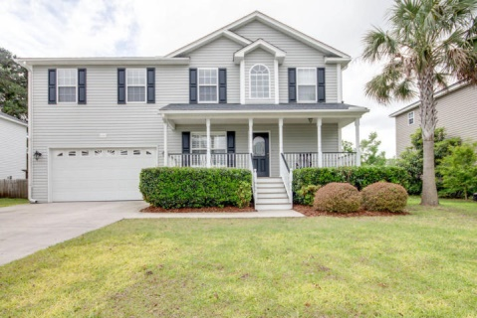
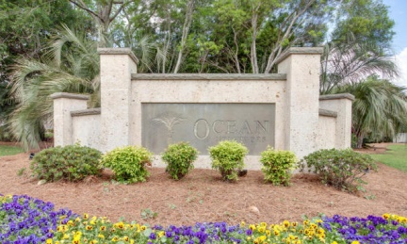
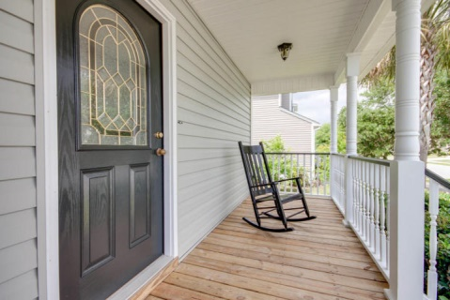
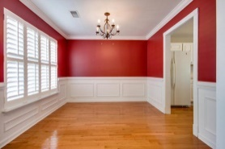
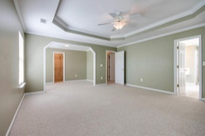
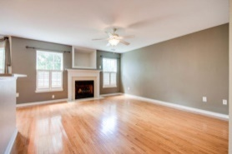
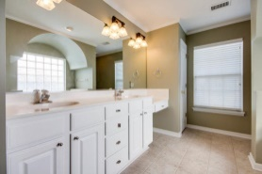
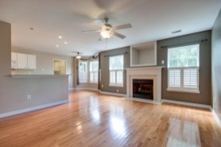
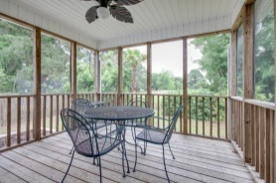
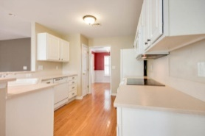
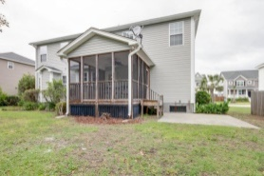
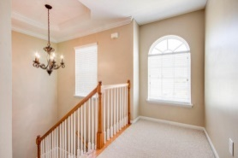
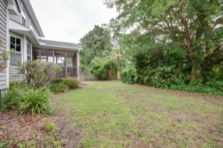


Sea Breeze Delight
1041 Clearspring Drive
Ocean Neighbors - Charleston
MLS# 15011988 - $365,000
This beautiful four bedroom home is approximately 4 miles to Folly Beach and 8 miles to downtown. Located in wonderful Ocean Neighbors where you can enjoy the sea breeze from the front porch rockers or from the back screened in porch.
The house backs up to a large open space, and you get a little lake view from the front of the house. Beautiful landscaping, irrigation, and a two car garage invite you inside where you have hardwoods downstairs, tile in the 2.5 baths, and carpet upstairs.
Formal dining room, eat-in kitchen plus bar, large family room, and large laundry room are all conveniently downstairs.
The huge master bedroom with tray ceiling, office area, and large walk-in closet has great views off the back of the house. The large master bath has a soaking tub, shower, and dual vanities. Three more nice bedrooms and a full bath are also upstairs.
There are several neighborhood common areas including the gazebo picnic area at the front of the neighborhood, a playground under a magnificent oak, and a community dock on the 12 acre lake.
Lee Lindler leel@goldenbearrealty.com
www.GoldenBearRealty.com
Golden Bear Realty | 654 Coleman Blvd, Suite 100 | Mt Pleasant , SC 29464
Cell (843) 637-0803 | Office (855) 725-5890 | Fax (561) 721-3311

