Slide 1

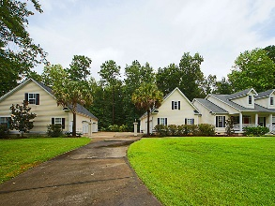
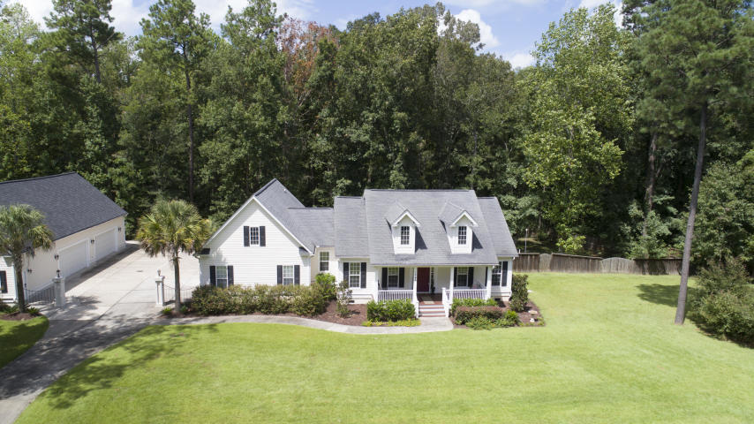
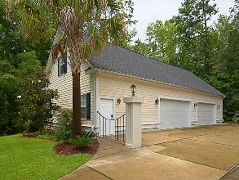
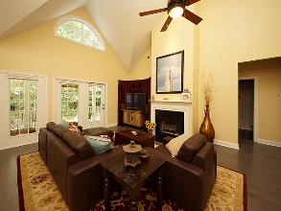
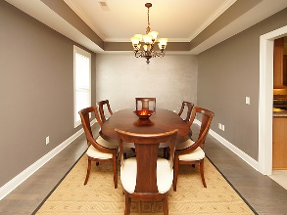
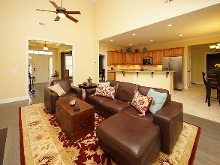
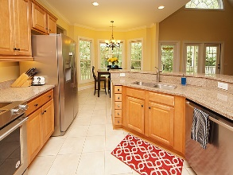
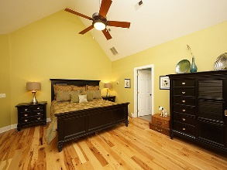
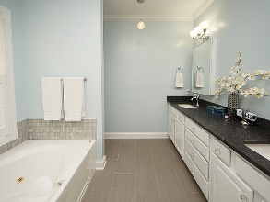
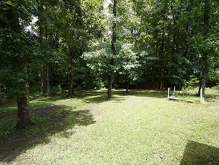



1042 Willington Drive
Winterseat | Ridgeville, SC 29472 | MLS# 18022414
Reduced to $458,000
Custom home on beautiful lake!
Wonderful home with 4-car detached garage/workshop
for the car enthusiast AND a 2-car attached garage
Lovely home on a large in the peaceful setting of the quaint gated community of Winterseat. This upgraded 4-bedroom home has a wonderful, open floorplan with a 2-car attached garage and a detached 4-car workshop with a car lift and loft for your man cave! As you enter, the foyer flows into the well-lit family room that is perfect for entertaining and gathering. The large open family room boasts a dramatic vaulted ceiling, gas fireplace, glass exterior door to the back porch, and several windows for lots of natural light! To the left of the foyer there is a bright and cheery dining room. The well-appointed eat-in kitchen overlooks the family room and has many nice features...granite countertops, lots of cabinetry for storage, stainless steel appliances, and tile flooring. This would be a great kitchen for the chef in the family! The large master bedroom is tucked away in the back of the home with a vaulted ceiling, laminate hardwood flooring, and walk-in closet. The nicely upgraded en suite bathroom has a wonderful walk-in tile shower, Jacuzzi tub...great for relaxing, a double-sink granite vanity, and tile flooring. The split floorplan has two additional nice size bedrooms with an attractive secondary bathroom conveniently located between them. The FROG, considered the fourth bedroom or second master bedroom, could also be used as a great game room or FLEX space. There is plentiful storage and a full bath. The outdoor area of the home is a delightful place to relax and enjoy the neighborhood. There are two covered porches...front and back that lend themselves to serene and peaceful spots to unwind overlooking a beautiful wooded backyard! In addition to the attached two-car garage, there is also a detached 4-car garage/workshop with a loft and Challenger VS10 2-post car lift. This well thought out addition to the home has numerous uses for the homeowner. The workshop has lots of storage for your vehicles/toys, a half-bath (to be completed) and a loft for your man cave. Behind the workshop is hidden RV/boat parking too. This is a fantastic feature of this wonderful property and would be a great place to call your next home!
Gay Hartmann
M (843) 607-3400 | O (843) 871-9000 | F (843) 202-2958
ghartmann@carolinaone.com
Carolina One Real Estate | Summerville, Trolley Road Office | 1530 Old Trolley Rd | Summerville, SC 29485-8225

