Slide 1

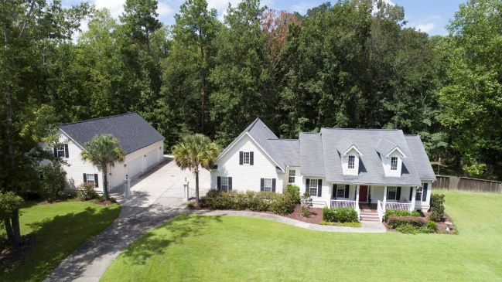
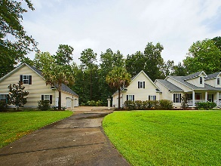
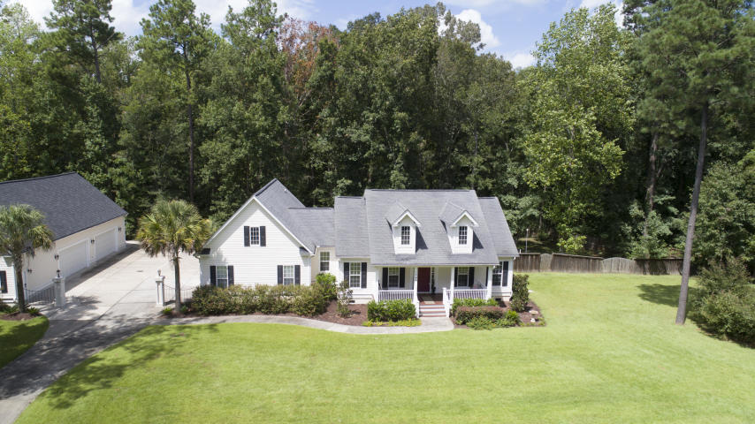
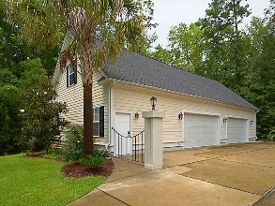
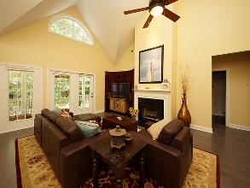
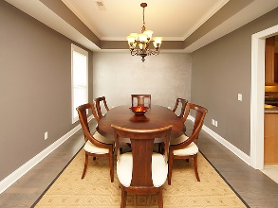
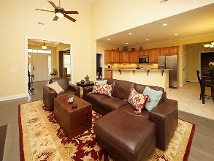
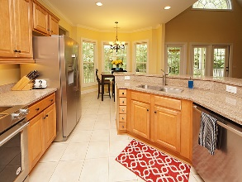
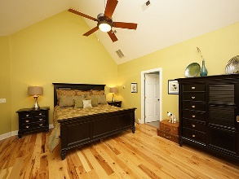
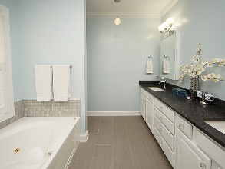
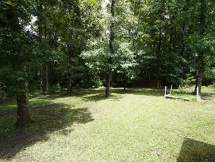



1042 Willington Drive Winterseat | Ridgeville, SC 29472 | MLS# 18022414 Price Adjusted to $450,000
Custom home on beautiful lake!
Wonderful Home With 4-car Detached Garage/Workshop For The Car Enthusiast AND A 2-car Attached Garage
HUGE 4-car Workshop With A Car Lift And Loft
Hidden RV/Boat Parking Behind Shop
Wonderful, Open Floorplan
Family Room Perfect For Entertaining And Gathering
Bright And Cheery Dining Room
Well-appointed Eat-in Kitchen
Upgraded Large Master Bedroom Suite
FROG Bonus Area / 4th Bedroom
Two Covered Porches
Serene And Peaceful Wooded Backyard
Gay Hartmann
M (843) 607-3400 | O (843) 871-9000 | F (843) 202-2958
ghartmann@carolinaone.com
Carolina One Real Estate | Summerville, Trolley Road Office | 1530 Old Trolley Rd | Summerville, SC 29485-8225

