Slide 1
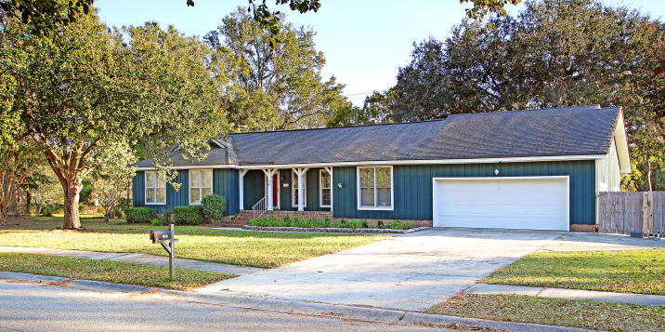
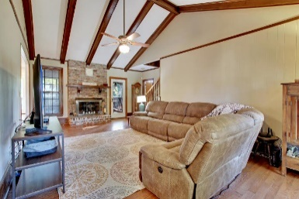
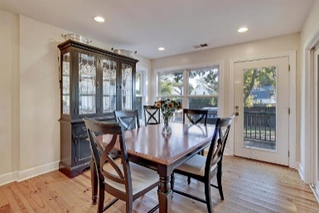
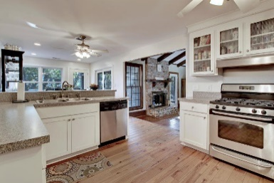
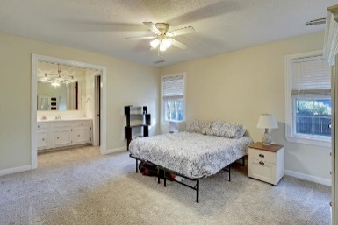
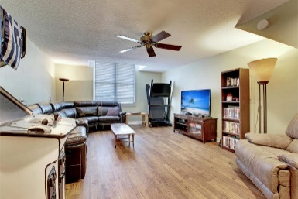
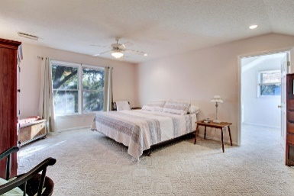
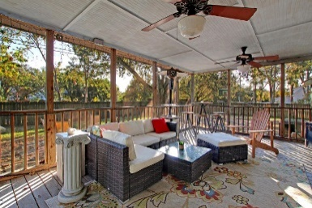
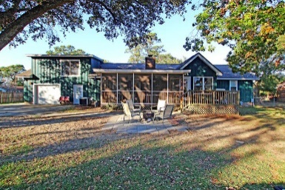

Deepwater Dock in Place
1044 Foxcroft Road
Harbor Woods ~ Charleston, SC 29412 ~ MLS# 19031845 ~ $474,500
Great home on James Island in the much desired Harbor Woods neighborhood.
This house boasts a large lot, drive through garage, boat parking spot with concrete pad, updated kitchen and dual masters! This home has a beautiful sunken living room and a vaulted beamed ceiling, large game room, a master suite upstairs with a sitting area, and master downstairs as well. Enjoy your evenings on the screened back porch or walks through this beautiful well established James Island Neighborhood!
Jonathan Vroon
(843) 514-3114
jvroon@southernlivingre.com
www.southernlivingre.com
Southern Living Real Estate 2249 Salt Wind Way, Mt. Pleasant, SC 29466

