Slide 1
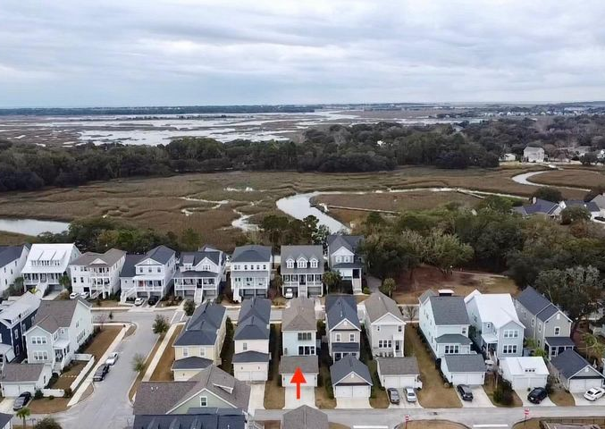
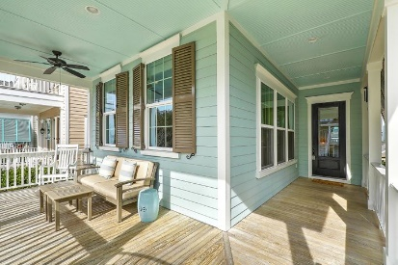
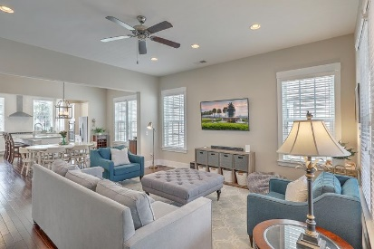
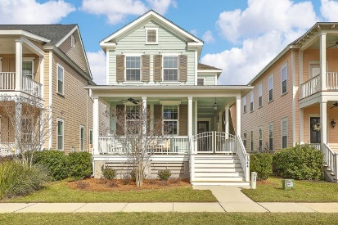
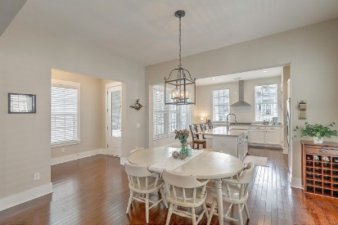
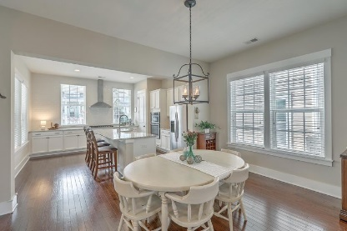
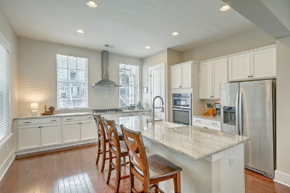
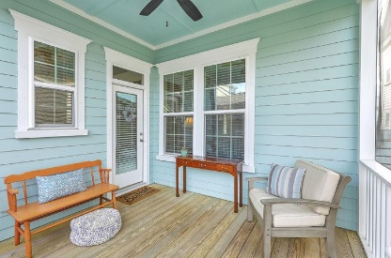
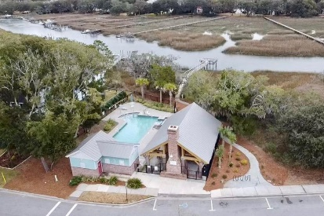


1044 Hills Plantation Drive
Seaside Plantation | Charleston, SC 29412 | MLS# 21000897 | $569,900
James Island Beauty!
This Modern Southern Charm home offers an easy and casual Low Country lifestyle in a highly desirable neighborhood with great amenities. Wide wrap around porch provides plenty of room to relax. Step inside and take in all of the design details. The gourmet kitchen is a cook's dream! Beautiful white cabinets, white tile backsplash and gorgeous granite countertops play well off of the stainless appliances and darker wood floors. The huge kitchen island with farm sink can seat four comfortably and also offers additional counter space. Dining area flows from the kitchen into the spacious living room/great room, which overlooks the screen porch and backyard. Seller has added a brick paver patio to increase the outdoor living space and as well as additional landscaping, irrigation and gutters.
The 23' driveway to the garage is longer than most offering plenty of extra space to park. Back inside, you will find a drop zone complete with hooks and a shelf to hold coats, bags, shoes, etc. Next to that is a powder room and across from there, a deep utility closet with added decorative shelving. Seller has upgraded all lighting and plumbing fixtures, added functional hurricane shutters in 2019, installed an electric copper lantern on the front porch along with an aluminum gate. Upstairs you will find a sizable Master Suite with a large walk-in closet. Master bath has gorgeous tile flooring, a double vanity and large tiled shower. 2 additional bedrooms, full bathroom, laundry room and small alcove complete the upstairs living space.
Enjoy the neighborhood amenities which includes a pool and picnic pavilion overlooking the water, walking trails, playground, dog park and neighborhood dock.
Beth Mandell
M 803-463-7734 | O 843-871-2121
bmandell@century21properties.com
www.bestcarolinahomedeals.com
Century 21 Properties Plus of Summerville | 118 W Richardson Ave | Summerville, SC 29483

