Slide 1
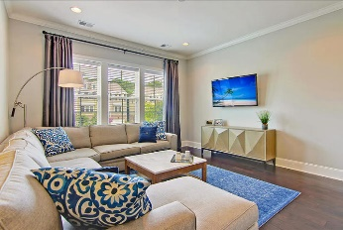
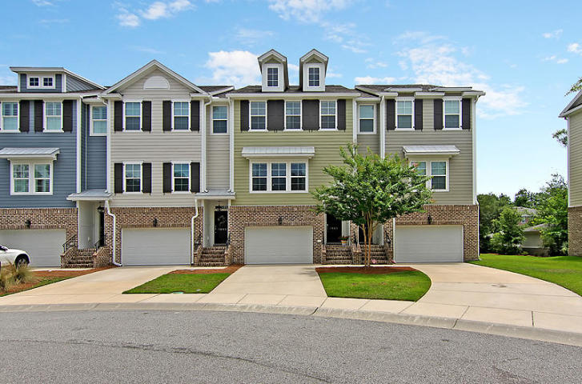
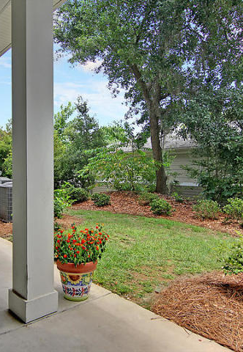
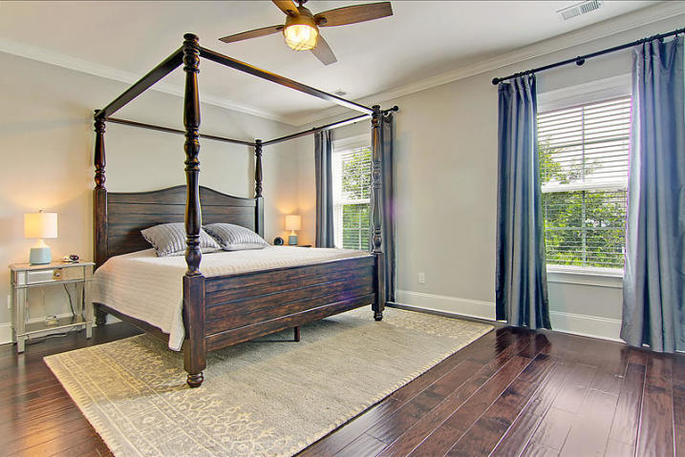
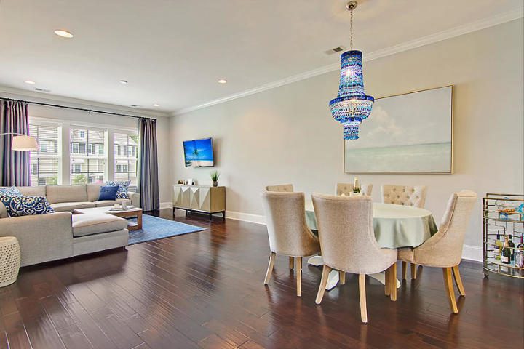
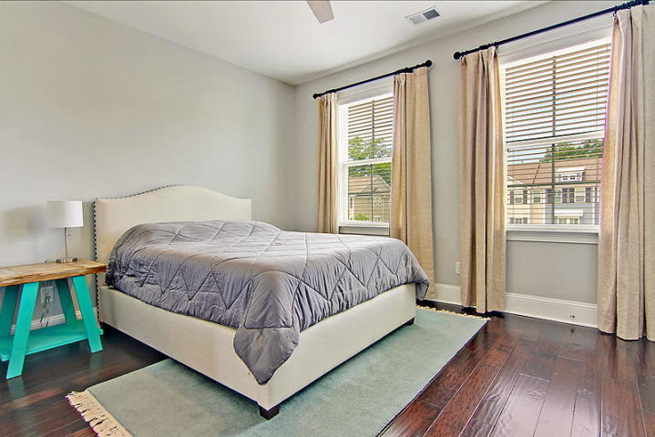
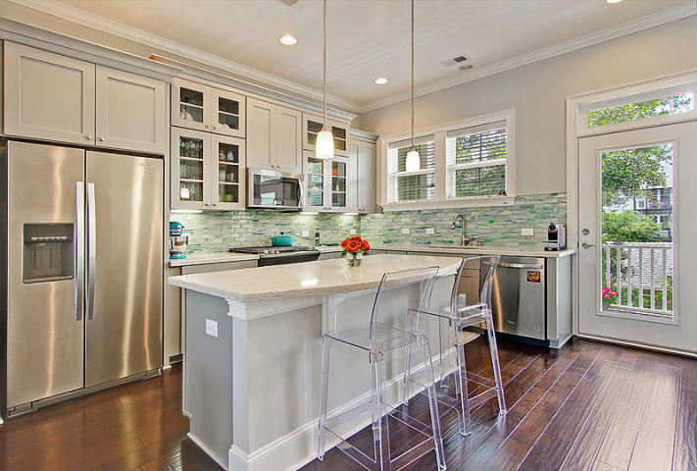
1045 Bowman Woods Drive
Bowman Park
Mount Pleasant, SC 29464
MLS# 20016568 | $519,900
Welcome to one of the best kept homes in a quaint neighborhood in the heart of Mount Pleasant. Built in 2017, this 3 bedroom 3.5 bath home is in "like new" condition and is absolutely move-in ready! The main level features an open floor plan including upgraded hardwood floors and 10' ceilings! The kitchen includes stainless appliances, gas cooktop, upgraded quartz counters, a gorgeous tile backsplash and a large island great for entertaining. Just off the kitchen is a spacious balcony where you can enjoy a morning cup of coffee or relax with a good book. Upstairs you will find a guest suite complete with its own full bathroom and a master suite complete with an extra large walk-in closet, a secondary closet, and a bathroom featuring a stand up shower, soaking tub, dual sinks and tiled flooring! The third bedroom is very versatile and can be used as an office, a game room or media room and is located on the first floor complete with its own full bathroom and covered patio. Plenty of natural light, energy efficient, Hers rated, tankless water heater, and impact resistant windows make this a very unique luxury townhome. The home includes an elevator shaft that is ready to have an elevator added if needed in the future. Currently it provides one extra finished closet per floor with plenty of storage space available. . A quick bike ride will find you on the beautiful beaches of Sullivans Island (3 miles) and Isle of Palms (5 miles). Historic downtown Charleston is only a 15 minute drive away. This excellent location has easy access to Highway 17 and Interstate 526, both just down the road.
Russell Price, Realtor
russprice3@gmail.com | (843) 670-1170
Brand Name Real Estate | 4 Carriage Lane, Suite 106 | Charleston, SC 29407

