Slide 1
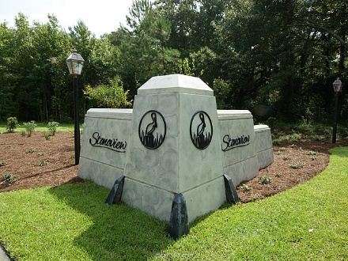
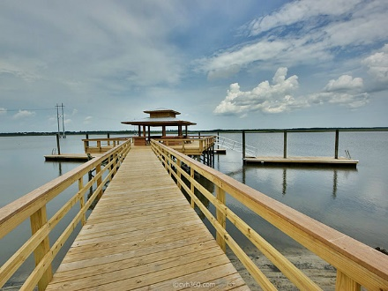
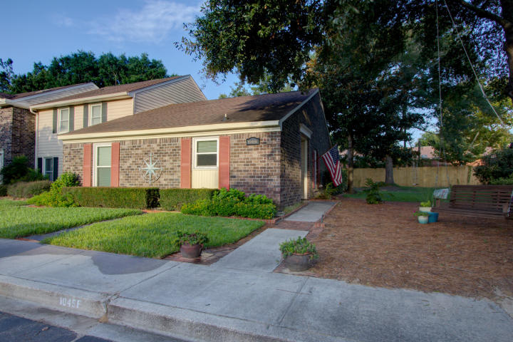
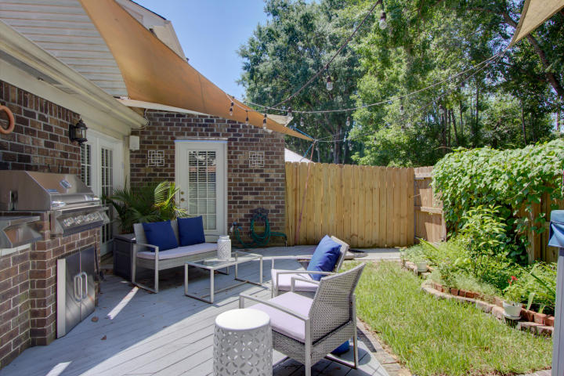
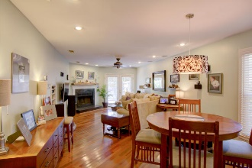
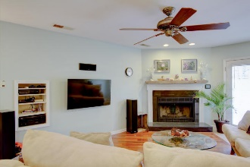
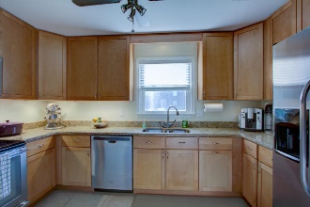
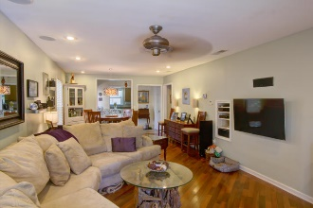
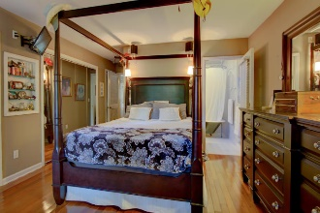
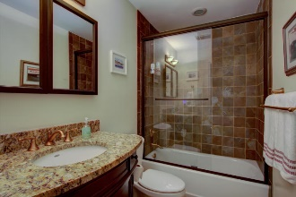
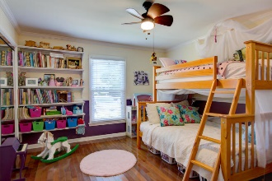
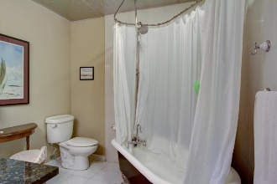
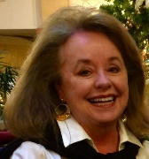

Open House Saturday 12-3 Refreshments Provided
1045 Provincial Circle F
Walk To Shem Creek And Bike To Downtown!
Patriots Province ~ Mount Pleasant, SC 29464
MLS# 18022323 ~ $325,000
Time to scale back to a smaller luxurious townhome that has been totally updated!
Walk to Shem Creek, Whole Foods, Trader Joes, and theatre.
End unit one-story with 2 bedrooms and two baths with a wood burning fireplace.
Backyard is very trendy and lends itself to awesome entertaining.
IN THE MOUNT PLEASANT ACADEMY school district!
Residents and Board are working together to reduce monthly HOA fees.
Donna Evans
REALTOR, ABR, CRS, EPRO, GRI
(843) 568-3948
donnaevans.realtor@gmail.com | www.comeliveincharleston.com
The Boulevard Company, LLC | 35 Broad Street | Charleston, SC 29401

