Slide 1
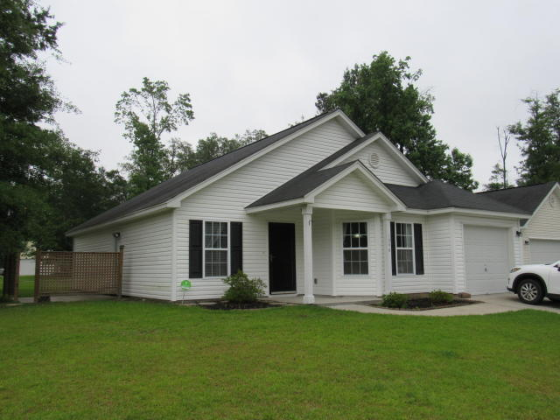

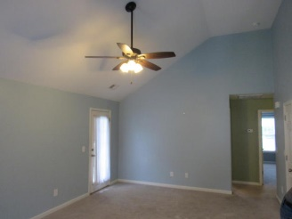
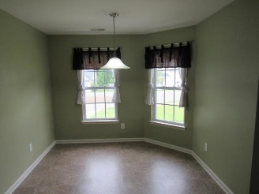
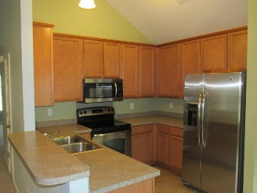
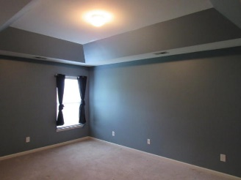
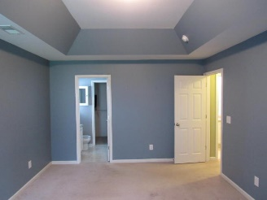
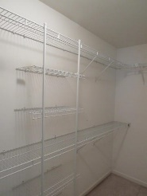
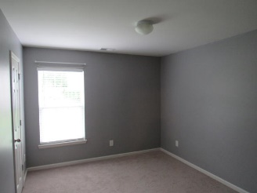
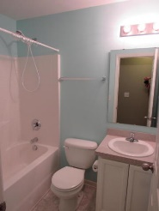
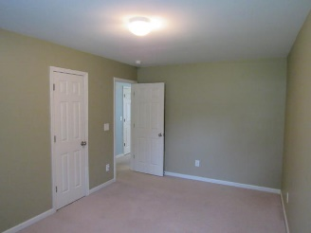
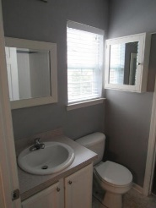
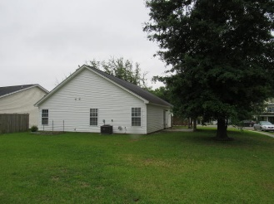
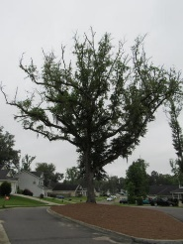


Newer Construction in Carlton Place! High Corner Lot! Move In Ready! Bring your clients!! Just $172,500!
1046 Steelechase Lane
Carlton Place :: Hanahan :: MLS# 16013562 :: $172,500
1,260sf :: 3 Bedrooms :: 2 Baths
OWN FOR LESS THAN YOU CAN RENT!! This 1260 square foot ranch is on a HIGH corner lot. Walk in to a large, open floor plan with vaulted ceilings. This home has three bedrooms and two full baths. The master bedroom has a huge walk-in closet and elegant tray ceilings. The master bathroom features a large garden tub/shower combo. All window treatments and stainless steel appliances convey with the property. Carlton Place is a newer community but still has beautiful trees and surrounding woods. FLOOD INSURANCE IS NOT REQUIRED UNLIKE SOME OTHER AREA HOMES. SAVE THOUSANDS YEARLY AND KEEP A LOWER MONTHLY PAYMENT! Come see this great property today!
Jon Moore
Mobile - (843) 732-3365
jonathanwyattmoore@gmail.com
Charleston Real Estate Group. LLC
792 Folly Rd. C1
Charleston, SC 29412
www.charlestonrealestategroup.com

