Slide 1
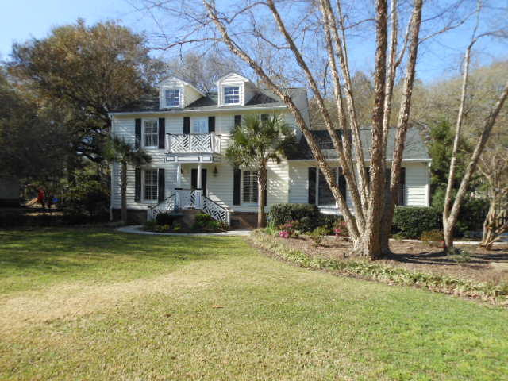
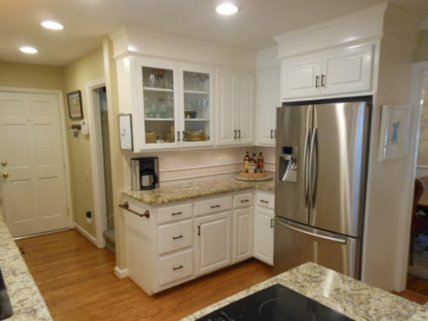
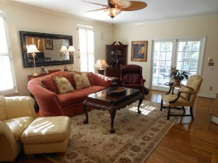
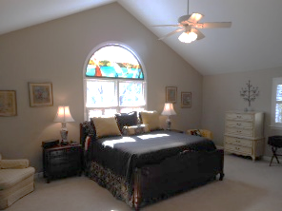
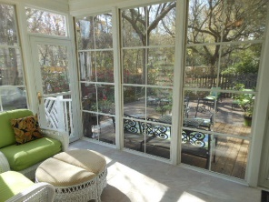
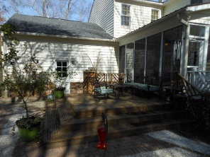
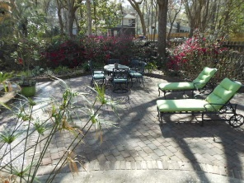
1047 Governors Run ~ Snee Farm
Open House Saturday 12-3
$40,000
Price Reduction!
4 Bed ~ 3½ Bath ~ 3000sf
Like New, Upgrades Everywhere
Features A Backyard Oasis. $599,000
Kitchen 100% Updated
Master Bedroom Cathedral Ceiling
Rear Sunroom
Rear Yard Landscaped Oasis
7 Minutes to Beach
Golf Course, Tennis, & Pool
You better hurry…this home may very well have multiple offers
the first weekend it's offered for sale.
Rick Willis
843-327-3017 · Rick@RickWillis.com · The Group, LLC

