Slide 1
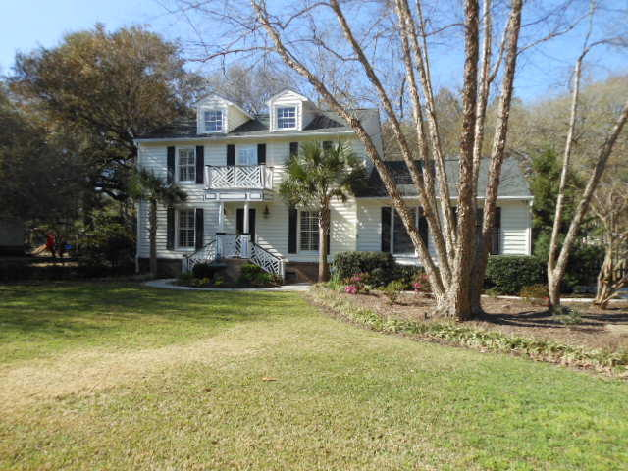
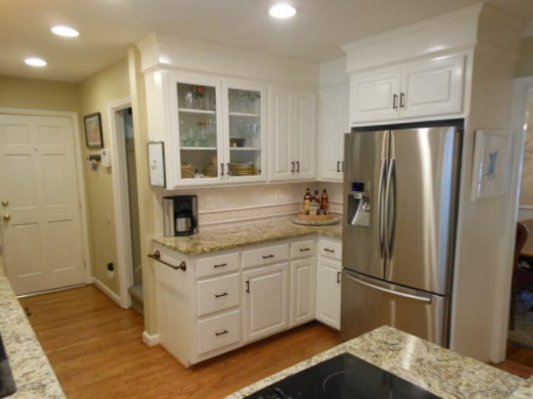
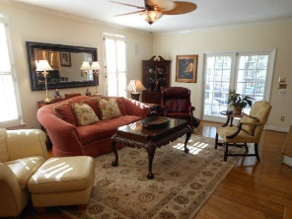
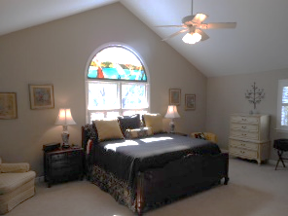
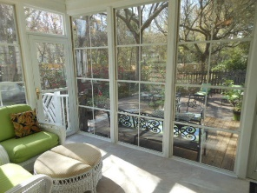
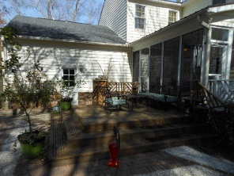
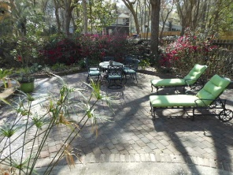
Snee Farm · Mount Pleasant
$599,000 · 1047 Governors Road
$40,000
Price Reduction!
First class all the way!!!
Truly a 10 on a 10 point scale
Kitchen 100% Updated
Master Bedroom Cathedral Ceiling
Rear Sunroom
Rear Yard Landscaped Oasis
7 Minutes to Beach
Golf Course, Tennis, & Pool
You better hurry…this home may very well have multiple offers
the first weekend it's offered for sale.
Rick Willis
843-327-3017 · Rick@RickWillis.com · The Group, LLC

