Slide 1
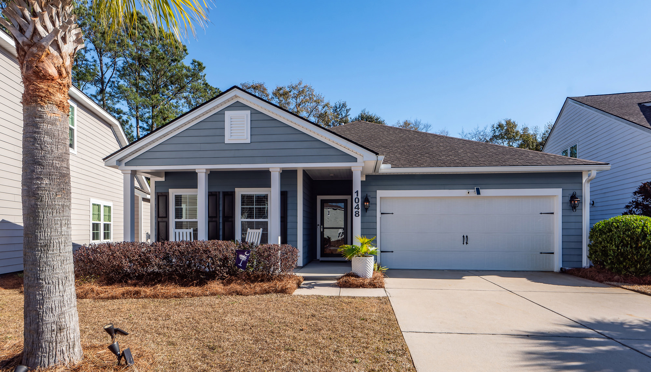
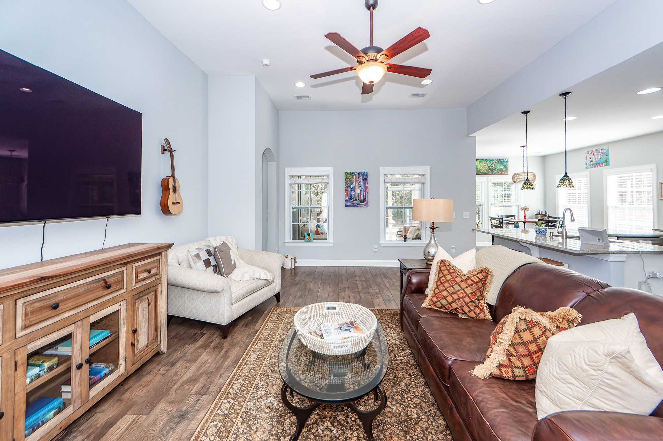
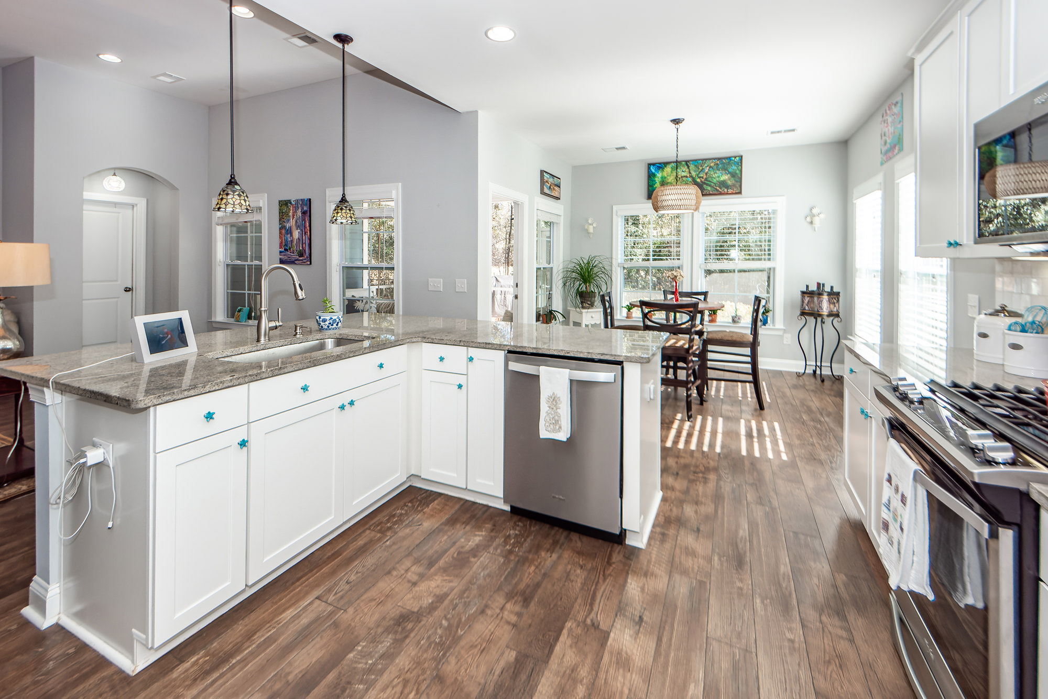
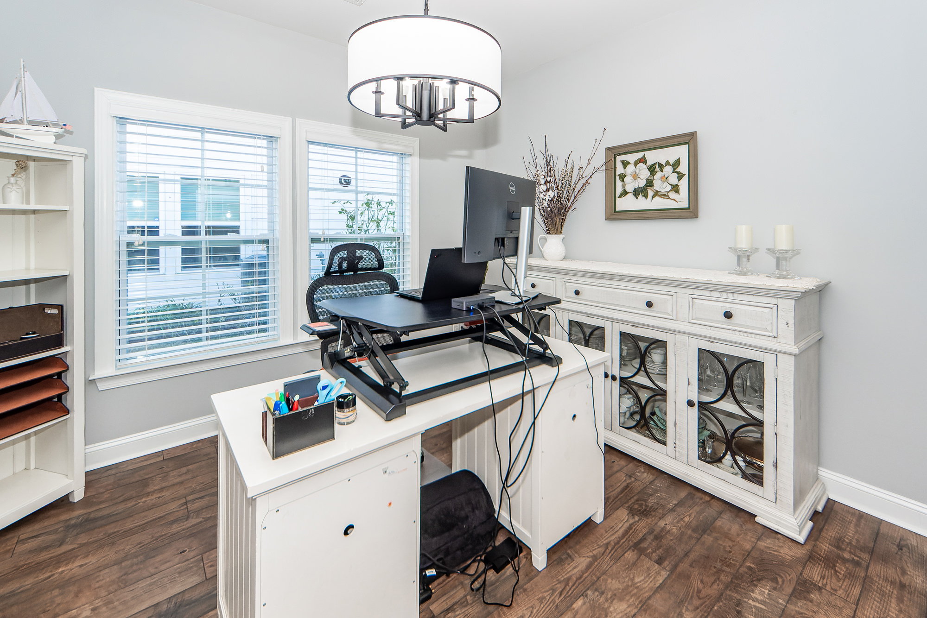
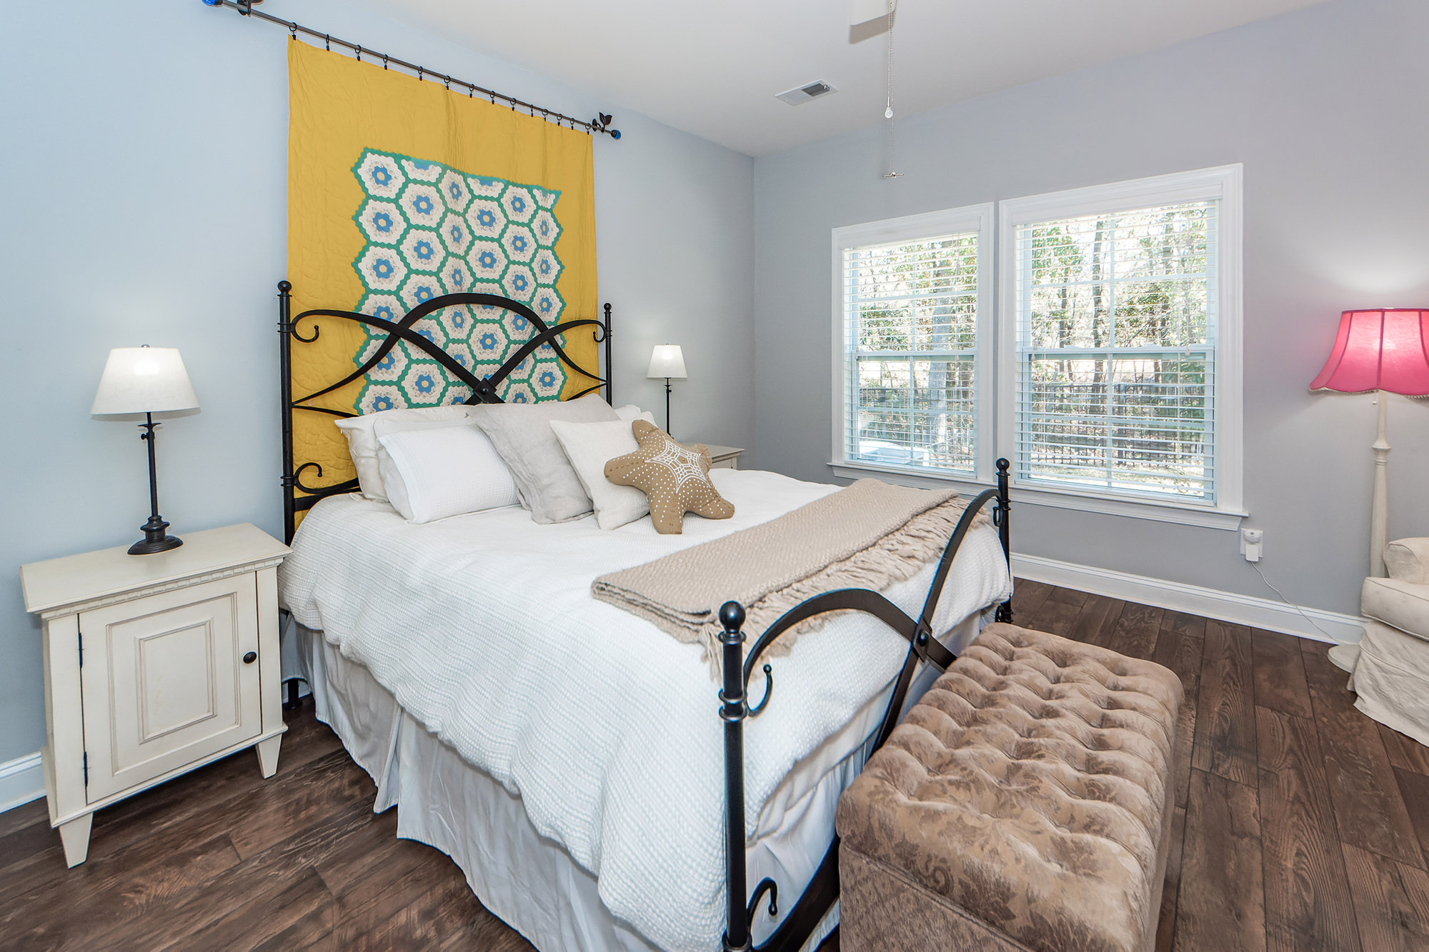
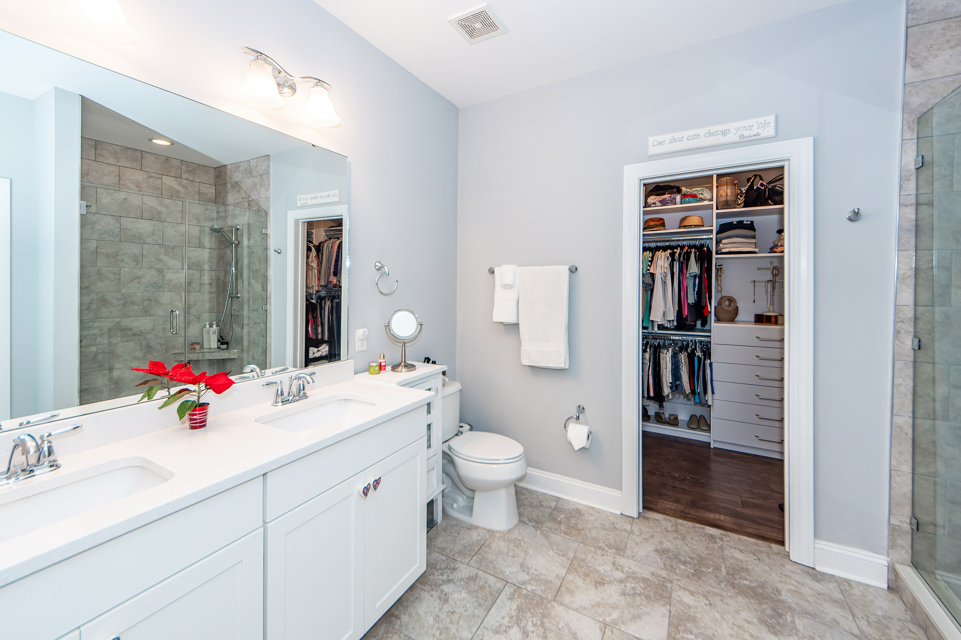
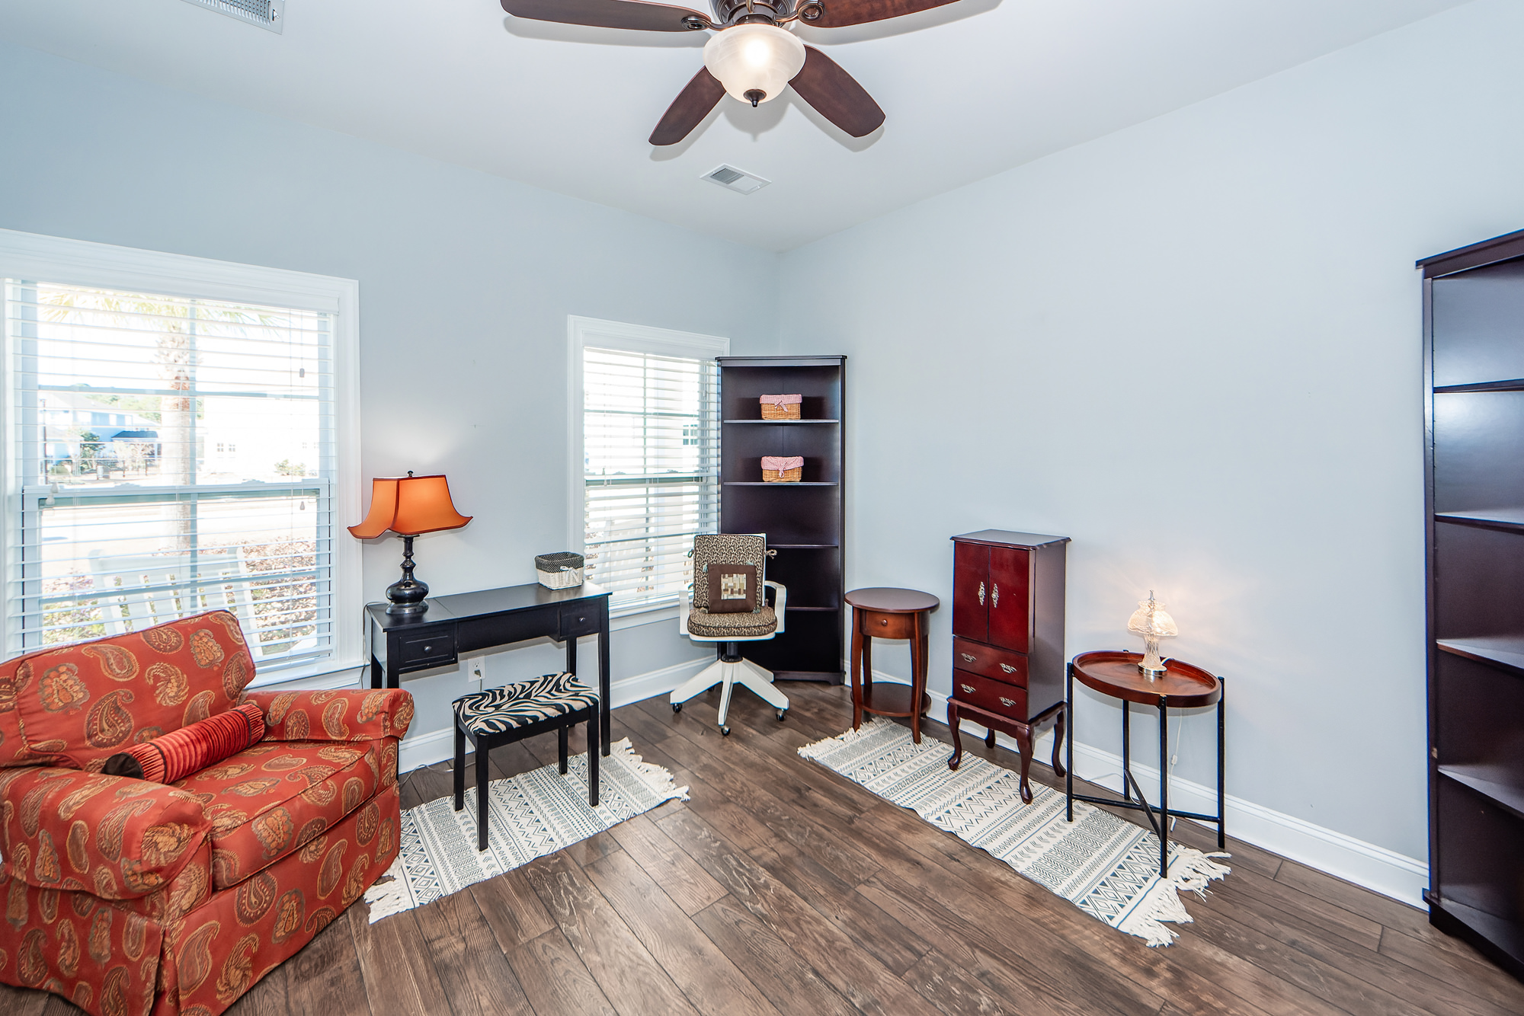
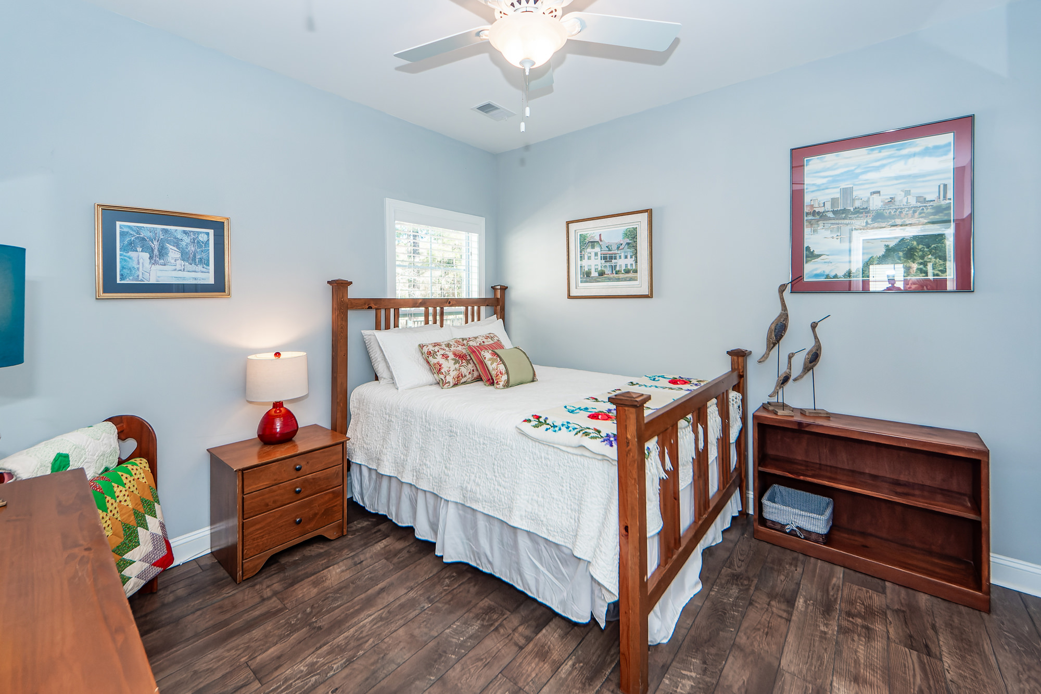
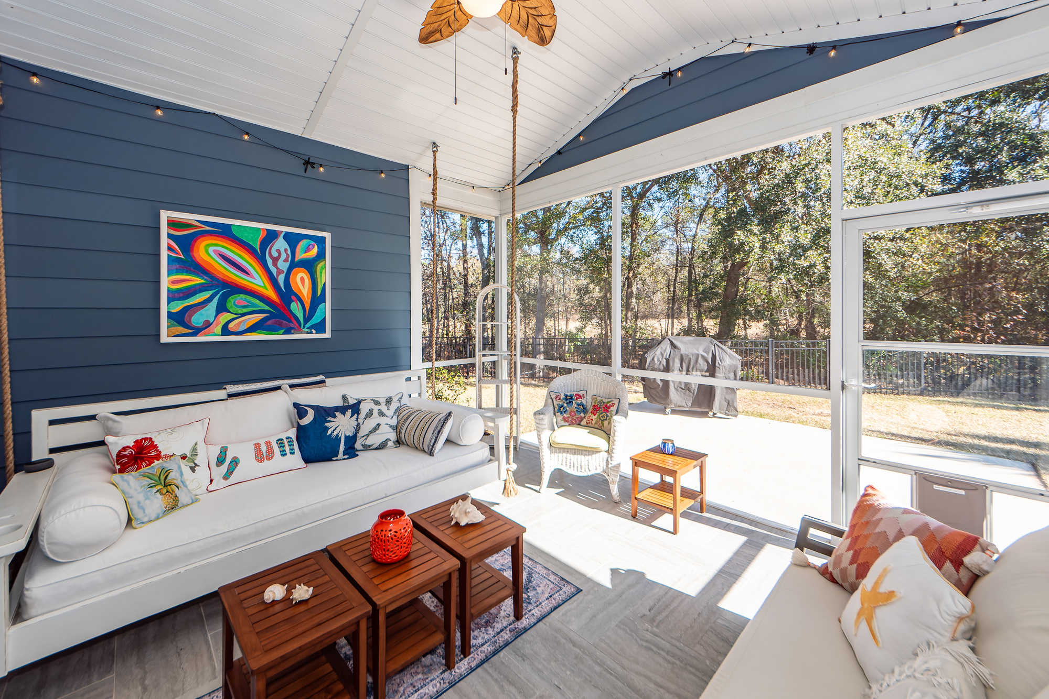
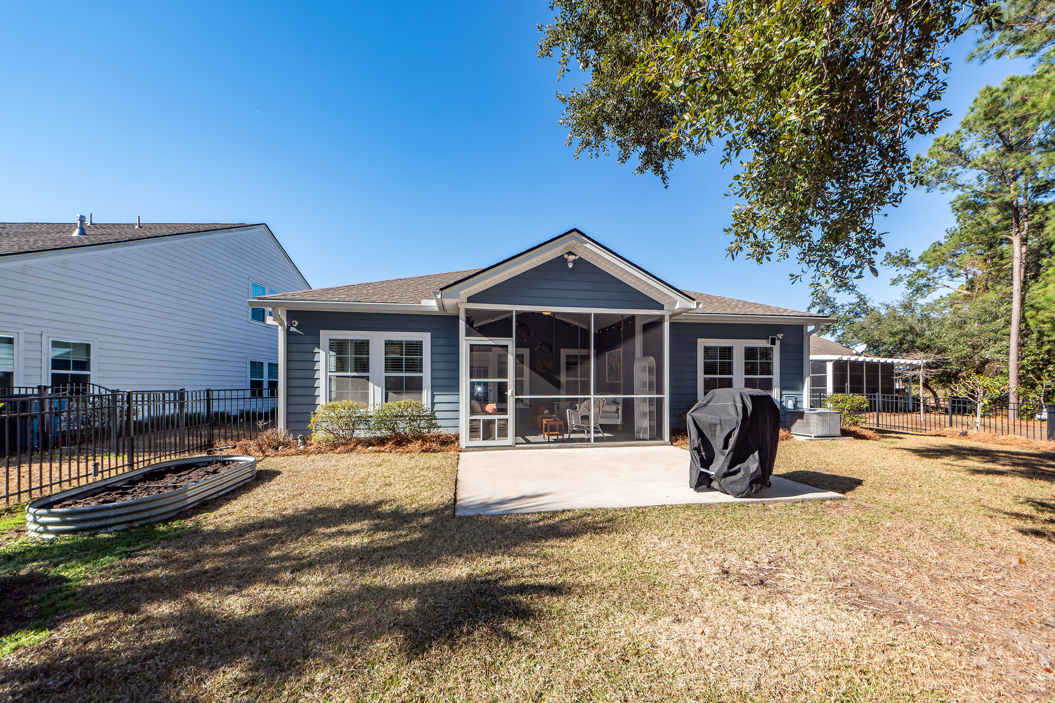
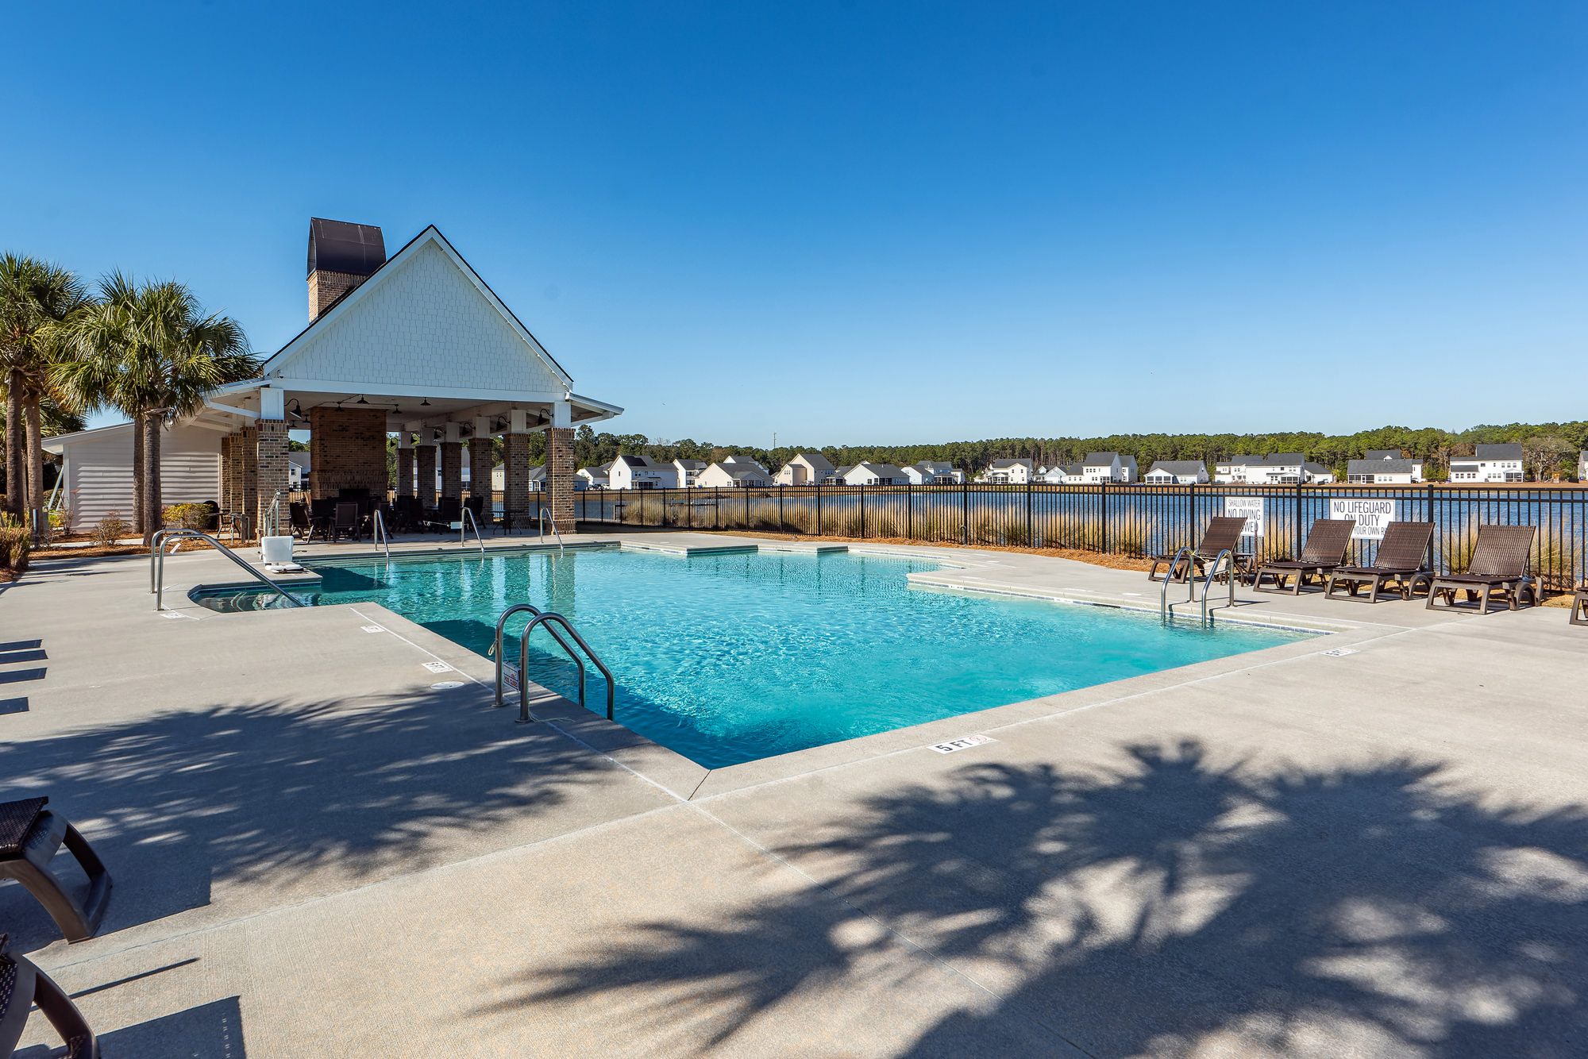
1048 Pigeon Point
St. Johns Lake | Johns Island, SC 29455
MLS# 25000264 | $595,000
Show & Sell!
This beautiful like-new one story hardie plank home with hurricane proof windows & front porch features 3 bedrooms, 2 baths & attached 2 car garage. The large open floor plan showcases arched entries, high ceilings, eat-in kitchen with large island & separate dining room. Large screened porch opens to back patio & private tranquil fenced backyard with irrigation system. Custom designed closets in pantry, linen and primary bedroom closet. Laundry room has built-in cabinets. LVP and ceramic tile floors.
Enjoy a virtual tour of this property
Charles Salmonsen
843-224-0300 | appraisals@salmonsen.com
Salmonsen Realty | 864 Lowcountry Blvd Ste B | Mt Pleasant, SC 29464

