Slide 1
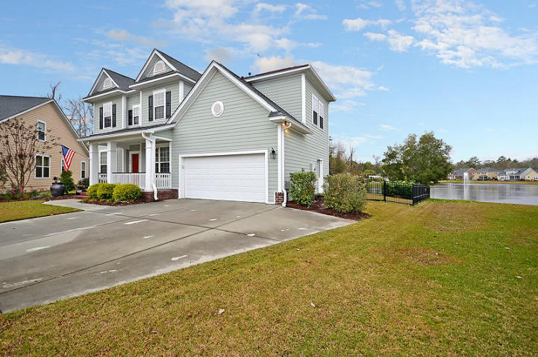
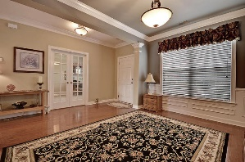
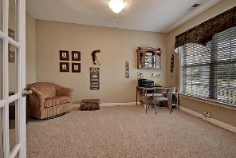
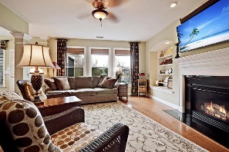
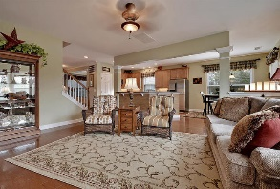
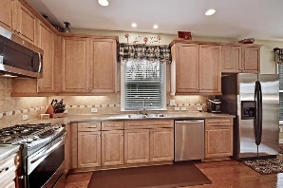
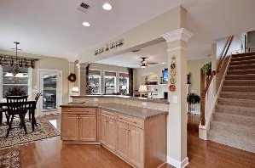
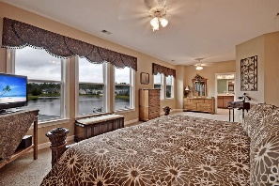
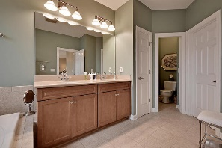
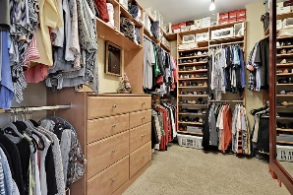
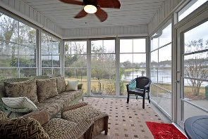
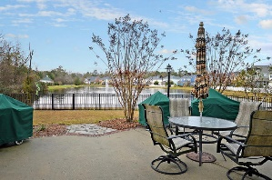
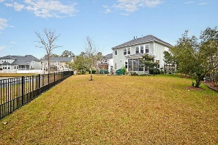


Beautiful Pondside Home
104 Back Creek Ct
Legend Oaks Plantation
Summerville, SC 29485
MLS# 15031397
$349,900
3 Bedrooms | 2/2 Baths | 3,015 sf
Be wowed from the moment you step in to this like -new home! So well kept and beautifully updated, this home will impress you! On a quiet cul-de-sac location, you have a big front porch welcoming you and curb appeal galore. Enter and you'll find gorgeous wood floors with an office/den to your right with French doors. To your left, a large dining room with lovely trim work. Straight ahead, you'll see the great open space of the kitchen overlooking the family room. The kitchen offers a breakfast bar, gas range, pantry and eat in area. The family room has a gas fireplace, built in shelving and tons of natural light. Off the kitchen is your own piece of paradise! A stunning sunroom overlooking a large pond! Sit here every night and watch the amazing sunsets right out your back door!
The backyard has a gorgeous patio, is completely fenced in and is private! Upstairs you'll find a large loft area with its own half bath. Two bedrooms with a full bath in the hall as well as another sitting area. Then comes the huge master suite! The master suite gets the same amazing views of the pond and beautiful sunsets! The master also offers a large walk in closet with built in shelving and drawers that connects from the bedroom to the master bath! The master bath has dual vanities, shower stall and tub.
Larry & Kathy Mazalatis
Larry Cell 843-693-0529
Kathy Cell 843-693-0159
Office 843-871-9133
AGENTOWNED PREMIERE GROUP | 1800 TROLLEY RD | SUMMERVILLE, SC 29485

