Slide 1
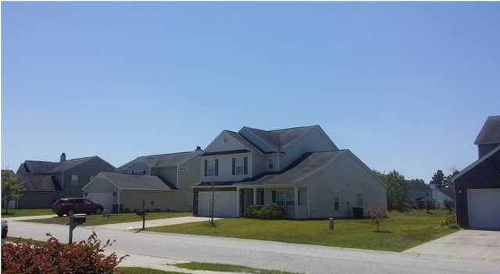
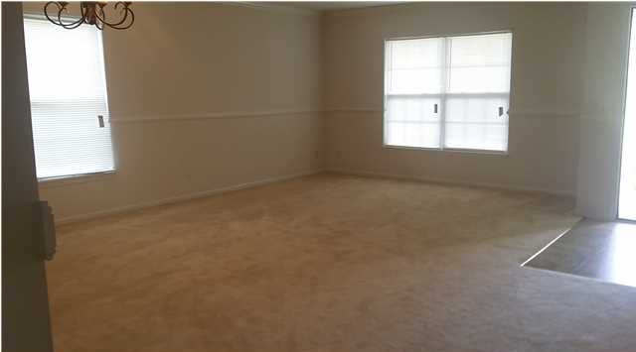
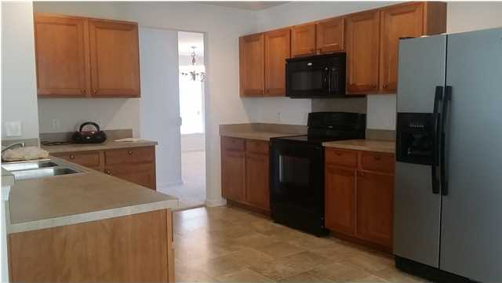
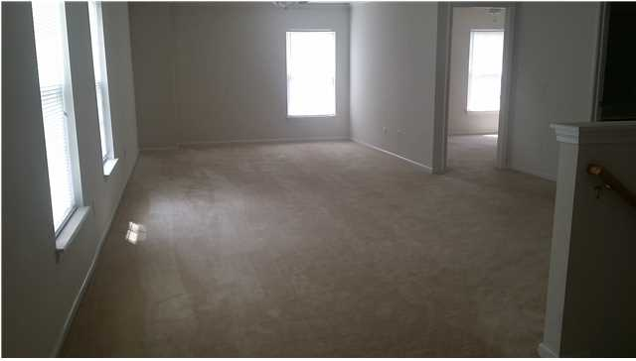
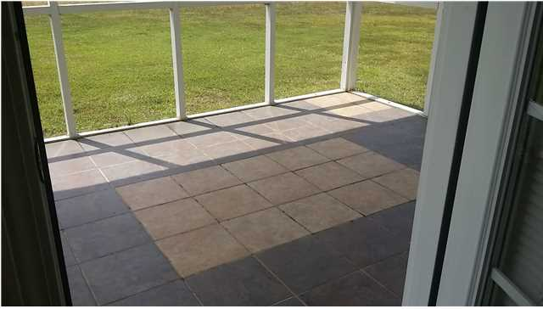

104 Buckfield Ln Weatherstone - Summerville, SC MLS# 1423309 - $1,550 / mo
Big 4 Bedroom Home Within a Mile of I-26!
Are you looking for a large home convenient to I-26? This home has not only 4 bedrooms but a huge bonus room. The master bedroom with a master bath is on the first floor. The kitchen opens up to the family room which has a wood burning fireplace. Off the family room is a screened-in porch where you can enjoy watching all of the wildlife on the pond. There is a formal living room/dining room as well. Weatherstone is not only convenient to I-26 but it is close to shopping, dining and entertainment as well. Weatherstone is family friendly with its pool and amenity center, play park and side walks. A pet no larger than 25 pounds will be accepted.
Liz & Bob Simonds
843-261-7138 O | 843-437-9696 M lizandbob@agentowned.com
AgentOwned Realty Co. Premier Group, Inc. | 141 A N. Main St | Summerville, SC 29483

