Slide 1
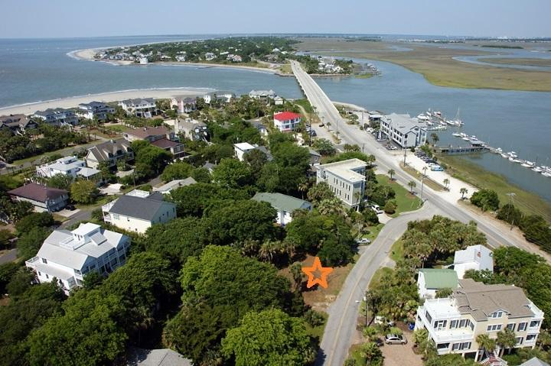
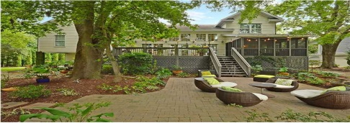
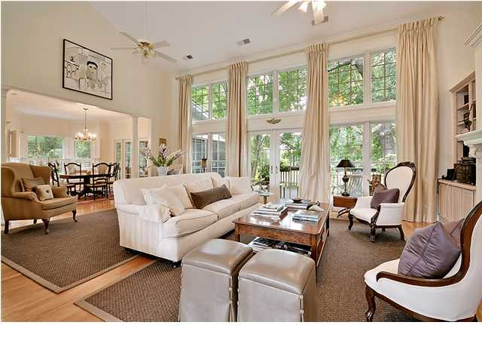
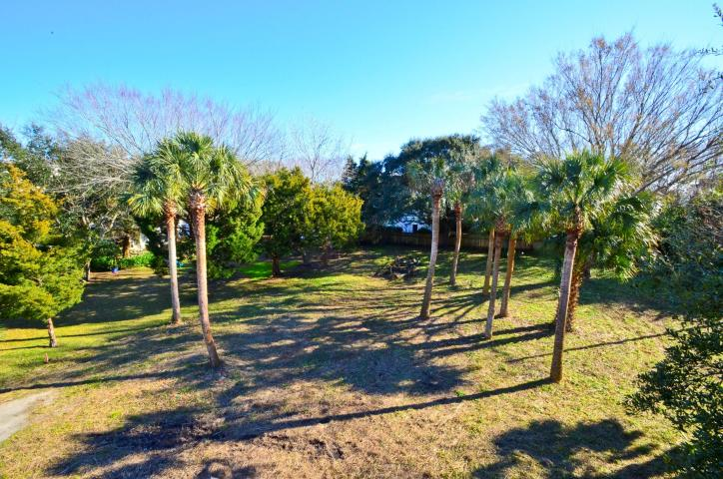
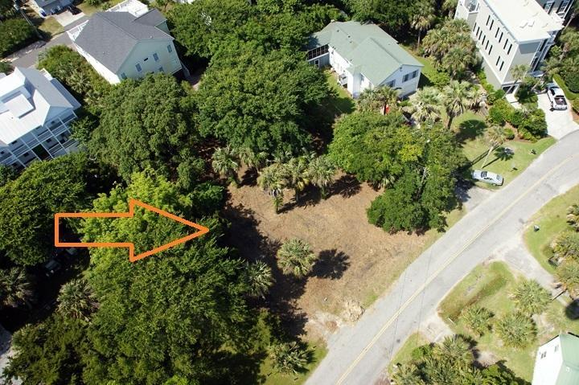

Price Reduced Over $30k
$3,500 Agent Bonus!
Priced Under Market Value
104 Carolina Blvd ~ Isle of Palms ~ MLS# 14031194 ~ $465,000
This stunning lot is just what you're looking for! From this lot, you're just steps from Breach Inlet and only a few blocks from the gorgeous beaches of Isle of Palms. There are so many benefits to the Isle of Palms: great restaurants, baseball and soccer fields, a public boat ramp, a marina, and of course, tons of water sports! Build your dream home in this perfect location and let the relaxation begin.
Call or email for details: (843) 654-7777 or Spencer@MattOneillTeam.com

