Slide 1
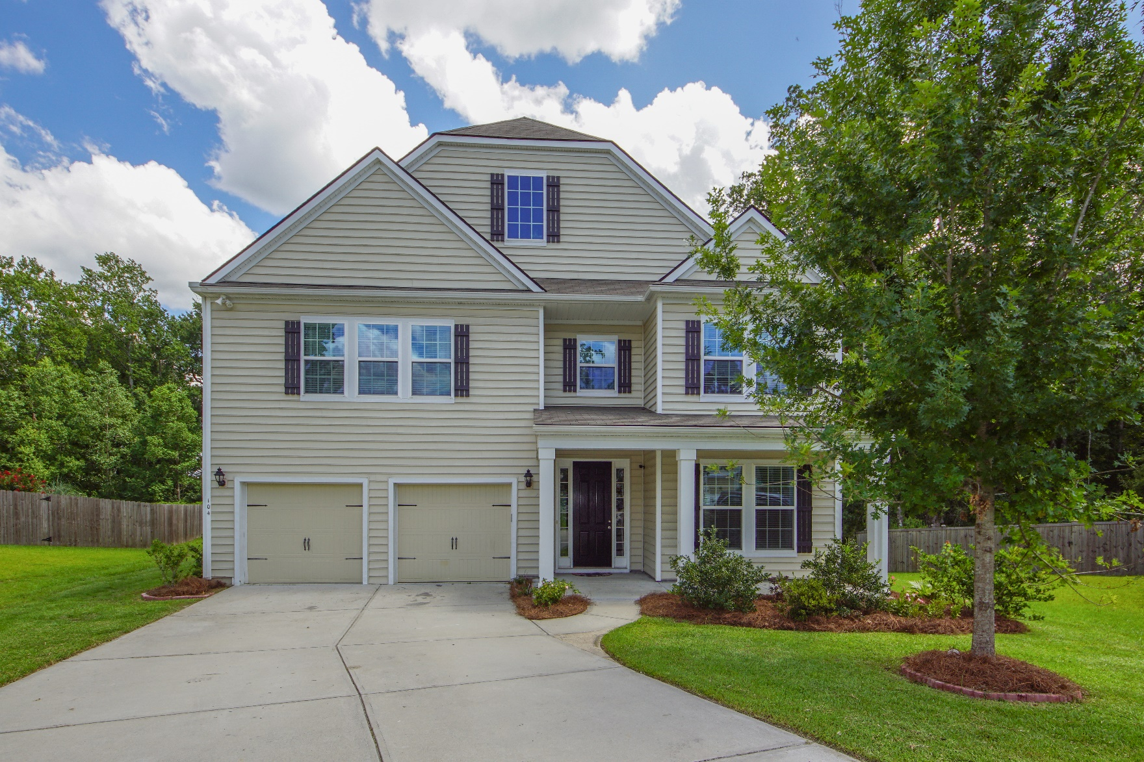
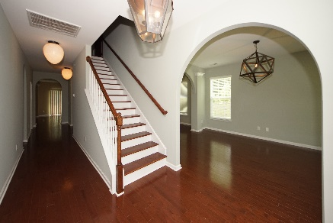
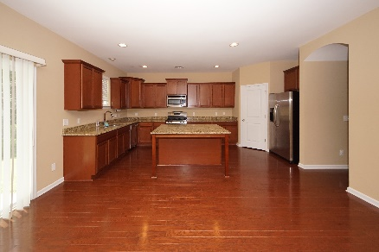
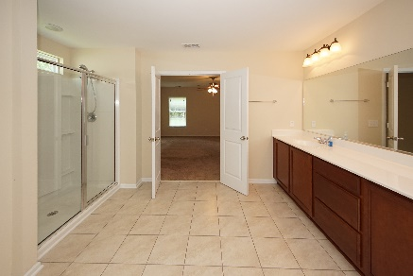


104 Carya Court
Summerville, SC 29483
MLS# 19021041 :: $329,000
5 Bed / 4 Bath
Just Reduced in Hickory Ridge
Price Drop!
Why wait for new construction when you can have 3818 sq. ft., 5 bedrooms, 4 bathrooms to include 2 master suites with all of the upgrades!
Located in Hickory Ridge this gorgeous home has all the upgrades and space the new owner could desire and this home is move in ready!
Over sized kitchen, butlers pantry, over sized island, family room with gas fire place, 2 master suites, formal living, dining and study. All located in Dorchester District II school system.
Access to Pine Forest Country Club pool membership is also available to residents of Hickory Ridge.
Connie White, Broker
843-532-3356
connie@chrepros.com · conniewhiterealestate.com
Charleston Homes · 597 Old Mt. Holly Road · Suite 301 · Goose Creek, SC 29445

