Slide 1
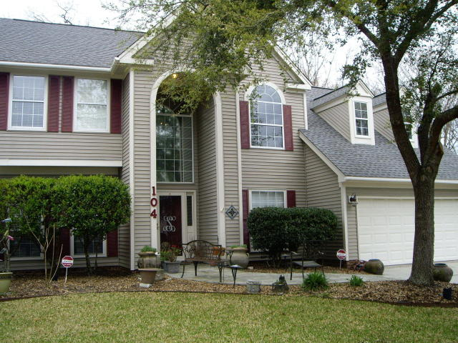
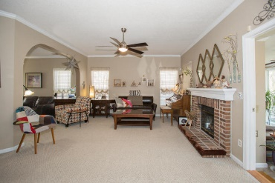
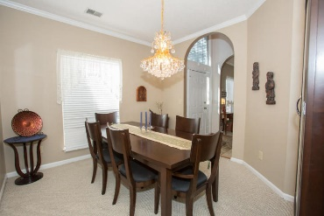
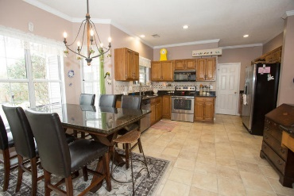
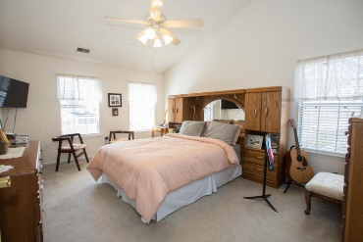
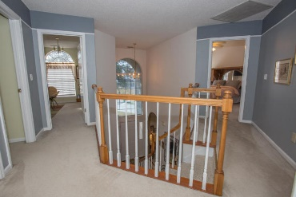
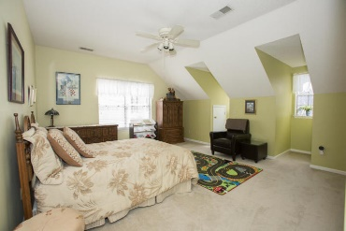
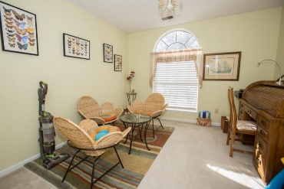
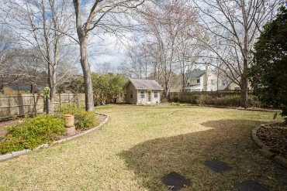
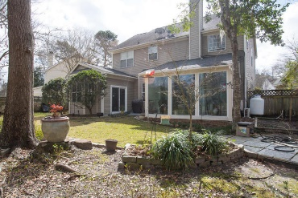


104 Cottage Court
Brandymill
Summerville, SC 29485
MLS# 18004400
$270,000
Reduced to $260,000
Welcome Home!
This well maintained 4 bedroom 2 1/2 bath move-in ready home is nestled in a great neighborhood in a cul-de-sac. You will be entering an open foyer leading to arched open Den and Family room with Fireplace. Family room open to beautiful Sunroom added in 2016 overlooking a beautiful fenced backyard with Storage Shed & Sprinkler System. Separate Dining room and eat-in-kitchen with granite counter tops. Large Laundry room leading to large storage/utility room that everyone would love to have. Upstairs has large master bedroom with large master bath with two walk-in-closets. There are additional bedrooms and bathroom upstairs. Thank you for showing.
Cathy Rosenblum
843-817-7869
crosenblum@comcast.net

