Slide 1
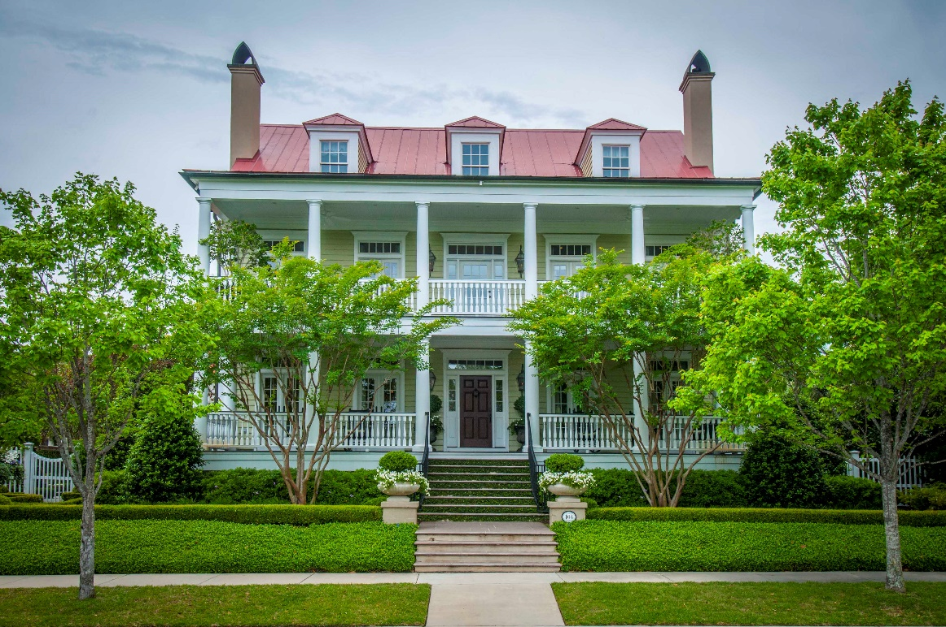
Time’s Running Out on this Beautiful Home. The Listing Expires in Two Weeks. If you have a buyer who loves only the very best…the time is now. It will NOT be available again !
104 Dalton Street • Daniel Island
Offered At: $2,175,000
MLS: 1411344
Connie Dittrich, Realtor 843.475.7993 cdittrich@carolinaone.com

