Slide 1
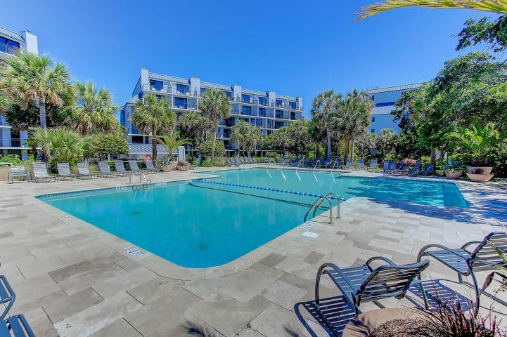
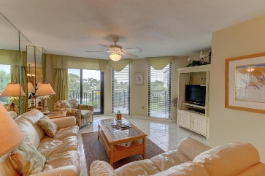
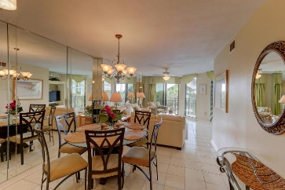
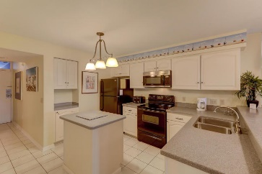
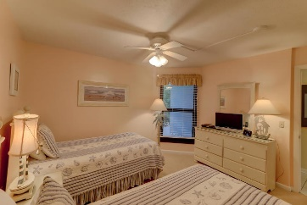
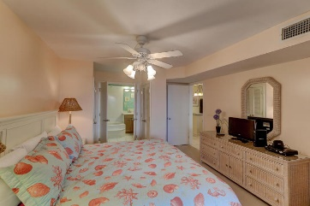
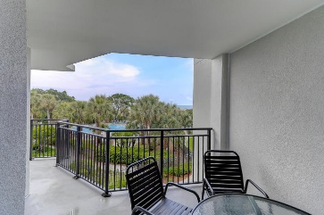
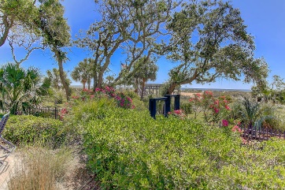


209 Shipwatch Villa B
Wild Dunes ~ Isle of Palms
MLS# 18016570 ~ $540,000
EASY TO SHOW
8/30 CHECK-OUT THROUGH 9/2 CHECK-IN
GREAT OCEAN VIEWS
Great opportunity to own this incredible Oceanfront property in Wild Dunes on the Isle of Palms! Imagine having your breakfast or a glass of wine in the late afternoon on your private deck overlooking the Atlantic Ocean. The buildings at Shipwatch are Like New...due to a recent renovation which included new exterior siding, storm rated windows, metal roofs, new railings, etc. This property is being sold fully furnished and ready to enjoy! The amenities on the property are exceptional, starting with the pool, lush landscaping and beach access. The monthly regime fees are very affordable as compared to other condo buildings in Wild Dunes. The current monthly fee is $554 and includes building maintenance, pool, landscaping, water, sewer, basic cable and internet.
The current transfer fee to Wild Dunes at closing is .05% of the purchase price but will go up to 1% on July 18, 2018. The Shipwatch HOA also has a one time transfer fee of .05% based on the purchase price at closing. Great vacation rental potential, currently on Island Realty's rental program. Dreams do come true!!
Darlene Smith
Office - (843) 886-8110
Mobile - (843) 696-7824
darlenesmith@carolinaone.com
DarleneSmithTeam.com
Carolina One Real Estate
1503 Palm Blvd Ste
Isle of Palms, SC 29451

