Slide 1
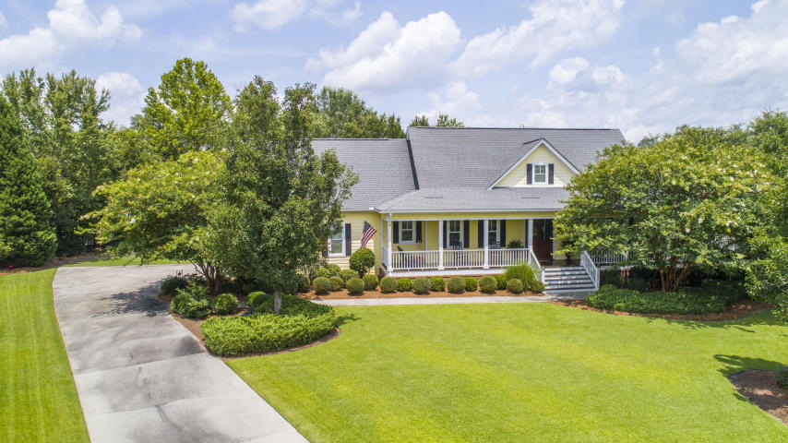
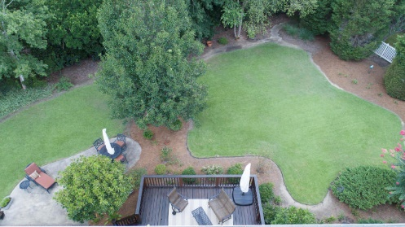
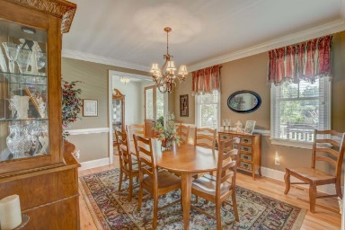
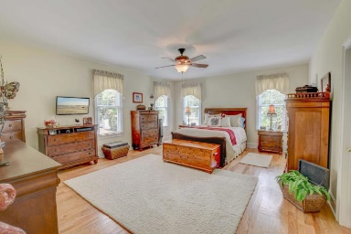
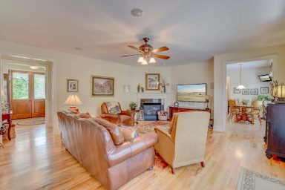
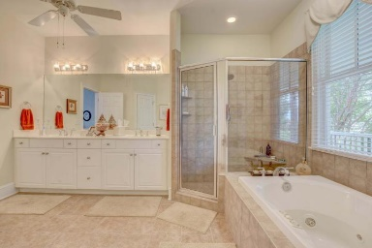
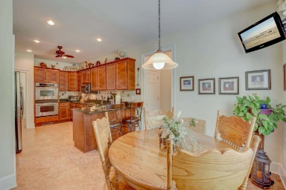
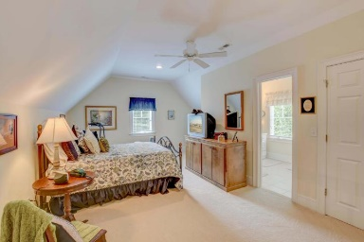
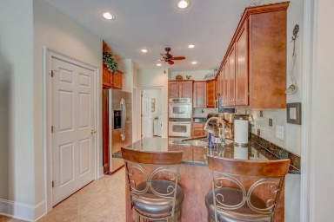
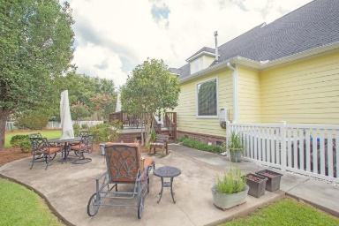


104 Grazing Meadow Court
Summerville, SC 29483
MLS# 18020438 ~ $435,000
Motivated seller says come & tour!
~ Welcome Home to High Meadow Farms ~
Here is a RARE opportunity to own a custom built low country home with a front porch most only dream of! This custom neighborhood is tucked away off Butternut in an area of horse farms. As you pull into this cul-de-sac you will be amazed at the lot sizes! 1/2 acre. This yard will rival most parks and the owners have put a lot of time and love into this place. The breeze is most always on the Southern porch! Enjoy! As you approach the custom wood entry you will find attention to detail in every minute part of this home! Rarely will a builders model show this well. Large living area, Gorgeous wood floors, upper end kitchen, Massive master suite down has dual closets and a breath taking master bath! There is a second master up that is handicap ready.
Christopher McCormick
Office - 843-871-9133
Cell - 843-224-3204
cj.mccormick@agentownedrealty.com
AgentOwned Premiere Group
1800 Trolley Rd
Summerville, SC 29485

