Slide 1
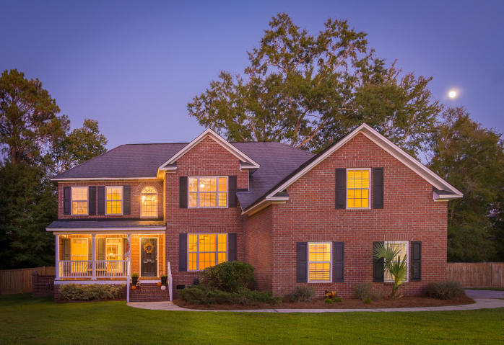
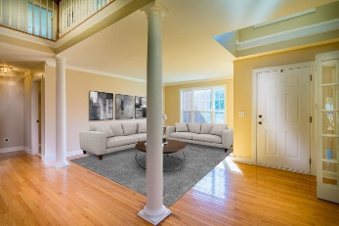
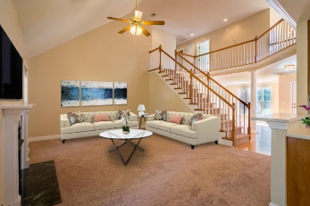
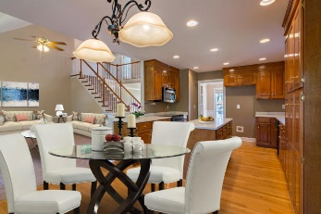
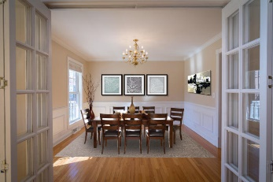
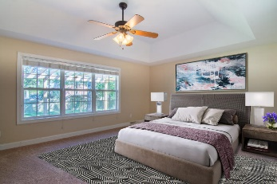
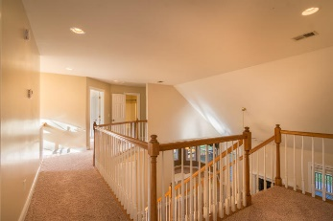
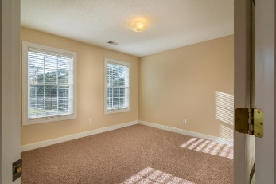
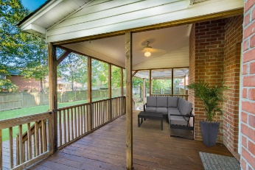
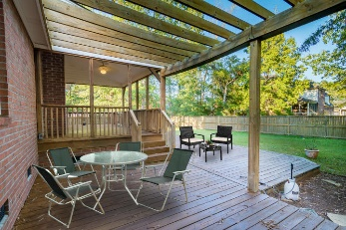
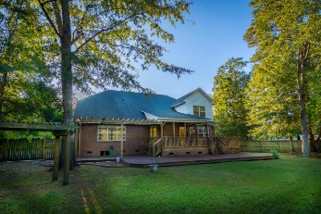


104 Harcourt Place Crowfield Plantation Goose Creek MLS# 19028995 $450,000
Open House Lunch ~ Friday, Oct 3 from 11 - 1
Handyman Special… Bring your hard hats!
$25,000 PRICE
ADJUSTMENT
New Price!
This Beautiful Brick Home is in the Desirable Gated Community in the Hamlets of Crowfield. It features 6 bedrooms, 3.5 baths and a HUGE MASTER LOCATED DOWNSTAIRS with a nice Walk-in Closet. The bath has dual vanities and a jetted tub with Separate Shower. The kitchen is equipped with upgraded Custom Cabinetry and a huge island with Corian countertops. The Family room is large with a gas Fireplace for those chilly nights. Cathedral ceilings in both Foyer and Family room. Large backyard with nice freshly stained decking and privacy fence & also has a storage shed. There is a gas hook-up for grilling on back deck. Two car garage with very nice storage cabinets that the Seller is leaving for Buyer.
SELLERS ARE VERY EAGER TO SELL! BRING ME AN OFFER!!
Deborah Reid
(843) 323-0231 debbiereidhomes@gmail.com | www. debbiereidhomes.com
Realty One Group Coastal | 654 Coleman Bvld Suite 100 | Mt. Pleasant, SC 29464

