Slide 1
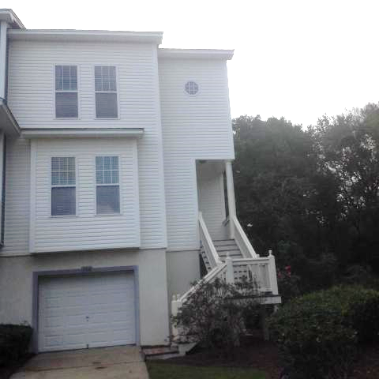
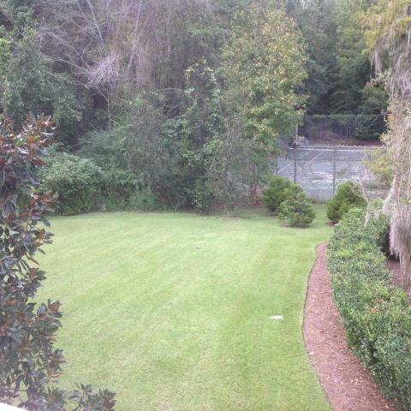
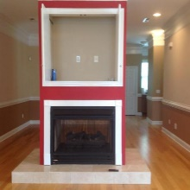
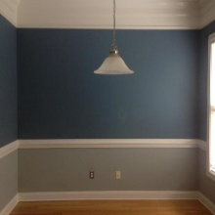
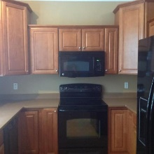
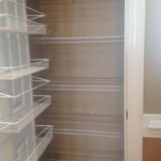
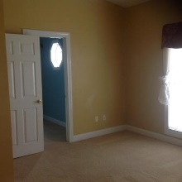
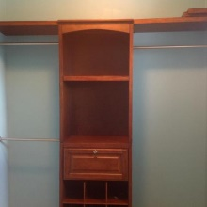
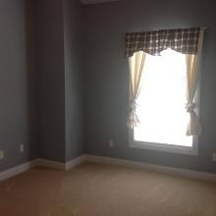
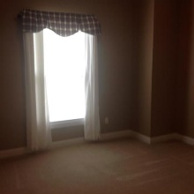
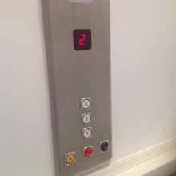
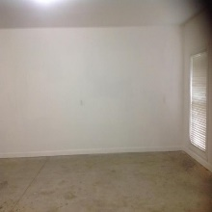
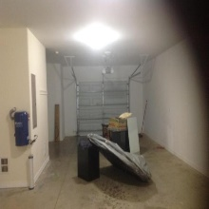
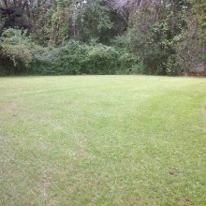
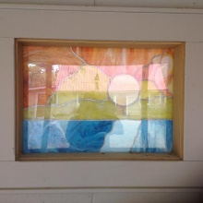

Great 3 Bed/2.5 Bath Townhouse With Elevator!
104 Hidden Palms Boulevard
Hidden Palms | Summerville, SC 29485 | MLS# 17027695 | $185,900
Immaculate townhouse with 3 bedrooms and 2.5 baths.
Elevator as well as an end town home.
Next to the tennis courts and the large side yard.
Great location (behind Harris Teeter off Berlin G Myers).
Many upgrades so make your appointment today.
Carla C Davis
Mobile - (843) 437-4873
gaweber@tds.net
AgentOwned Premiere Group
141 A N. Main Street
Summerville, SC 29483

