Slide 1
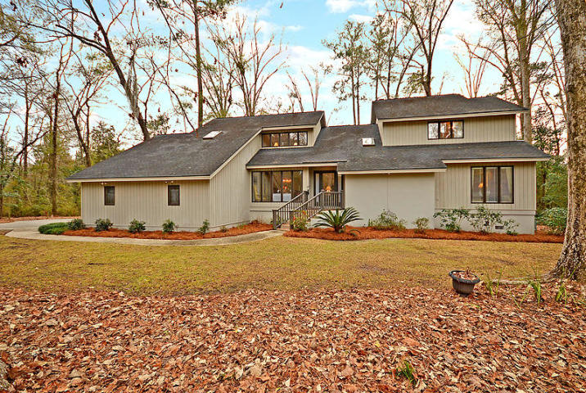
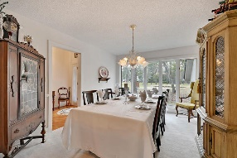
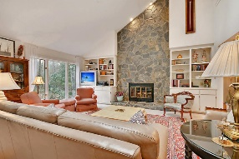
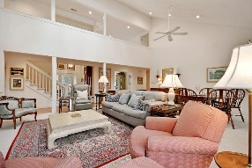
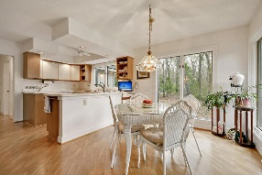
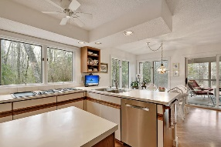
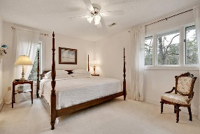
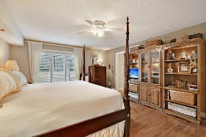
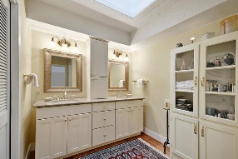
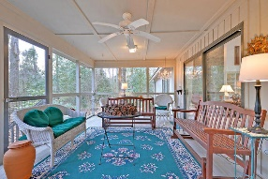
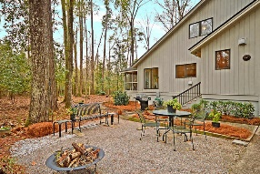
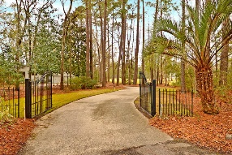
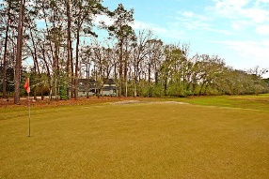


Golf Course Home-Private Cul-de-Sac
104 Lucretia Lane
Country Club Estates
Summerville, SC 29483
MLS# 19003070
$474,000
6 Bedrooms | 4 Baths | 3,568 sf
Get ready to be impressed with this lovely, private home located in historic Tea Farm! This home is the best of both worlds as you'll see when driving through the gates of the driveway. To the left of the home is wooded privacy, to the right, views of the 2nd green of the Summerville Country Club golf course! Upon entering the home, you'll immediately be impressed with the two story foyer, the natural light and the tall windows, which give you great views from every room. To your left is the dining room which offers plenty of space for entertaining. The living room is enormous and has built in bookshelves and storage as well as a stunning floor to ceiling stone fireplace. Off the living room is a large screened in porch that overlooks your wooded paradise. Back inside, the kitchen has a great layout, with a large eat in area, pantry, vegetable sink and a cooktop with a griddle! Off the kitchen is the laundry room which has so much extra storage! Cabinets, a closet and a utility sink. On the other side of the home, you'll find the master suite. The master bedroom has views of the golf course, as well as a small sunporch off the back to enjoy your morning coffee on while taking in all that nature has to offer. The master bedroom has wood floors, the master bathroom has two walk in closets, dual vanities as well as a separate area for the shower and commode. Also on the first floor, is a guest room or office. This room has built in storage and shelving and a full bath is conveniently located right outside this room. Heading upstairs, you'll find two very large bedrooms, connected by a jack and jill bathroom, both with wonderful closet space. Down the hall, you'll find a loft area, then another bedroom which has a full bathroom. Through the bathroom, out the other side to a small set of steps down is a great sixth bedroom! This spot is unique and has so many possibilities. It can be a bedroom, a game room, a work out room...you name it! This home has been very well maintained over the years and it shows! Tea Farm is located in downtown Summerville, just minutes from the square. Dorchester District 2 schools service this area. Don't miss the opportunity to view this home! It's most definitely a must see!
Larry & Kathy Mazalatis
Larry Cell 843-693-0529
Kathy Cell 843-693-0159
Office 843-871-9133
AGENTOWNED PREMIERE GROUP | 1800 TROLLEY RD | SUMMERVILLE, SC 29485

