Slide 1
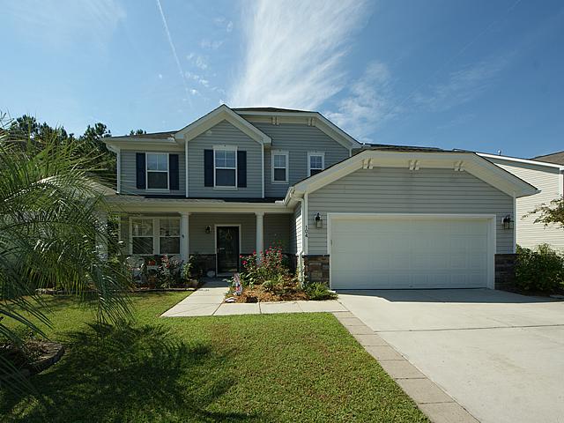
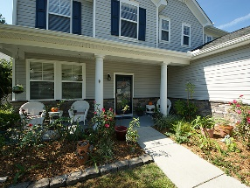
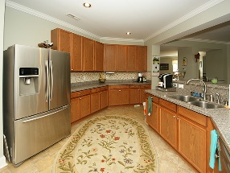
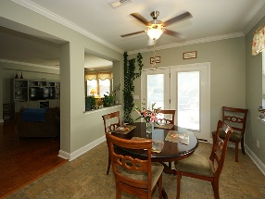
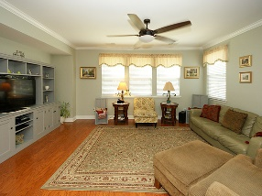
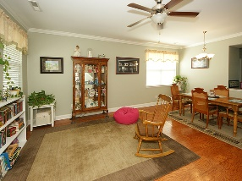
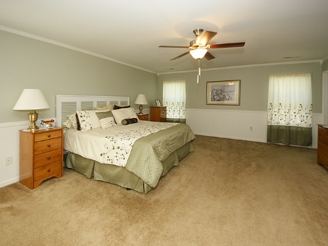
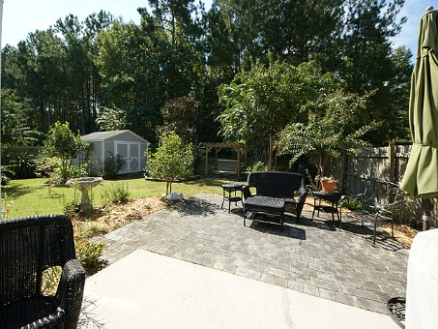
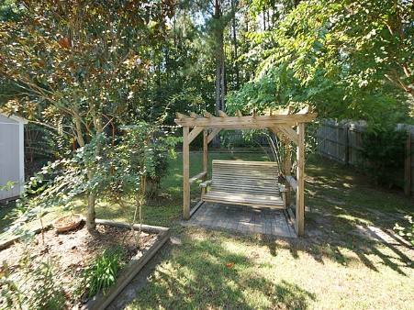

104 Salt Meadow Ln
Blackberry Creek
Summerville
MLS# 16026382 | $289,000
3,341 Sq Ft - 4 Bedroom – 2½ Bath
GREAT OPEN FLOOR PLAN!!
Talk about a home that is great for entertaining or a family with children this is it. You will enjoy cooking in the spacious kitchen with 42'' cabinets, new stainless steel appliances and Stilestone countertops with tiled backsplash. New wood floors in most of the expansive downstairs area. There is extra storage in the closet under the stairs and all bedroom closets are walk ins with lights. Many upgrades in this home to see, like crown molding throughout the downstairs with an in house vacuum system. You will love the large roomy Master Bedroom with crown molding and chair railing. The master bath is large with double sinks and updated cabinets. Enjoy your little bit of paradise in this beautifully landscaped backyard sitting in your swing watching the wildlife.
Barbara Limehouse
843-870-8291
bllimehouse@gmail.com
Weichert Palmetto Coast
1035 Johnnie Dodds, Ste B2
Mt. Pleasant, SC 29464

