Slide 1

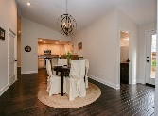
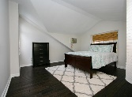
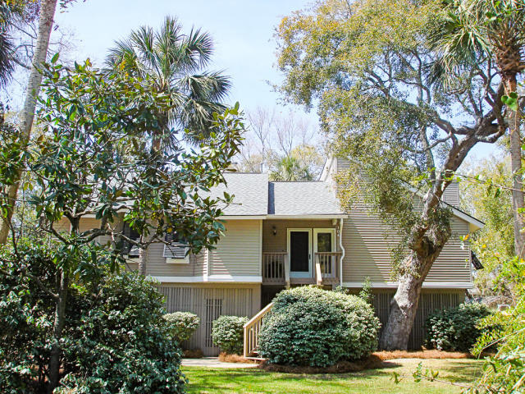
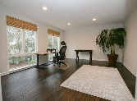
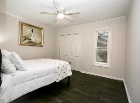
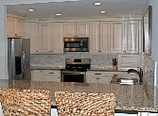
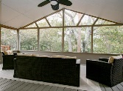
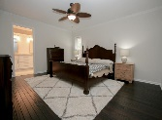
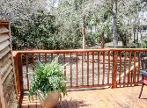
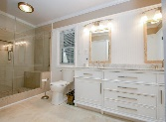
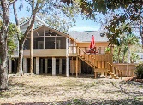
104 Sparrow Drive
Forest Trail · Isle of Palms, SC 29451 · MLS# 18008831 · $899,000
Open House Saturday 11am - 4pm
Refreshments Provided
This beautiful beach island home has it all! Offering elevated construction, hardwood floors, granite counter-tops and stainless steel appliances. With most of the home's living area conveniently located on the 1st floor. This home's layout is perfect, 1st floor offering 3 bedrooms, 2.5 baths, a large great room, kitchen with sit-up bar and separate dining area, as well as an additional large bonus room area with over-sized windows overlooking the private backyard, perfect for use as an additional living area/bedroom/office or even game room. A screen porch and deck round off this main floor. The 4th bedroom's location upstairs, makes it perfect for a separate bedroom or a great area for a playroom. Besides this home being located in quite possibly one of the quietest areas of the island, it also sits on a .45 acre lot, with plenty of room for outdoor entertaining or adding a future pool. Room to park a boat behind the fence as well.
Neil Schneider · 843-200-8902 · neil@charleston.info

