Slide 1
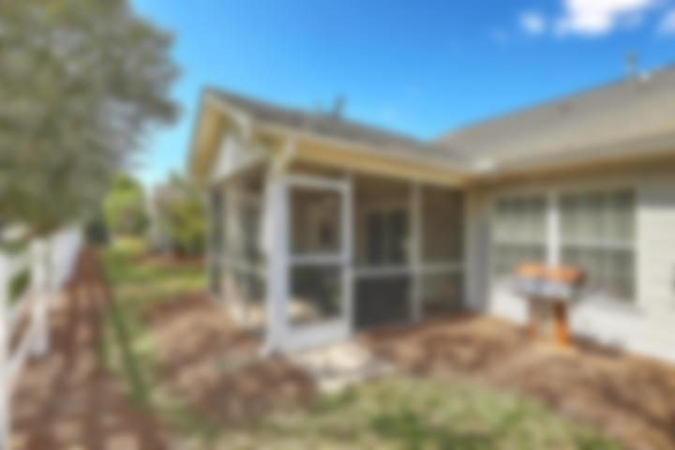
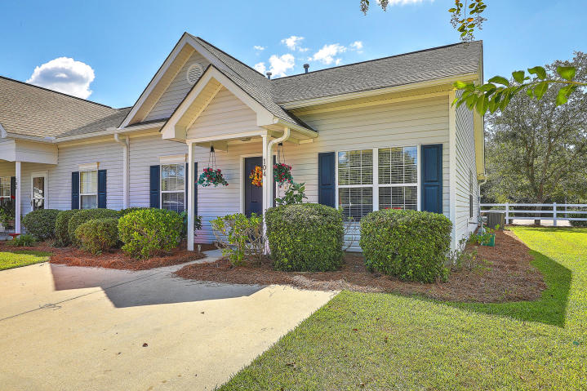
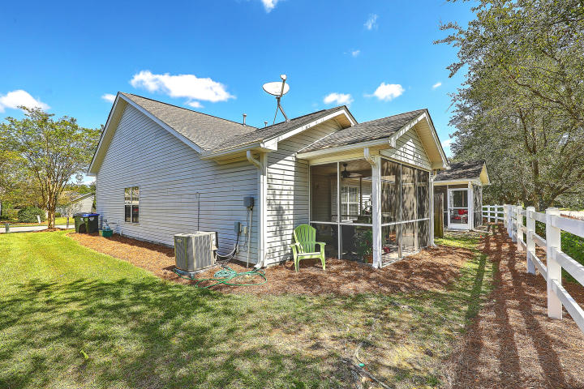
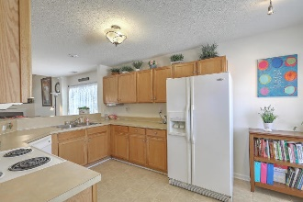
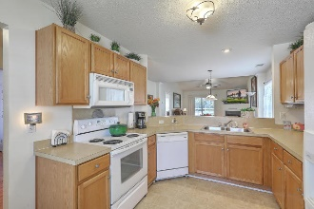
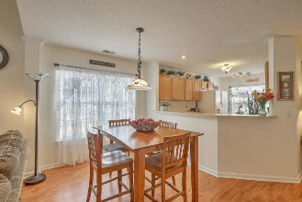
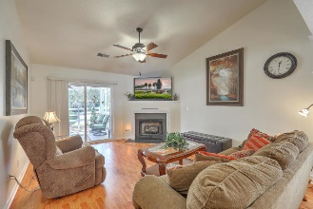
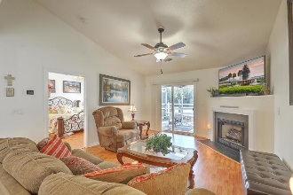
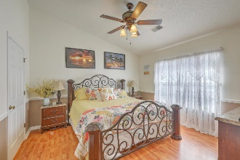
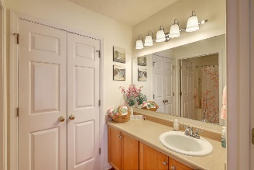
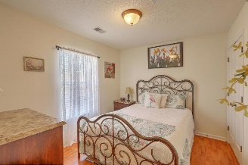
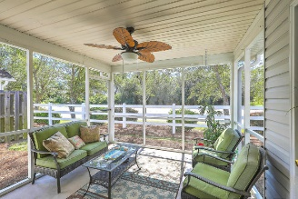



JUST LISTED!! Lovely Move-in Ready Duplex
Open House Saturday 1-4pm
104 Townsend Way
Village On Central | Summerville, SC 29483 | MLS# 19027151 | $152,975
You will LOVE this great open-concept floorplan in this move-in ready 1-story duplex, perfect for those just starting out or looking to downsize! Features include**Nicely sized foyer that opens to large living room and dining room combo**Gleaming laminate flooring throughout**Cozy up to the gas fireplace on a chilly night or enjoy your morning coffee on your screened porch during warmer months**The well-equipped eat-in kitchen with breakfast bar, overlooks the living room, perfect for entertaining, and has ample cabinet space**Vaulted ceilings in the living room and master bedroom allows plenty of natural light**Spacious master ensuite with lots of closet space**Guest bedroom with access to hall bath from bedroom**HOA maintained lawncare and irrigation as well as maintenance of the common areas of the neighborhood. Conveniently located to shopping, schools and downtown Summerville being only 3 miles away, this townhome is truly located in a highly desirable area that you don't want to miss!
Desiree Maurer
Office - (843) 416-2000
Mobile - (843) 327-9010
desiree.maurer1@gmail.com
www.yourcharlestonhousesearch.com
Keller Williams Realty
496 Bramson Ct Ste 200
Mt. Pleasant, SC 29464

