Slide 1
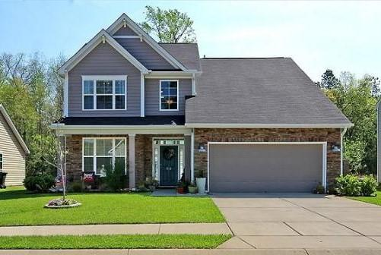
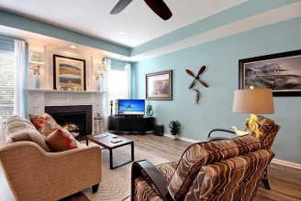
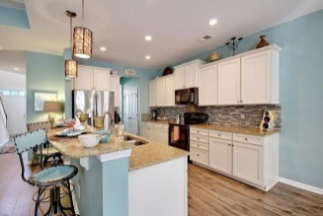
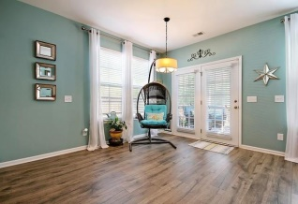
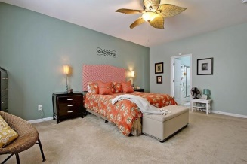
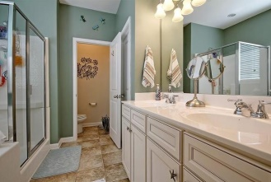
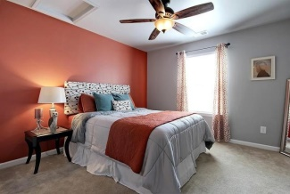
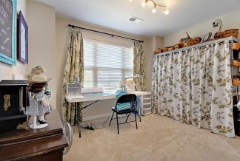
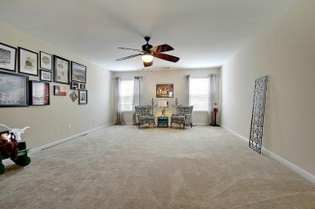
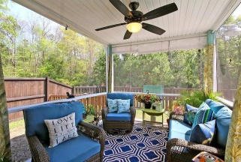
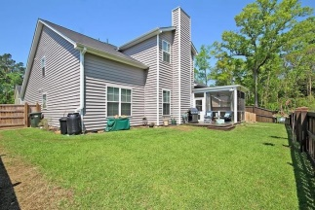

104 Vango Drive Sophia Landing Goose Creek, SC 29445 MLS# 15009417 $249,500 4 Bedrooms | 2½ Baths | 2,760 sf
Open House Saturday 1-3
Better Than New Construction No Hassle!
This is a showcase home that could have been the model! Unsurpassed decorator quality with custom upgrades galore are included in this 4 bedroom, 2.5 bath, 2700 sqft beautiful home. Entering the home you notice the gorgeous paint colors, open floor plan, and the custom floors that leads to the gourmet eat-in kitchen with quartz counter tops, stainless steel appliances, tile back splash, custom cabinets, a double pantry, and a new quiet dishwasher. The breakfast bar overlooks the oversized family room with tray ceiling and cozy fireplace. This open area is perfect for the chef who entertains, or the sports fanatic who loves to have guests over for he big game. The large screen porch and deck are perfect for having a peaceful cup of coffee in the morning or enjoying a good book in the afternoon and have stellar views. The luxurious master is on the main floor and has a spa quality attached bath with double sinks, garden tub, separate shower, and a walk-in closet. The first floor also has a flex room that can be a separate formal living room, dining room or office. Upstairs three big bedrooms with custom fans and light fixtures share a bathroom and all are light and bright and have an abundance of closet storage. A massive bonus room that could be a media room or separate play area for the kids is also on the second level. The large garage has ceiling fans and additional storage. This craftsman style home sits on a private, landscaped, and fenced lot backing up to a protected woodland area that provide gorgeous serine views. Sophia Landing is a wonderfully landscaped community with a play park and NEW community pool! The neighborhood is close to local shopping and grocery stores and is a short drive to downtown Charleston with 5-star restaurants, world class shopping and iconic history as well as a short drive to the beaches, the airport, Boeing and Daniel Island. Come take a look because you will not find another home that offers as much as this one: a chef's delight and entertainer's dream!
Stan Huff
843-670-2835 stan.huff@agentowned.com
Jill Marcacci
843-297-5590 jill@agentowned.com
www.agentownedrealty.com
AgentOwned Realty Co. Preferred Group, Inc. | 824 Johnnie Dodds Blvd | Mt Pleasant, SC 29464

