Slide 1


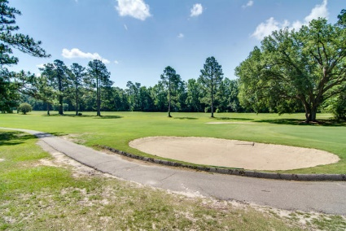
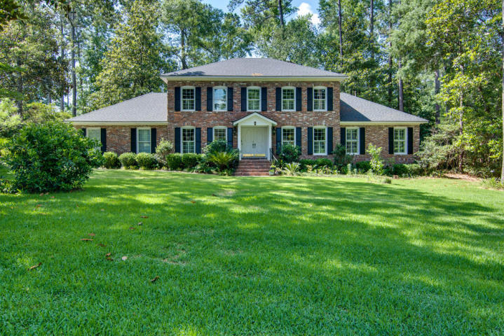
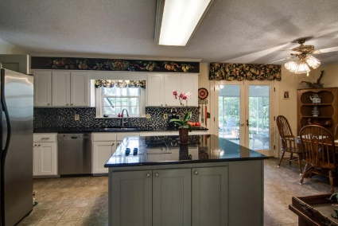
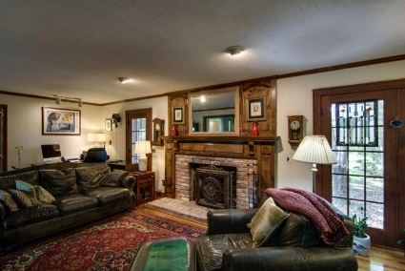
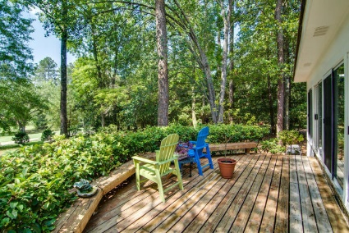
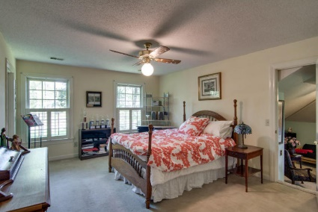
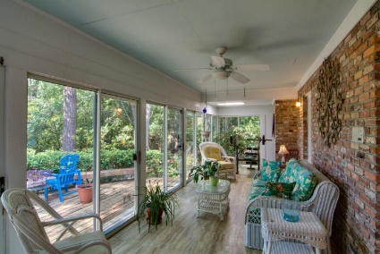
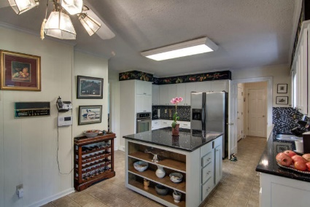
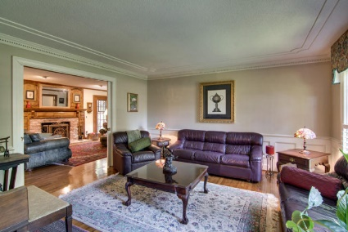

Tea Farm on the Golf Course!
104 W Shepard Lane
Summerville, SC 29483
MLS# 17016030 | $525,000
Just Reduced to $365,000
Rare opportunity to live in Tea Farm on the golf course! Stately brick home on beautiful lot filled with flowering shrubs and mature trees overlooking the golf course in one of Summerville's best kept secrets. This well maintained home features a traditional floor plan with downstairs master suite, large dining, living and family rooms with wood burning fireplace and hardwood floors, up-dated kitchen with quartz counters and stainless appliances and a lovely sunporch overlooking the third hole of the Summerville Country Club. Upstairs you will find a second master suite, two more generous sized bedrooms, a large bonus room with a separate staircase , a hall bath, an old school dark room and more storage space than you can possibly fill! A two car garage with a work area round out this great home.
Lori Claussen loric@goldenbearrealty.com
www.GoldenBearRealty.com
Golden Bear Realty | 654 Coleman Blvd, Suite 100 | Mt Pleasant , SC 29464
Cell (843) 224-8506 | Office (855) 352-9088 | Fax (561) 721-3311

