Slide 1
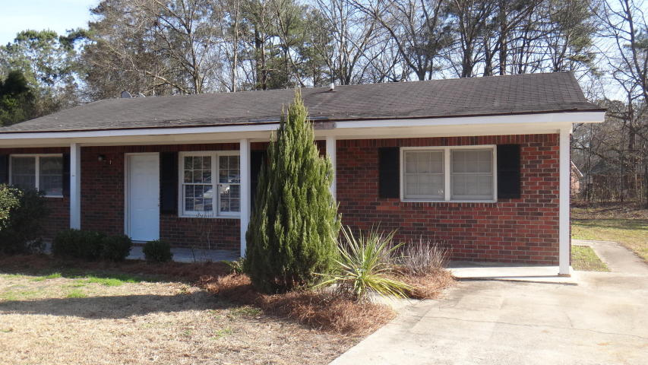
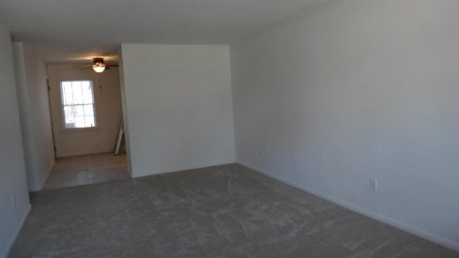
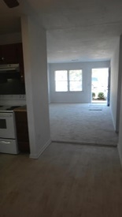
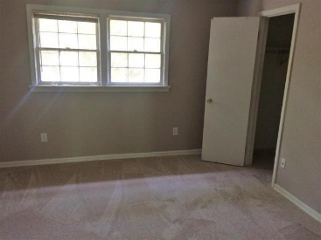
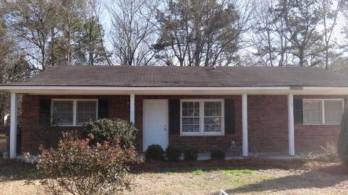


104 Wendy Way A&B
Greenhurst | Summerville, SC 29485 | MLS# 16004488 | $119,000
Calling All Investors!
Summerville Duplex with Great Rental Potential!
Great rental property or live in one side and rent the other. Side A has 2BR/1BA, is vacant and has been repainted, has new carpet, new vinyl, new kitchen faucet and new front door. Side B is 1BR/1BA, tenant occupied at approximately $550/mon. Both sides have a fenced back yard. Great investor opportunity!
Jeanette Henderson
(843) 834-0068
jeanette.henderson@carolinaone.com
www.jeanettehendersonrealty.com
Carolina One Real Estate
628 Long Point Rd.
Mt Pleasant, SC 29464

