Slide 1
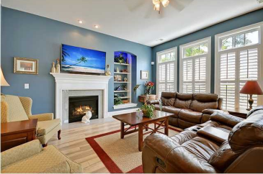
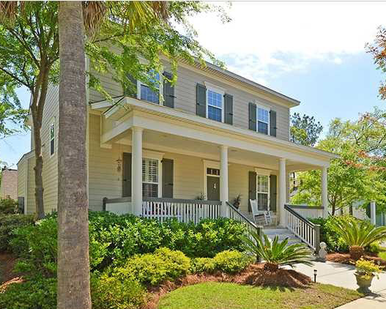
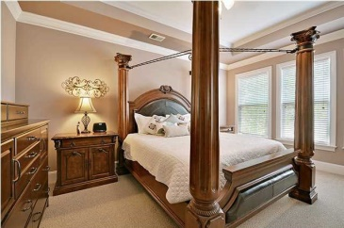
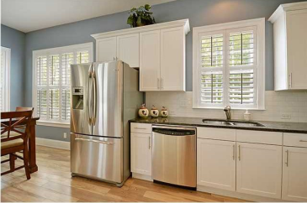
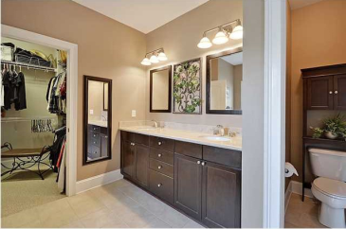
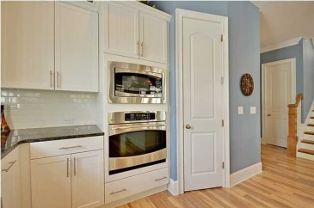
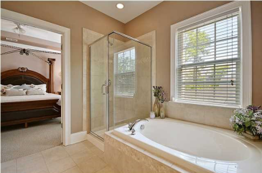
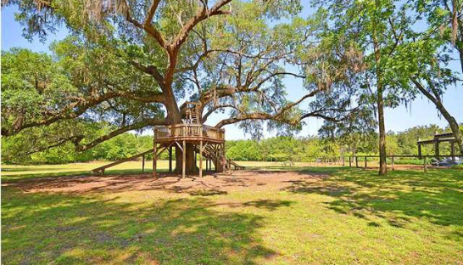
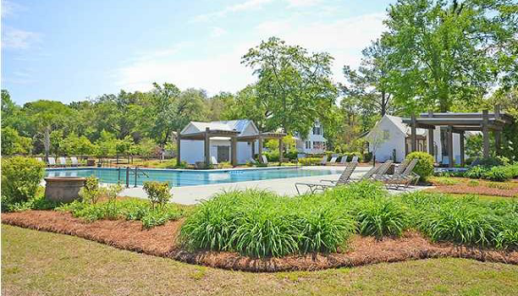
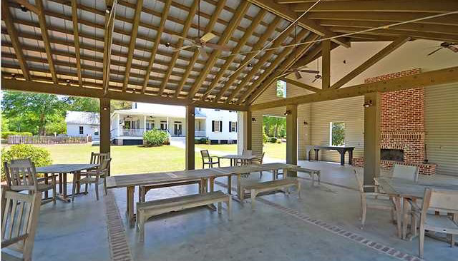

104 Westoe St | Summerville
MLS# 1411433 | $300,000
Amazing Home with All the Upgrades!
** Drastic Price Drop for Immediate Sale! ** Quality David Weekly Home ** Don't be fooled by New Construction Prices... Our Price INCLUDES TONS of UPGRADES ** Large, CORNER LOT ** 1/2% Paid Closing Costs with Preferred Lender ** Sit with some iced tea on your expansive front porch and watch the world go by… This classic Charleston home sits on an expansive corner lot that is beautifully landscaped. The spacious, Open floor plan makes cooking, eating and spending time together truly enjoyable. The great room has 10’ ceilings, wide plank hardwood flooring and is flooded with natural light. Custom, insulated plantation shutters make sure you can enjoy this room any time of the day. Your kitchen is a gourmet cook’s dream! GE Stainless Steel appliances and Gas Cook-top with Stainless Steel hood…Beautiful granite counter-tops and subway tile back splash. Steps from the kitchen is an open, airy screened porch with views across the lot…great for entertaining or just enjoying the great Charleston weather! A wood staircase with vaulted ceilings leads to the second floor and all four bedrooms. The master bedroom has huge picture windows and double doors that open to the master retreat bathroom. Double sinks and a separate soaking tub make getting ready easy and relaxing. The walk in closet has ample room for two. Did you notice the 9’ ceilings upstairs? Very rare. The home has been Freshly painted with certified Sherwin-Williams “Charleston” colors throughout. Lots of little extras have been added, too. ADT wireless home security system and an additional Comcast business line are just a few. Located in the coveted community of The Ponds, this “one-of-a-kind” home is not repeated throughout the neighborhood. The Ponds has miles of walking, hiking and biking trails, and ponds dotted throughout the community. A neighborhood pool, community pavilion and play area are great for families. Enjoy large Live Oak Trees and varied architecture in this established neighborhood. Close to all the great shopping, restaurants and medical facilities of Summerville! Don’t forget, this home is in the Dorchester II School District, too! If you are looking for a green home, this is it. The home has many green features including a Rinnai tankless hot water heater. Why wait for new construction when you can get a solid, well-built home with all the upgrades and MORE for less!
Call or email for details: (843) 214-8451 or Robin@ThePhillipsRealtyGroup.com

