Slide 1
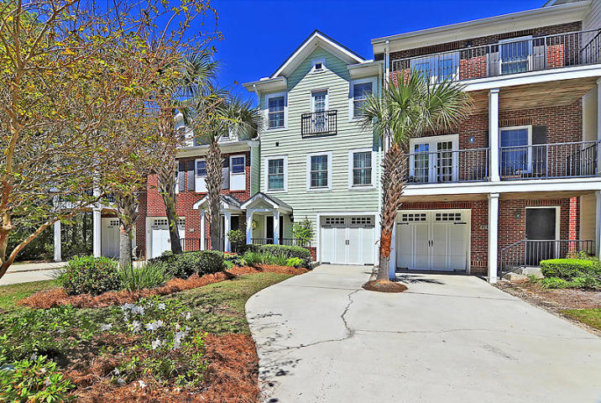
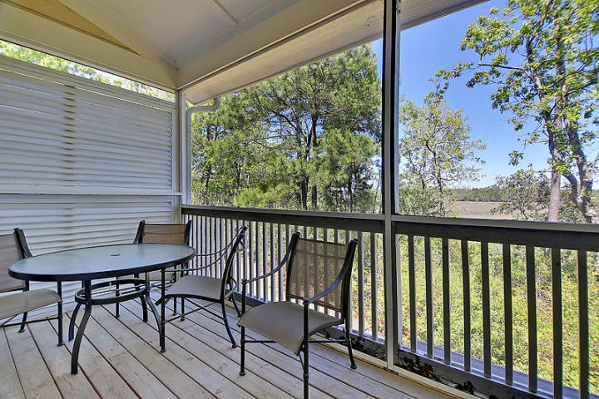
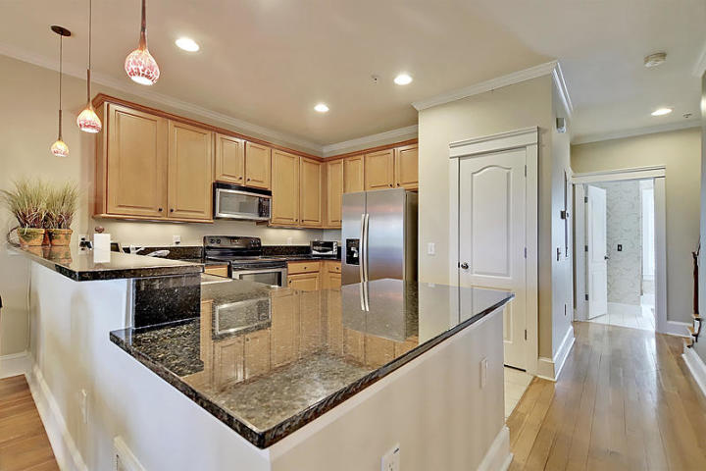
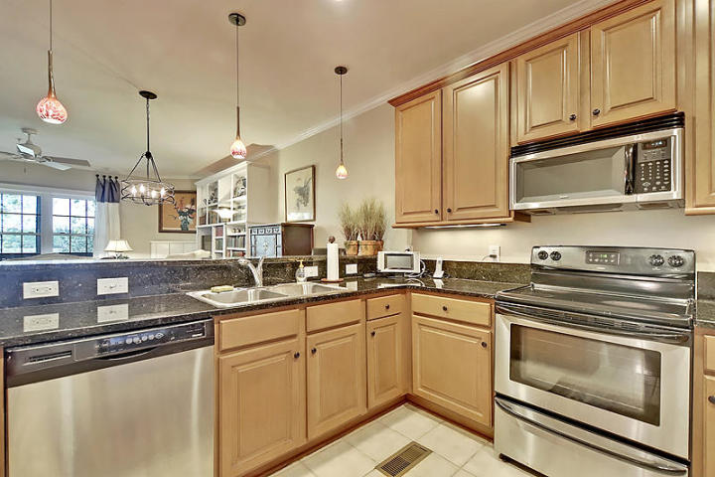
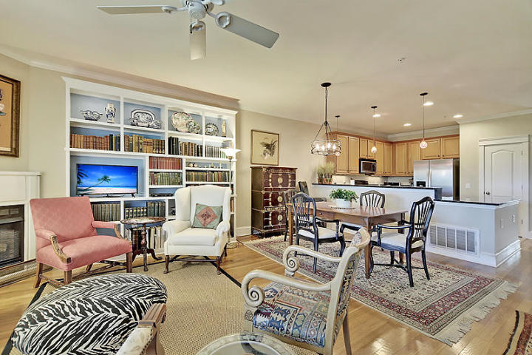
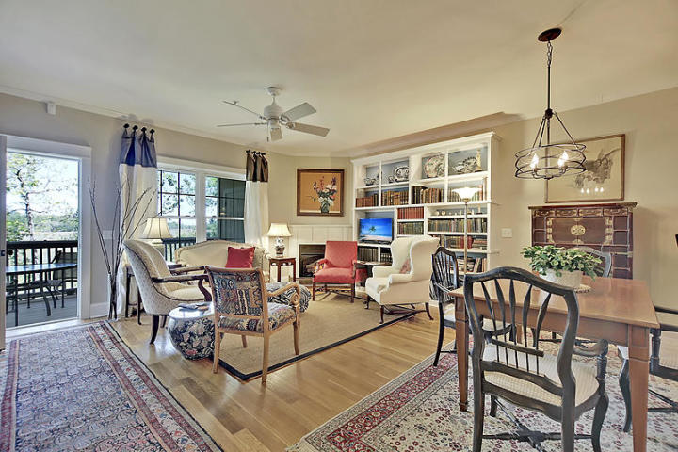
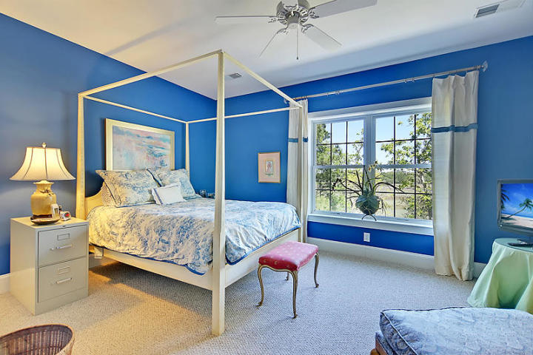
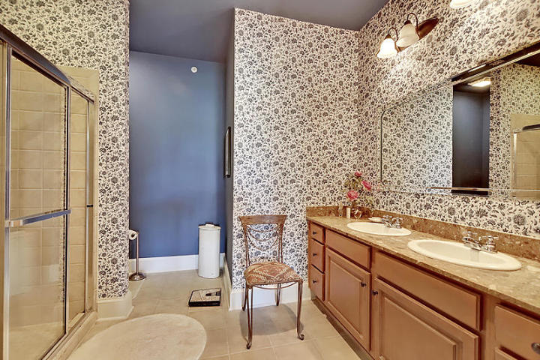
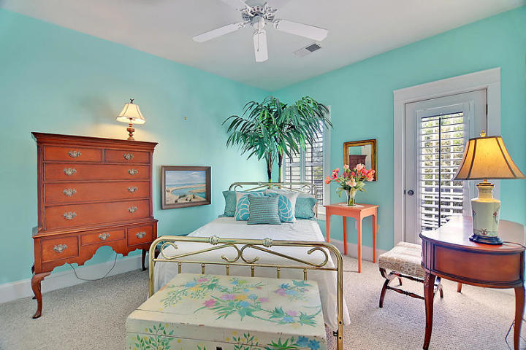
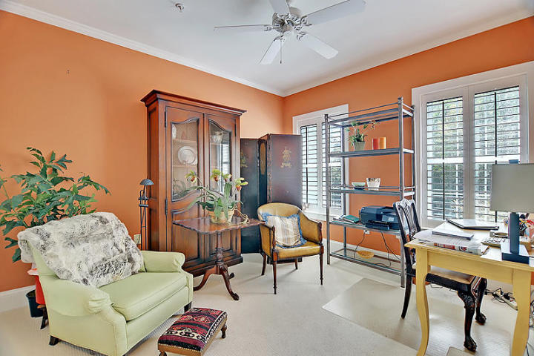
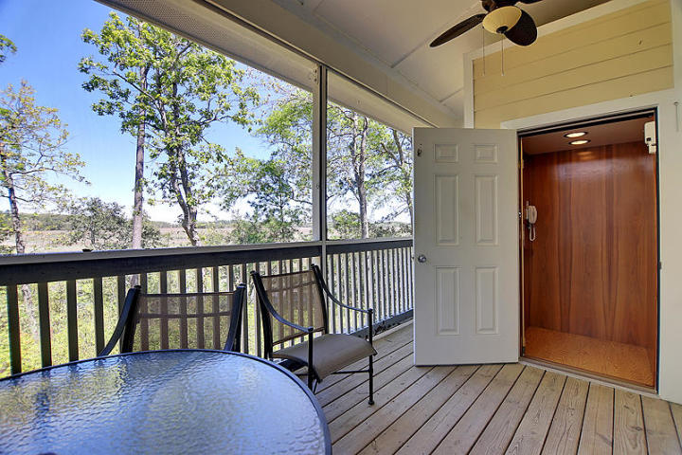
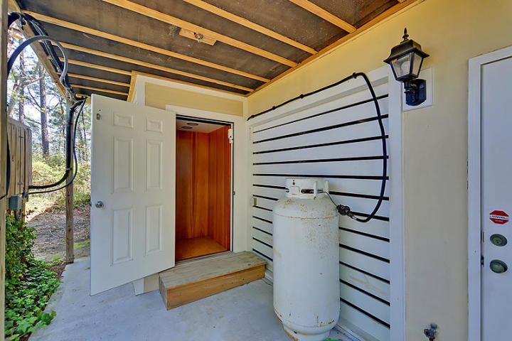
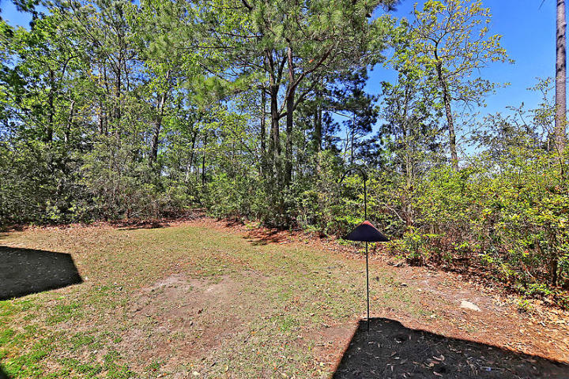
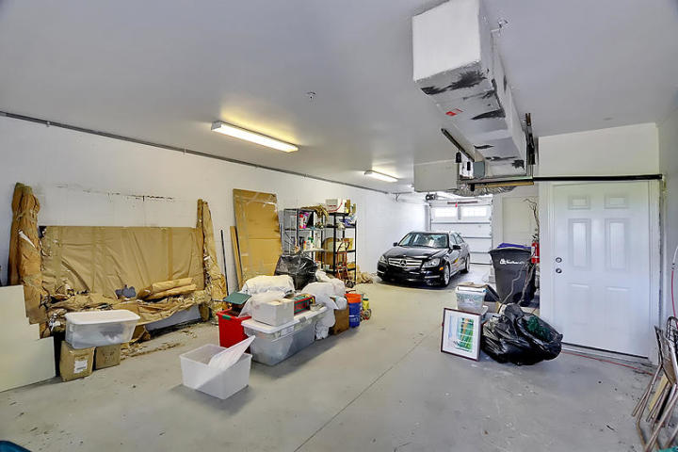
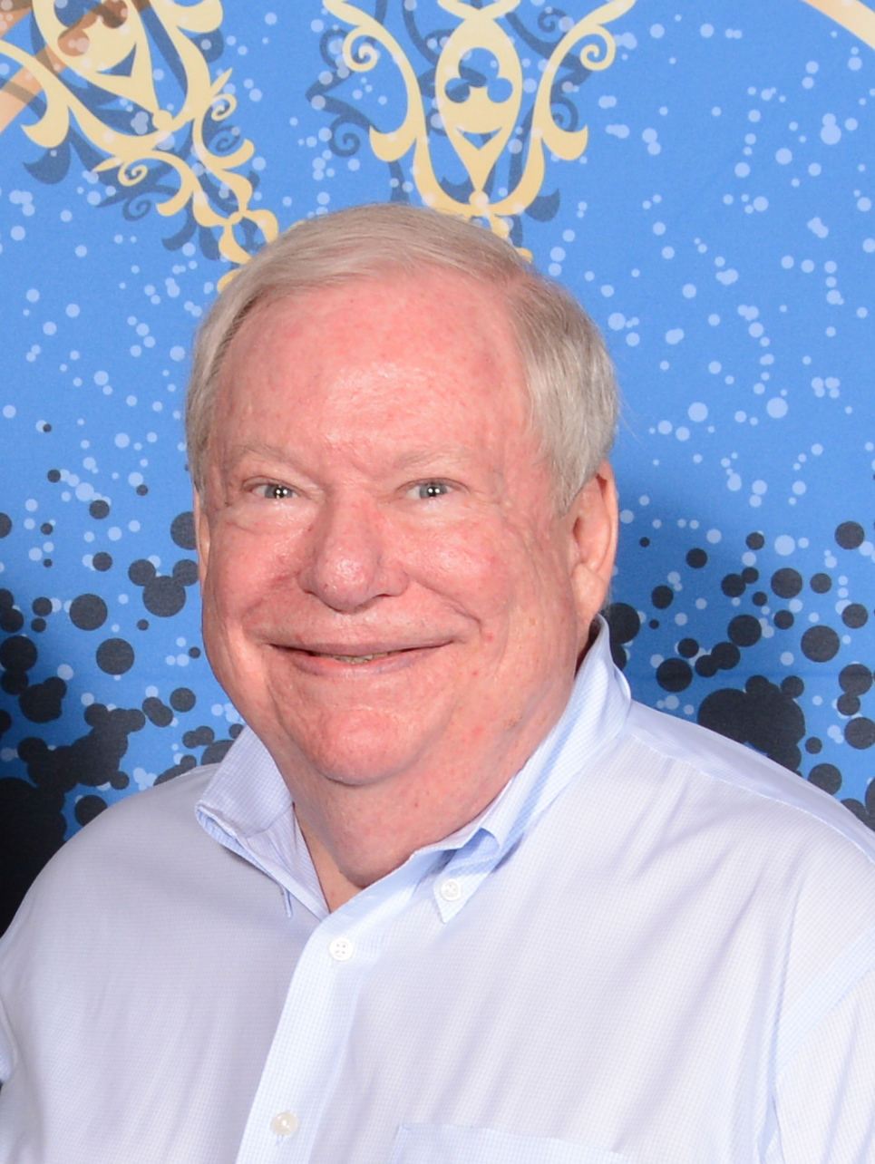

Open House ~ Sunday 4/14 ~ 1-4
Hosted by Mark Goldsmith | 843-743-4177 | markgoldsmith@kw.com
Buy.......Build.....Begin
104 Winding Creek Court 112-2
Etiwan Pointe | Mount Pleasant, SC 29464 | MLS# 19010129 | $365,000
Elegance, grace and luxury are the adjectives that come to mind when describing 104 Winding Creek Court. This exceptional 3 bedroom, 3 full bath townhouse has hardwood floors in the main section, ceramic tile in the kitchen and Berber carpet in all of the bedrooms. The upstairs hallway is hardwood. A half elevator has been added that includes a safety system to keep it working even without power. The kitchen has designer cabinets, granite counter tops, pantry, built in microwave and custom lighting. The Kitchen overlooks the large Family Room dining room combination with hardwood floors. In the Family Room you will find a Gas Vangard Vent Free fireplace and custom built in cabinets. The bedroom on this level has been converted into an office with ceiling fan. Enjoy the wonders of nature from your screened in porch with a privacy screen on the left side. The porch entrance is off of the Family Room. The half elevator opens on the porch. On the upstairs level you will find the very large master bedroom with walk in closet and the master bath with both a jetted tub, dual vanities and large walk in shower. On the lower floor the entrance foyer has ceramic tile floors and the entrance to the oversized tandem garage. The security system is supplied by ADT and the wiring was built into the walls during construction. Almost every closet had the wire inserts removed and improved real wood shelving installed. Plantation shutters are sprinkled throughout the house. Etiwan Point has great amenities including a dock, floating dock, pool, pool house, club house and a gym. This wonderful home was created with the loving touch of an interior designer.
Bob Ramella, Broker
CRS, CDPE, RCC, e-Pro
(843) 330-8300
bob@bobramella.com | bobramella.kw.com
Keller Williams Realty Charleston | 496 Bramson Ct Ste 200 | Mt. Pleasant, SC 29464

