Slide 1
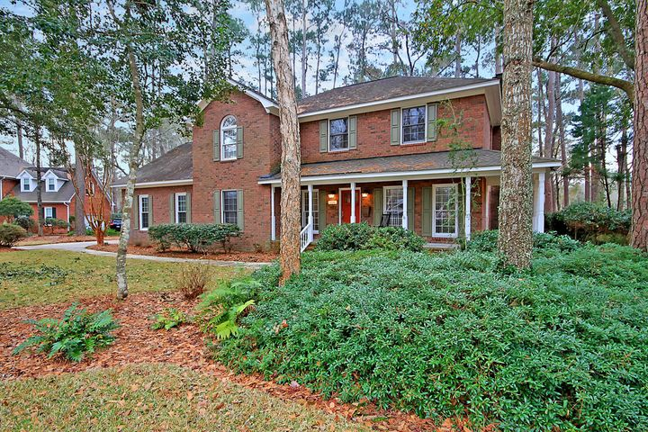
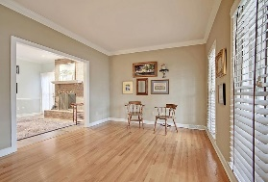
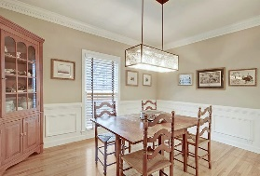
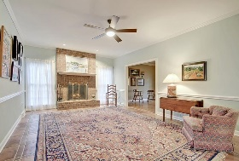
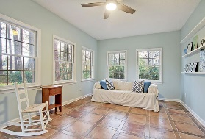
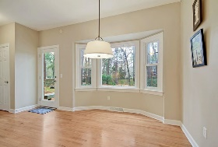
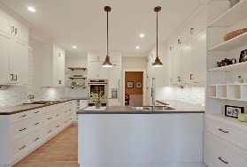
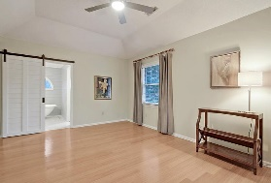
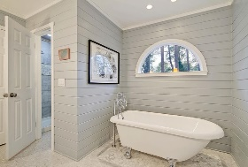
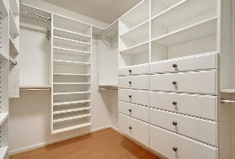
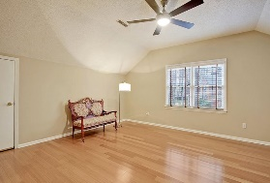
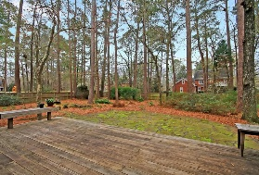
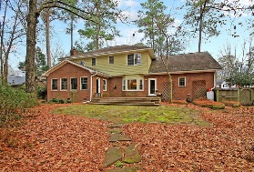
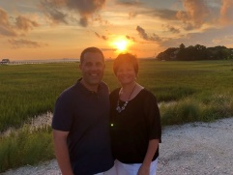

Summerville Beauty on Cul De Sac!
104 Caffrey Court
Ashborough East
Summerville, SC 29485
MLS# 21004378
$470,500
5 Bedrooms | 3½ Baths | 3,208 sf
Welcome to 104 Caffrey Court in the established neighborhood of Ashborough East. This well-maintained home is located on a cul de sac and is ready for you to move right in! Updates galore with stunning tile work in the bathrooms as well as an exquisite kitchen. The large wrap around porch with a swing welcomes you in. To your right, is a formal living room that could easily be used as a home office. To your left, is a large dining room with lovely trim work. The family room offers a fireplace and a wet bar area. From here you can access large sunroom through the French doors, deck and beautiful fenced in yard. Back inside, step in to the fully renovated kitchen which offers a gas cooktop, floating shelves, and a subzero Thermador refrigerator as well as a freezer. There is built in shelving for cookbooks and wine. This kitchen is truly a chef's delight! Off of the kitchen is the eat in area with large windows overlooking the backyard. Off of the kitchen is the laundry room which has a utility sink and cabinetry. This home has two staircases! Head upstairs and you'll find the master bedroom with a fully renovated bathroom and master closet. The claw foot tub, ship lap walls and gorgeous tile work give this bathroom a spa feel! The master closet is a dream come true with custom drawers and shoe shelves! Three more bedrooms all with wood flooring and another renovated full bath are also on the second floor. Down the hall is the bonus room as well as another full bathroom. The bonus room can be used as a fifth bedroom, media room, home gym, office or game room. The choice is yours! Ashborough East offers a community clubhouse, pool, playground and tennis courts. Walking trails surround parts of the neighborhood as well. This home is close to it all and is located in the Dorchester District 2 school zone. Come make this house your home!
Larry & Kathy Mazalatis
Larry Cell 843-693-0529
Kathy Cell 843-693-0159
Office 843-871-9133
AGENTOWNED PREMIERE GROUP | 1800 TROLLEY RD | SUMMERVILLE, SC 29485

