Slide 1
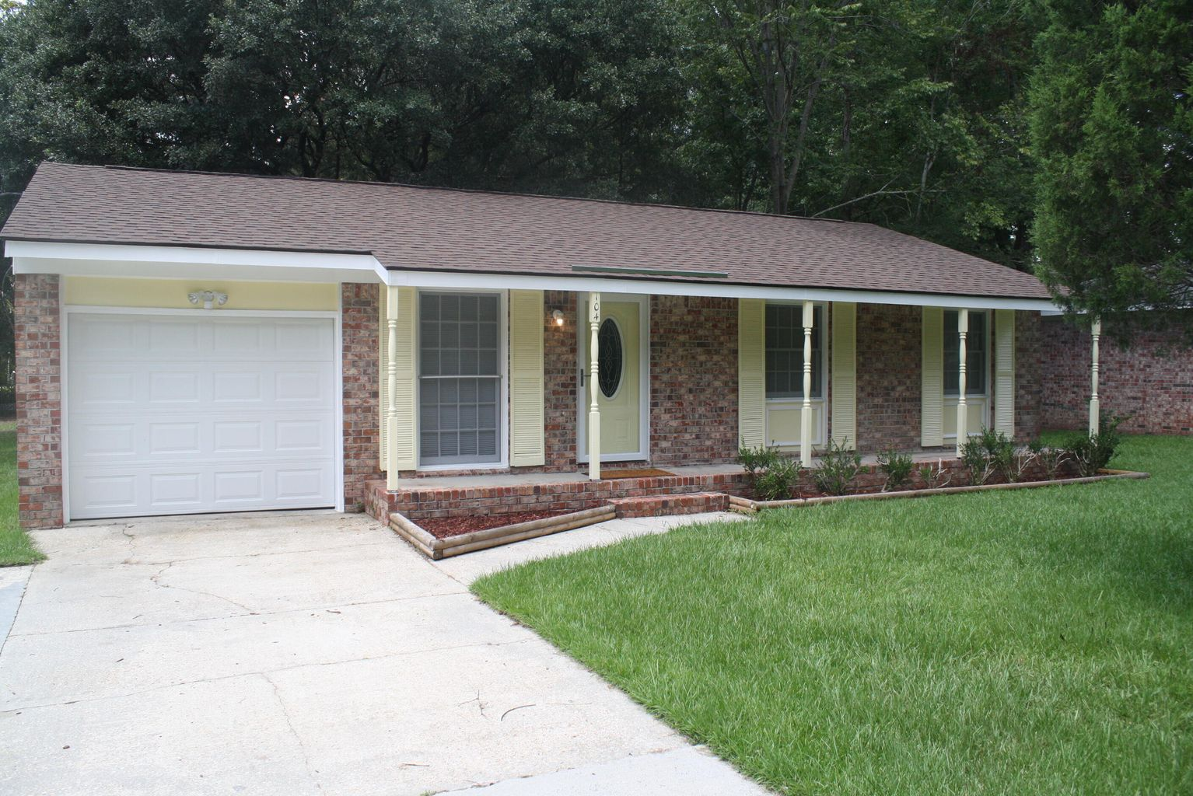
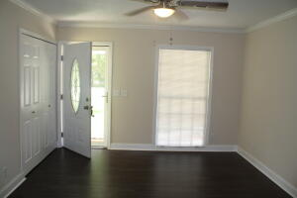
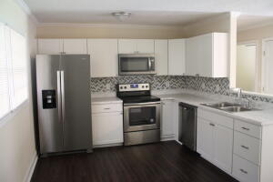
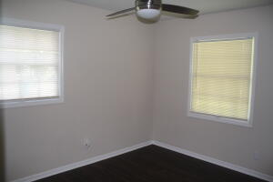
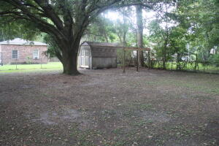


Open House Sunday Sept 18th from 12-5pm
104 Maple Drive
Pineview Hills ~ Goose Creek
MLS# 22021081 ~ $255,000
Very charming, move in ready home. All new appliances, ceiling fans, new hot water heater, AC - 2 years old. Roof 2-3 years old. New Paint, floors, cabinets, bathroom fixtures. New counter tops in the kitchen. Close to Navy Weapons Center, Boeing, Nucor, Volvo, Charleston Air Force Base. Elementary school nearby. Storage unit in back yard, chain link fence. Large back yard with beautiful oak tree. This house will not last long. Exceptional property. If square footage is important, verify.
Paul Bazemore
M 843-524-6900
randybazemore99@gmail.com
Paul Bazemore Realty & Associates
4832 Hwy 162 Unit B
Hollywood, SC 29449
www.bazemorerealty.com

