Slide 1
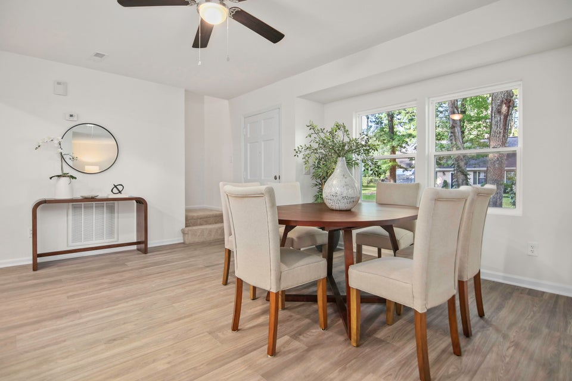
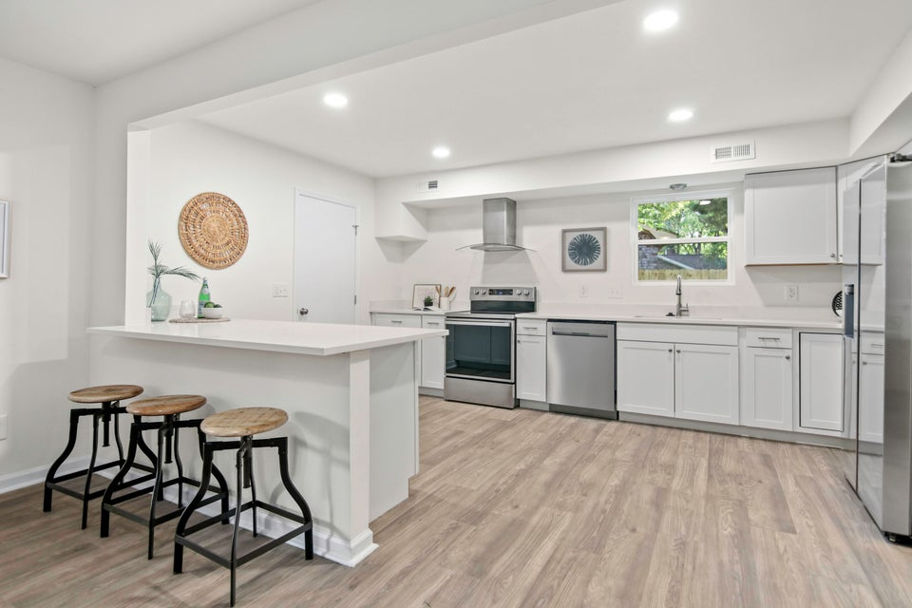
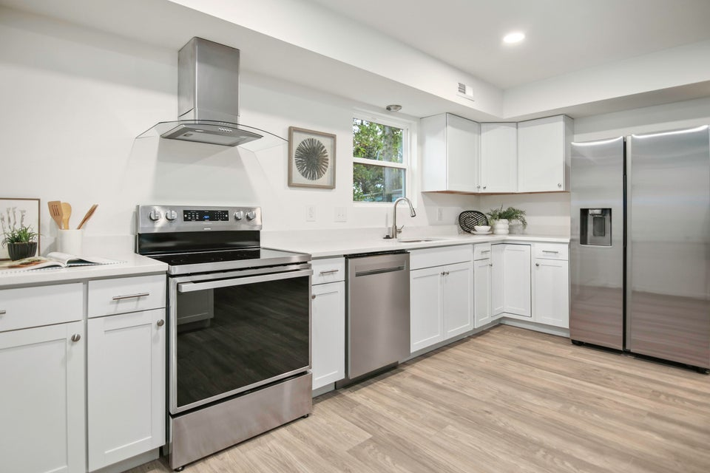
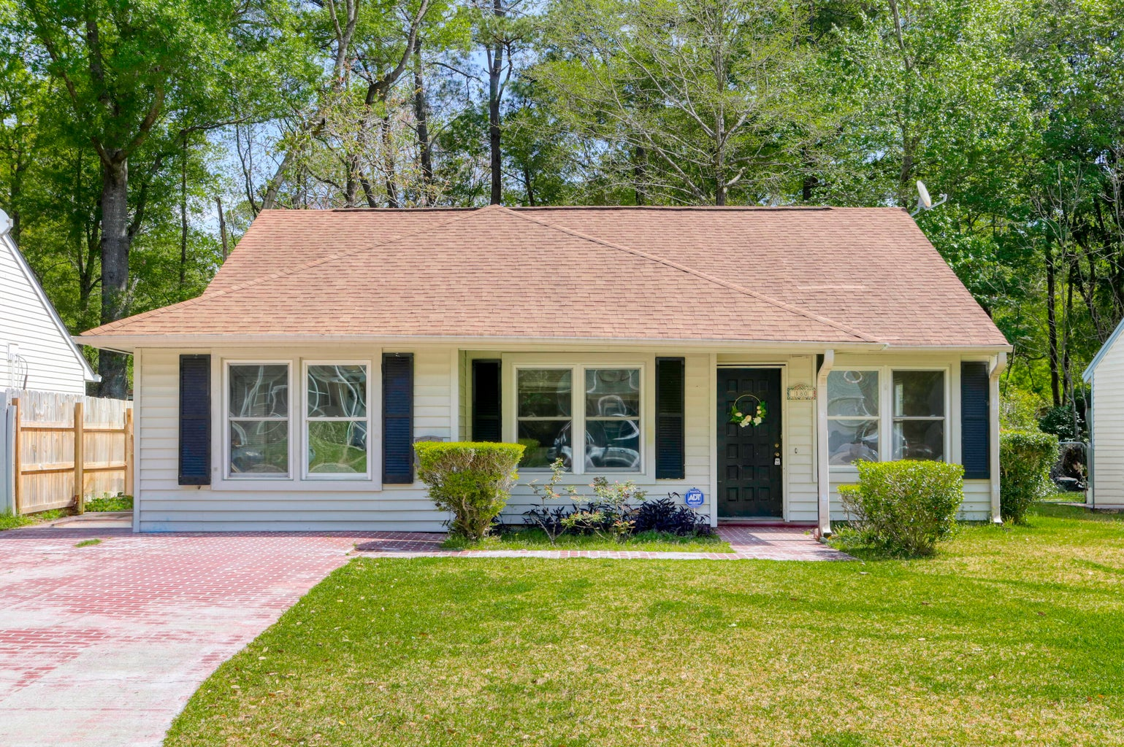
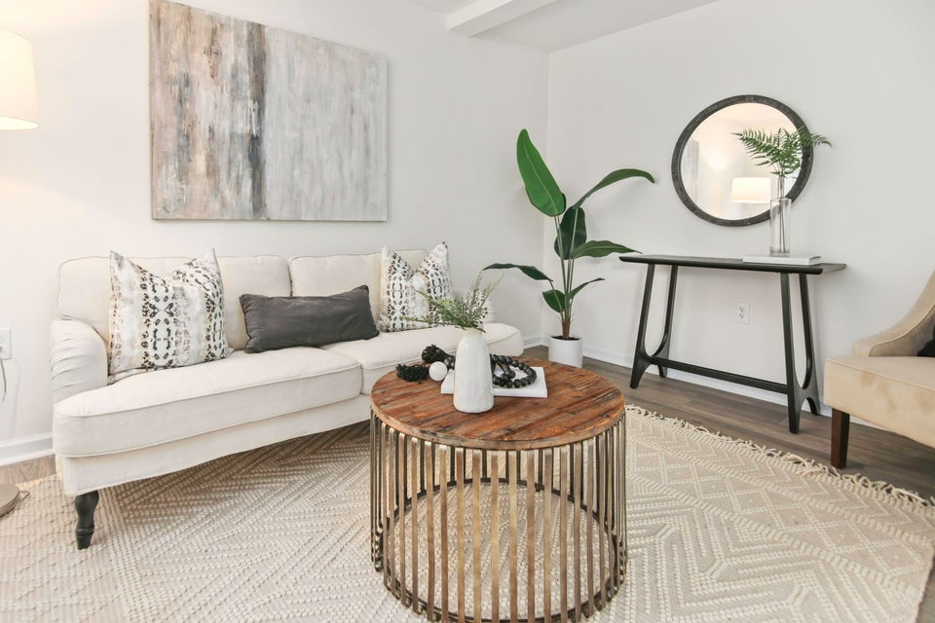
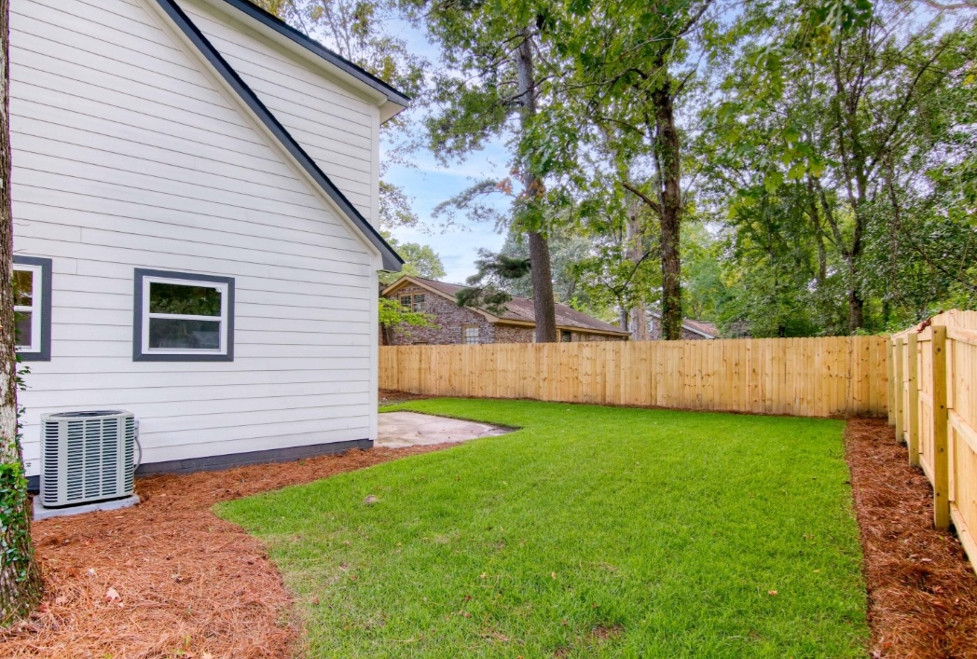




UPDATED 4 BEDROOM LADSON HOME IN DD2!
104 Pelican Street
Tranquil Estates | Ladson
MLS# 24023498 | $339,950
Welcome to 104 Pelican Lane, a beautifully renovated 4-bedroom home in Tranquil Estates, located within the desirable DD2 school zone. This charming property, set on a corner lot, features an open floor plan with thoughtful modern upgrades throughout. Step inside to discover a spacious living area that flows into the converted den and laundry room. New HardiePlank siding and brand-new HVAC system!! The kitchen is a chef's dream, complete with new cabinets, countertops, and stainless steel appliances, including a wine fridge. Whether you love hosting or simply enjoy cooking, this space is designed for both style and functionality. All four bedrooms are generously sized, with the upstairs rooms offering easy access to large carpeted storage areas. The fully renovated bathrooms feature new plumbing, fixtures, and finishes, giving them a fresh, modern feel. Outside, the fenced-in backyard provides privacy and security, perfect for relaxing or entertaining. The corner lot offers plenty of space to enjoy outdoor activities, and the neighborhood's quiet, peaceful setting makes it a perfect place to call home. With all-new floors, windows, appliances, and more, 104 Pelican Lane is move-in ready and tastefully redone. Located in the highly sought-after DD2 school zone, this home offers everything your family needs for comfortable, modern living.
TAKE A VIRTUAL TOUR
Peter Stanley
843-300-8251
petermstanleyjr@gmail.com
1,437 SF
4 BEDS
2 BATH

