Slide 1
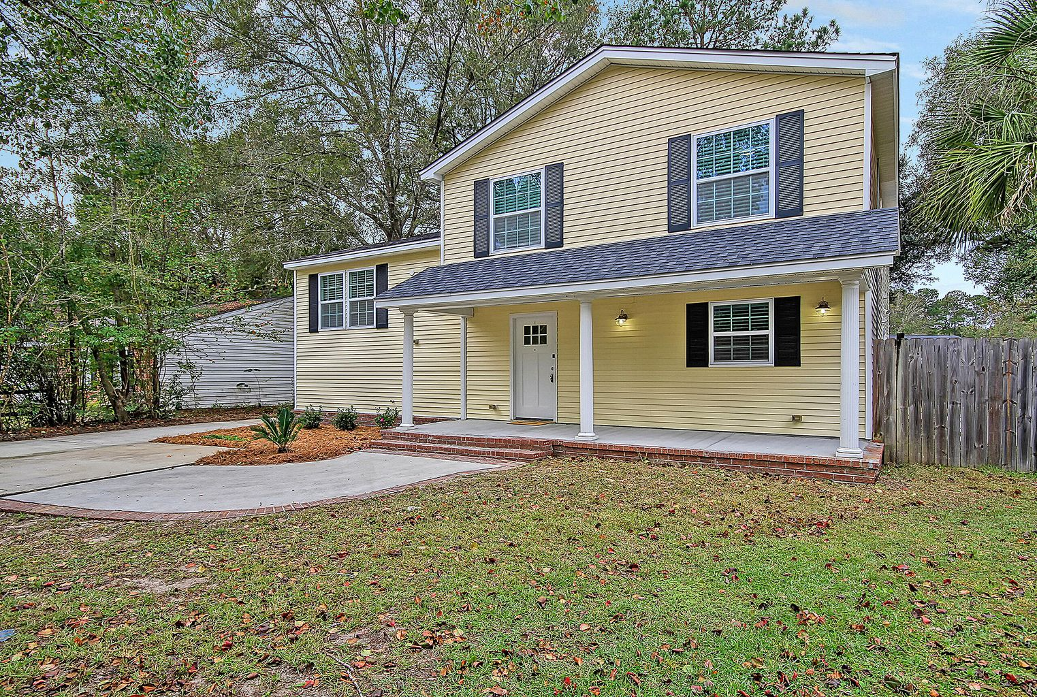
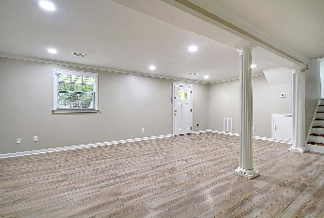
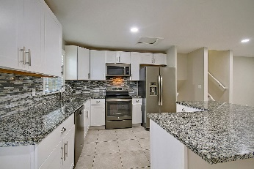
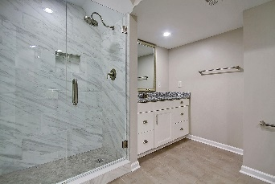
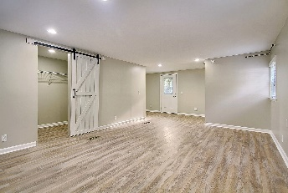
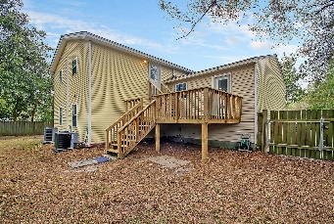
104 Seewee Court
Indian Springs | Summerville, SC 29483
MLS# 22028109 | $374,000
Want unique? Ready to move in home in desirable Dorchester District 2 schools, with NO HOA! This one of a kind split level home is upgraded throughout. Laminate flooring in most of the home with tile in the bathrooms and kitchen. Downstairs master bedroom with upgraded dual vanities, and premium tiled shower with frameless glass. French doors lead to outdoor patio surrounded by Palm Trees. The kitchen has granite countertops and upgraded appliances. Plenty of space for a large dining table or another entertaining space. Up the steps are 3 more bedrooms, a full hall bath, and an ensuite bathroom on the large bedroom in the back. Off the kitchen is a large deck that gives access to the surprise 5th bedroom! This room is unique and can be used for entertaining instead! This is a see it to to believe it home! 30 year architectural roof, wiring, windows replaced in 2016. New HVAC and ductwork in 2020. Brand new water heater and freshly painted. What more can you ask for? Come see this one for yourself!
Sean Harrington
(843) 226-9652 | sean@milerproperties.com

