Slide 1
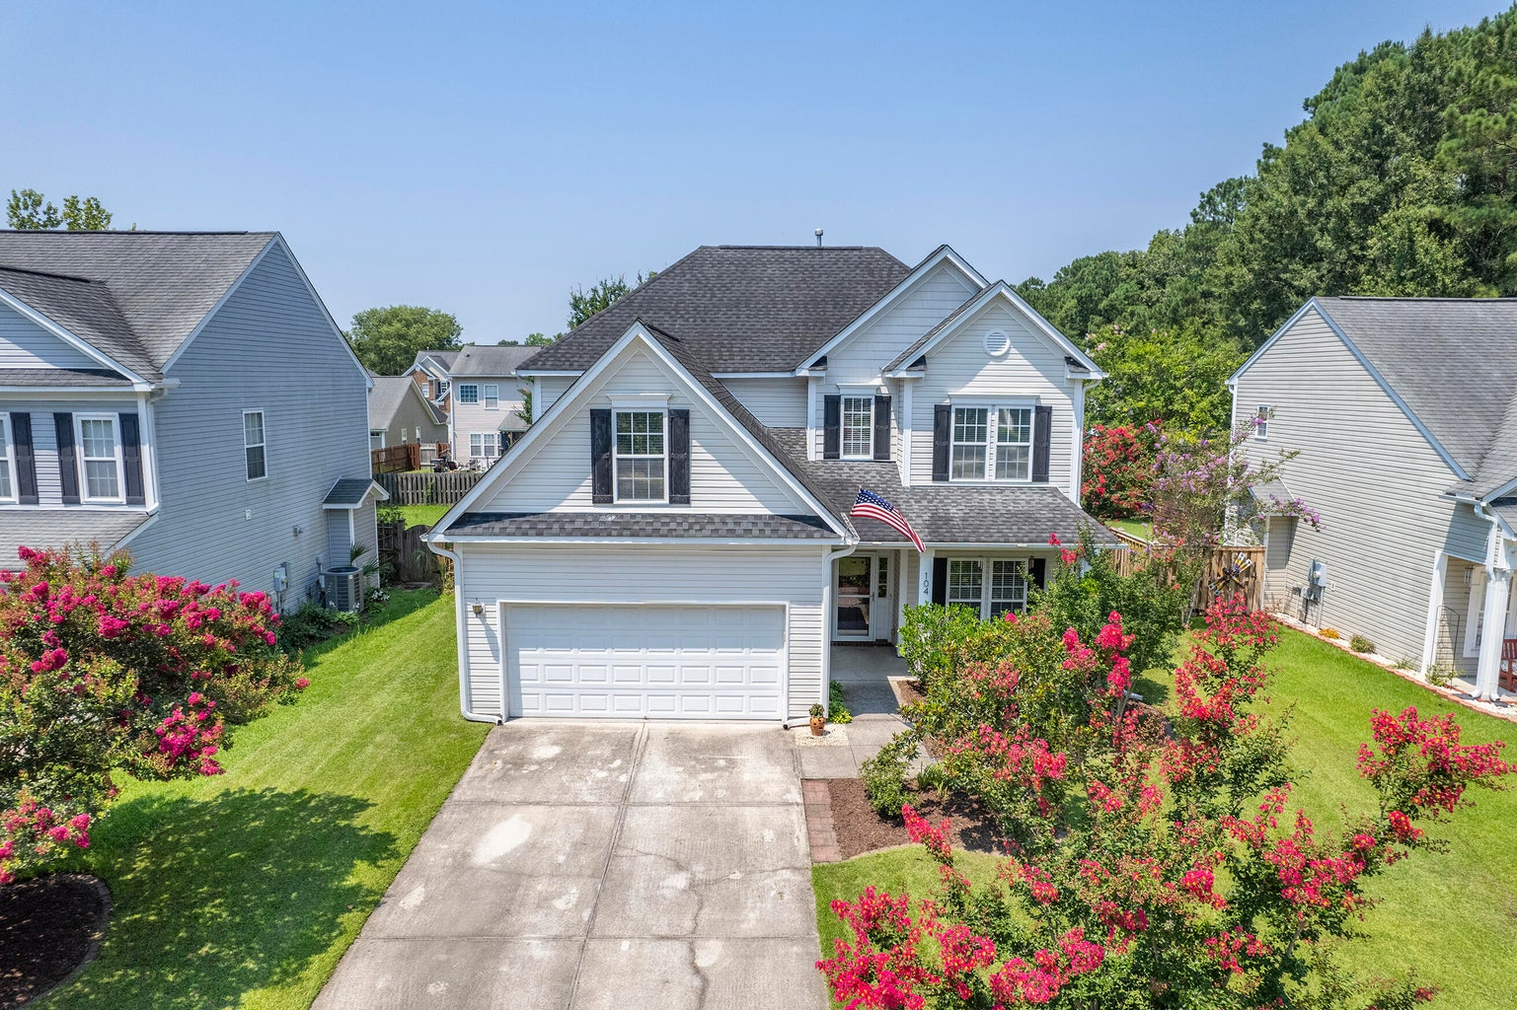
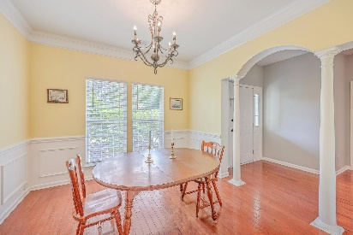
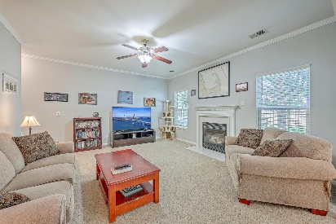
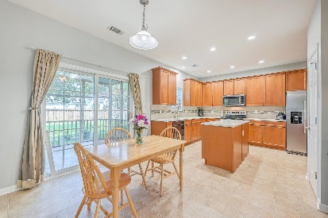
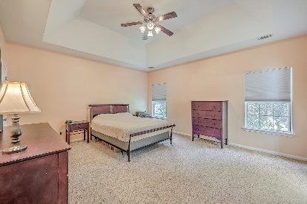
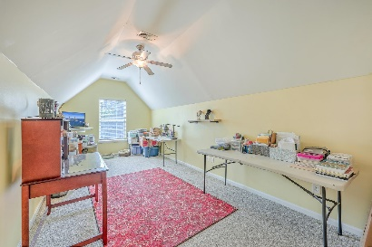
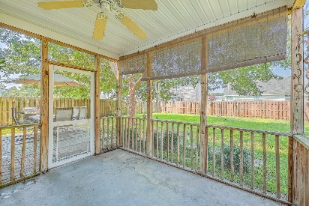
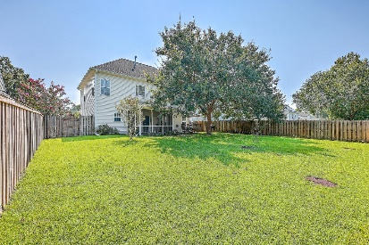


104 Valentin Drive
Plum Creek | Summerville, SC 29483 | MLS# 24018217 | $380,000
OPEN HOUSE SUNDAY 12-2
Welcome to your dream home situated in a prime location close to top-rated schools, an array of restaurants, shopping and charming downtown Summerville. Beautiful landscaping and a covered front porch welcomes you in to a light-filled home creating a warm and inviting atmosphere. The open layout that seamlessly connects the living, dining and kitchen areas is perfect for entertaining and family gatherings. Loads of cabinet and counter space, a butler's pantry, island and newer fridge/stove and microwave make this a chef's dream. Upstairs you will find spacious bedrooms, each offering ample space, ensuring comfort and privacy for all family members. The Primary En-Suite has a trey ceiling, 2 walk-in closets, double vanities, a separate garden tub and shower. 2nd and 3rd bedrooms have been freshly painted. 4th bedroom is the bonus room with a closet. Step outside to a nice-sized screen porch overlooking a spacious fenced-in yard and additional patio. Garage has built-in shelves and a utility sink. Newer Hot Water heater 10/2023. Don't miss out on this opportunity to own a home in a desirable and established Knightsville neighborhood.
Take a virtual walkthrough!
Beth Mandell
M 803-463-7734 | O 843-871-2121
bmandell@century21properties.com
www.bestcarolinahomedeals.com
Century 21 Properties Plus of Summerville | 118 W Richardson Ave | Summerville, SC 29483

