Slide 1
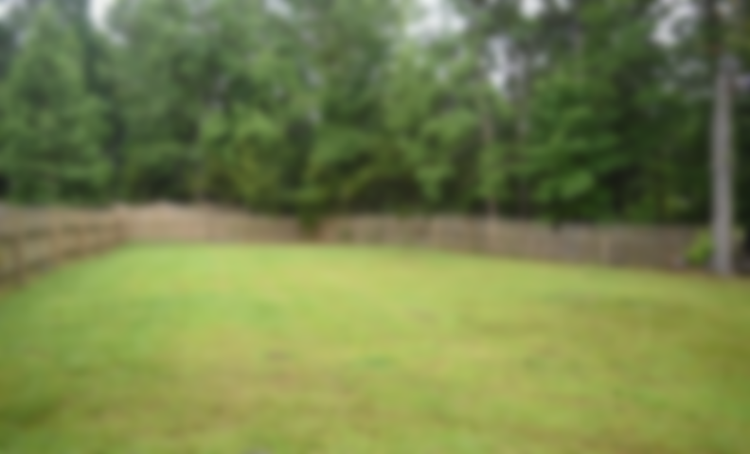
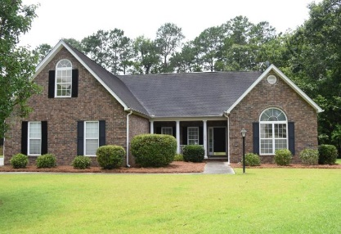
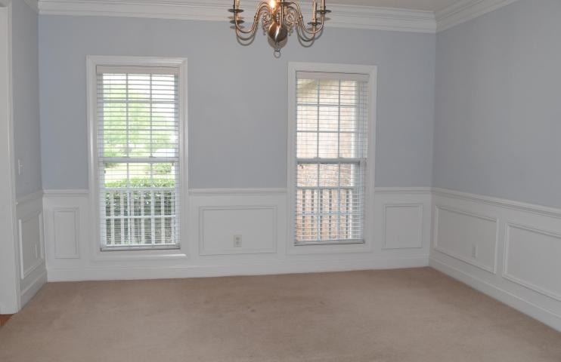
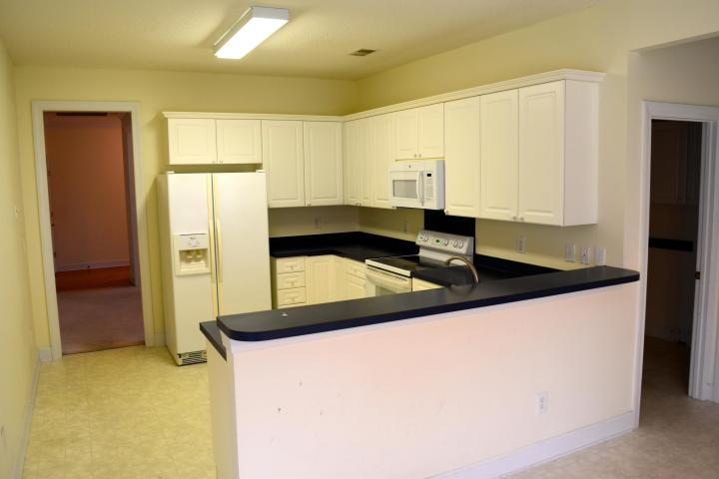
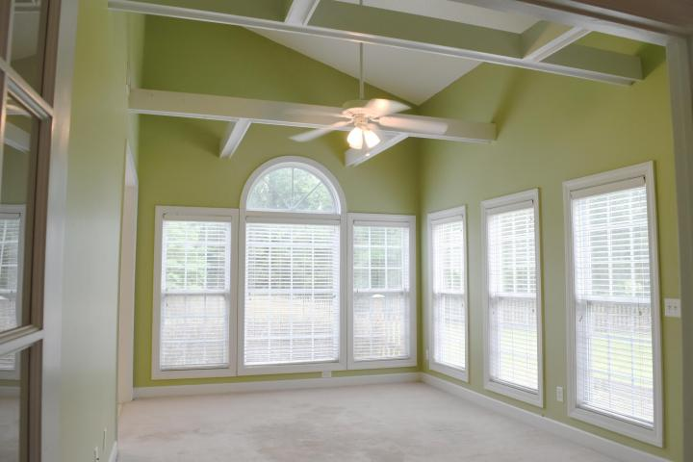
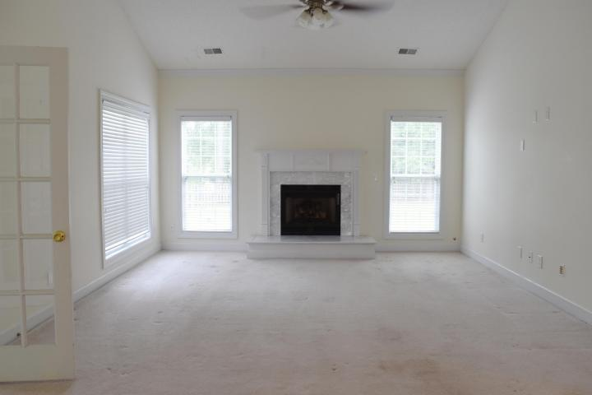
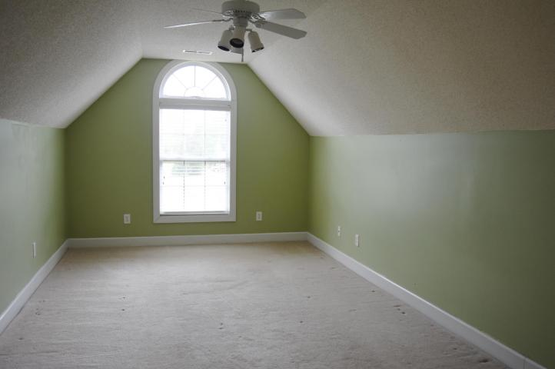


Priced to Upgrade! Move in ready and upgrade in your own time.
1050 Dunes Mill Court
Dunes West ~ Mount Pleasant, SC 29466
MLS# 16017532 ~ $439,500
4 Bedrooms | 2 Baths | 2,646sf
Bright & open ranch with a sunroom & bonus room, which is 4th bedroom Located in a small 18 home subsection at the end of a cul-de-sac. Huge private fenced yard. House backs to pond buffer. Oversized shower and Jacuzzi tub in master bath. Vaulted ceiling in great room and sun room. Tray ceilings in dining room and master bedroom. Irrigation system on separate meter. House is priced to reflect that owner will make no upgrades. This house has so much character and charm. Lots of possibilities. Come and enjoy all Dune's West has to offer. Dock facilities, golf, pools, tennis, walking, boat storage and more.
Ann Whalen
C (843) 224-8696
O (843) 856-8800
ann.whalen@cbcarolinas.com
Coldwell Banker Residential Brokerage
1127 Queensborough Blvd. 103
Mt Pleasant, SC 29464

