Slide 1
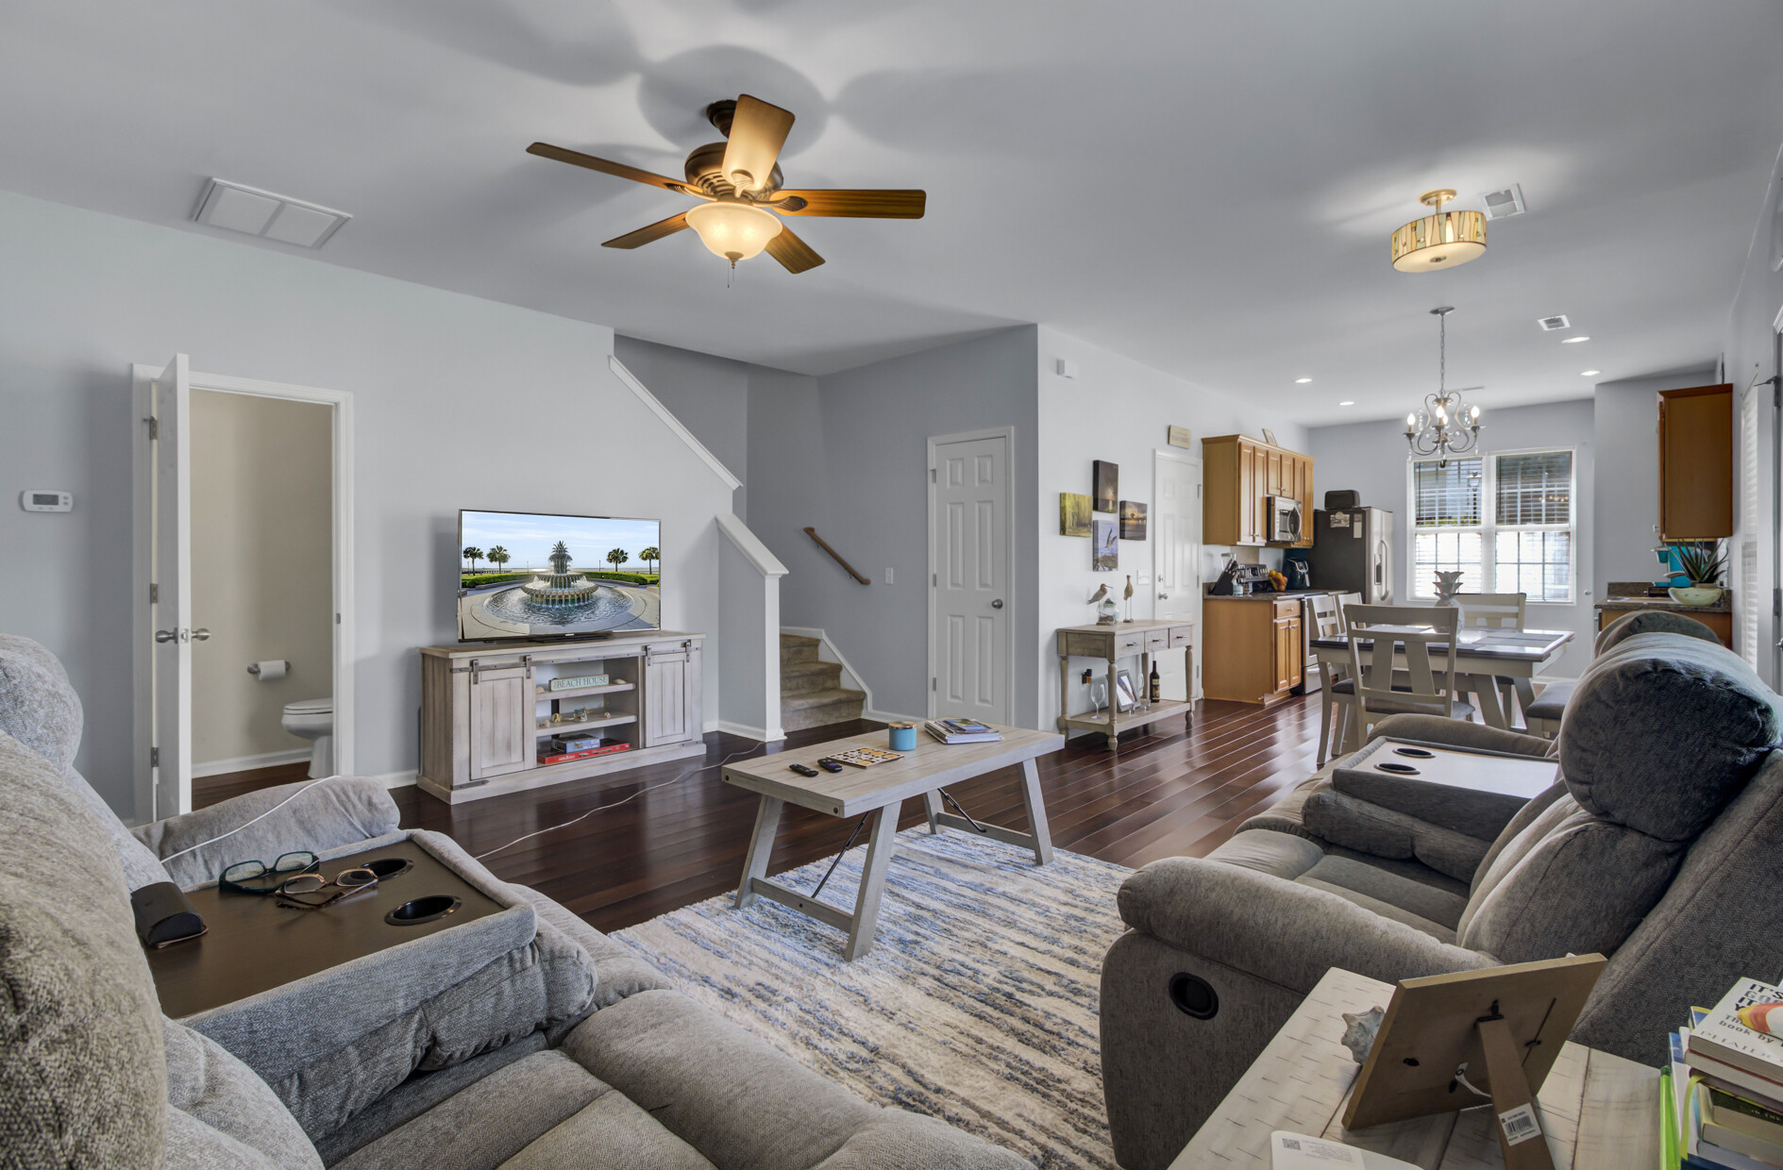
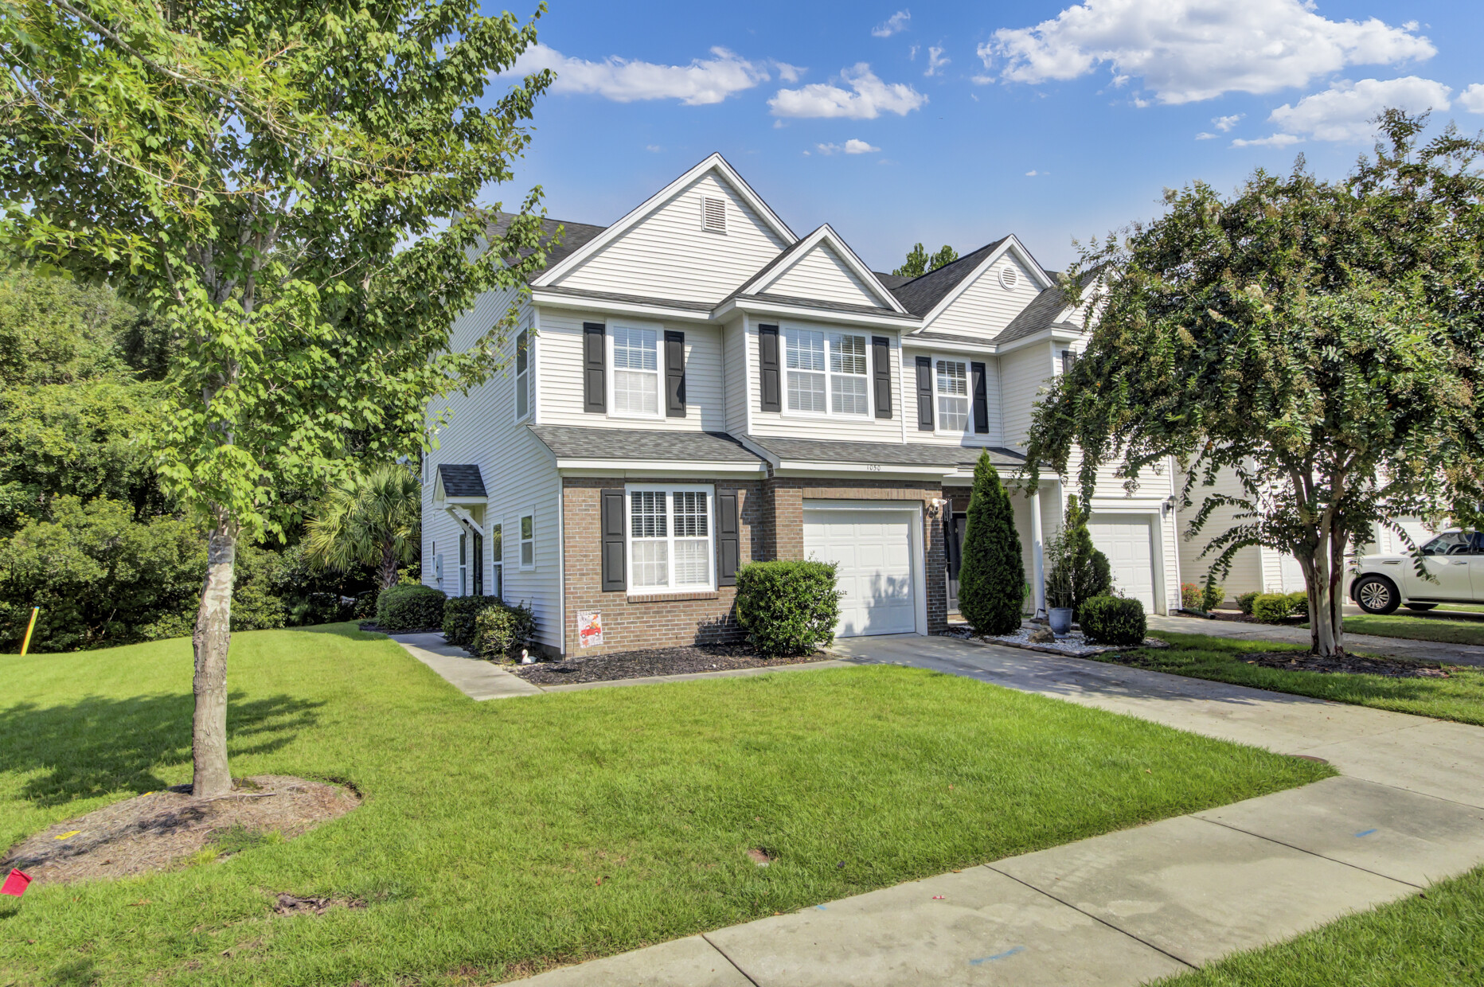
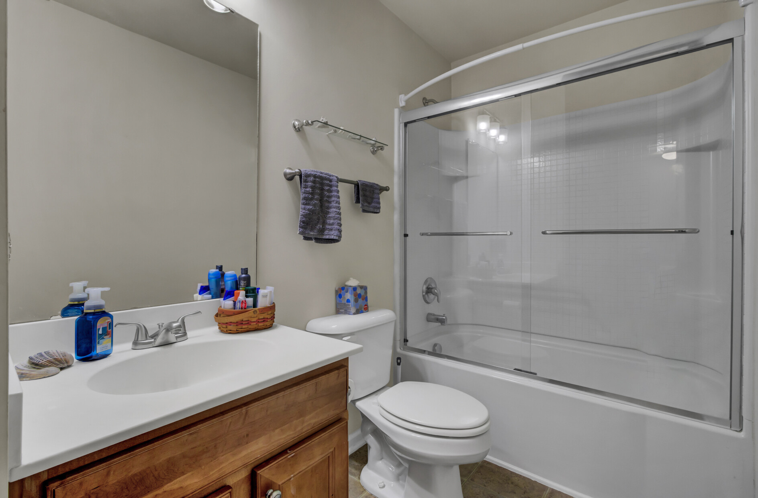
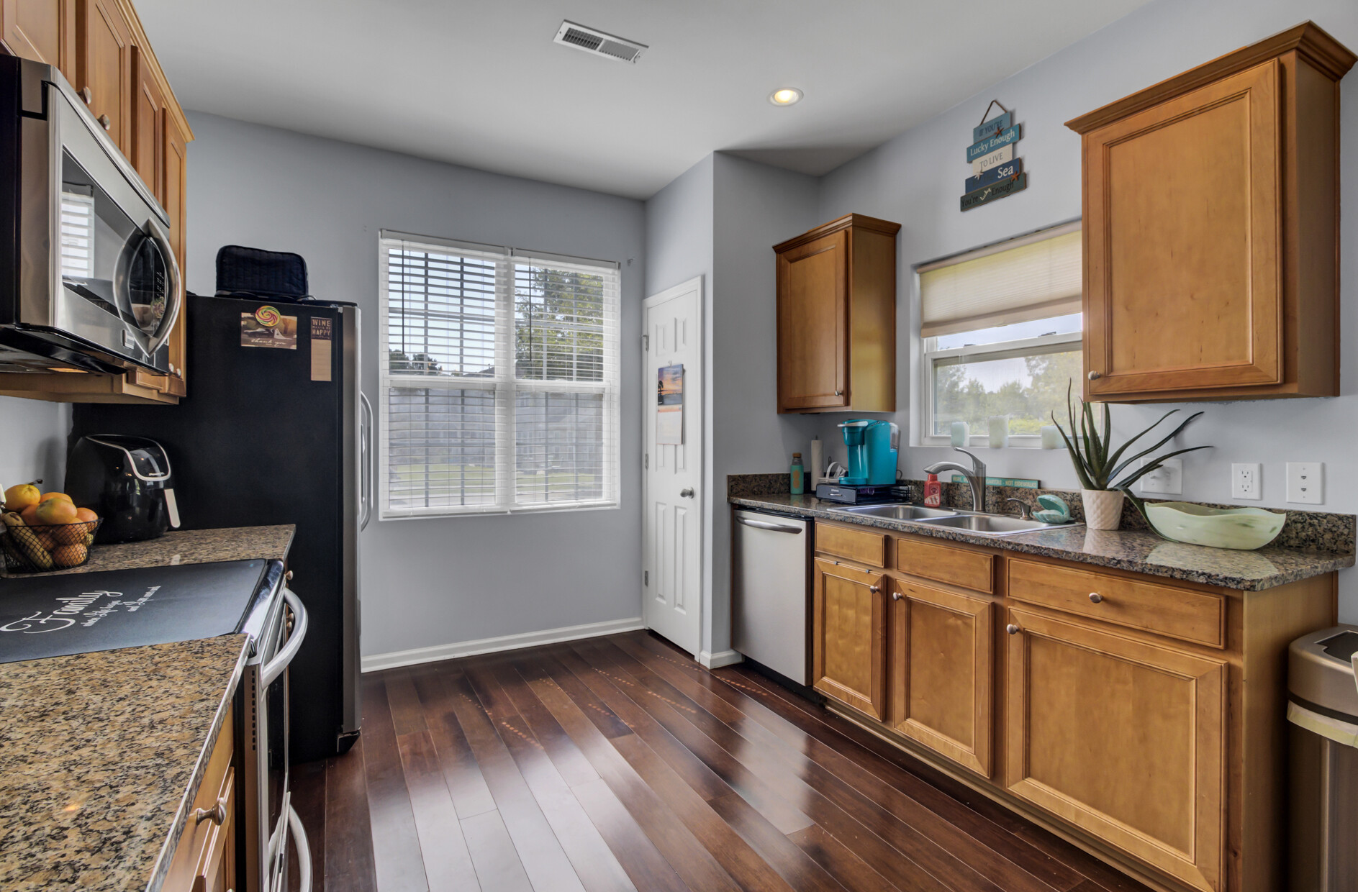
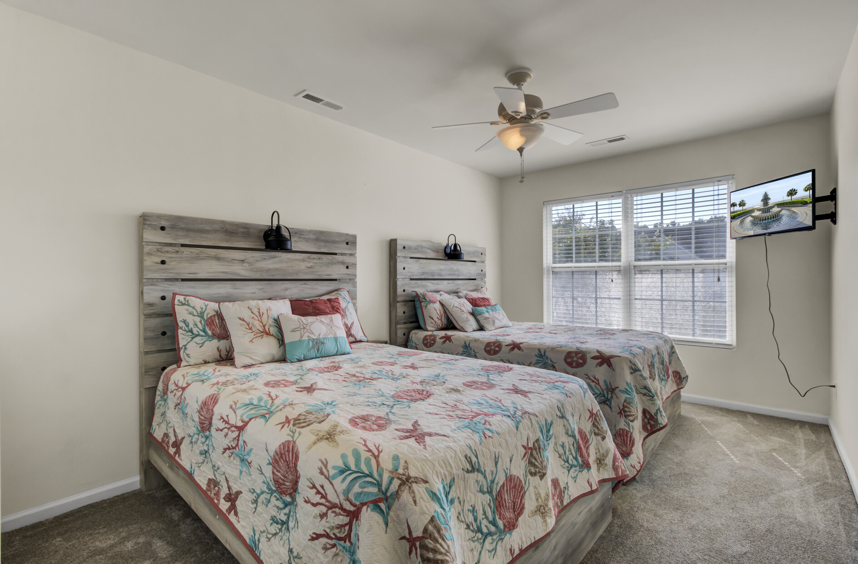




NEW IMPROVED PRICE DUAL PRIMARY SUITES
1050 Bennington Drive
Cain Crossing
Charleston, SC 29492
MLS# 23019195 | $449,900
Video Tour
Come check out this hot listing in the popular, rapidly developing area between Daniel Island and Mt. Pleasant!
An end unit townhome with DUAL PRIMARY SUITES!
Cain Crossing is a townhome community with a pool and their monthly fees are UNDER $200. This is a rare floor plan with so much to offer.
Schedule tours through ShowingTime! Questions??? Contact Ellen O'Neil 843-300-8530
Take a video tour of the property!
Ellen O'Neil
Broker/Owner, ABR, e-PRO, CNE
Charleston Realtor of Distinction
(843) 300-8530
www.EllenONeilProperties.com

