Slide 1

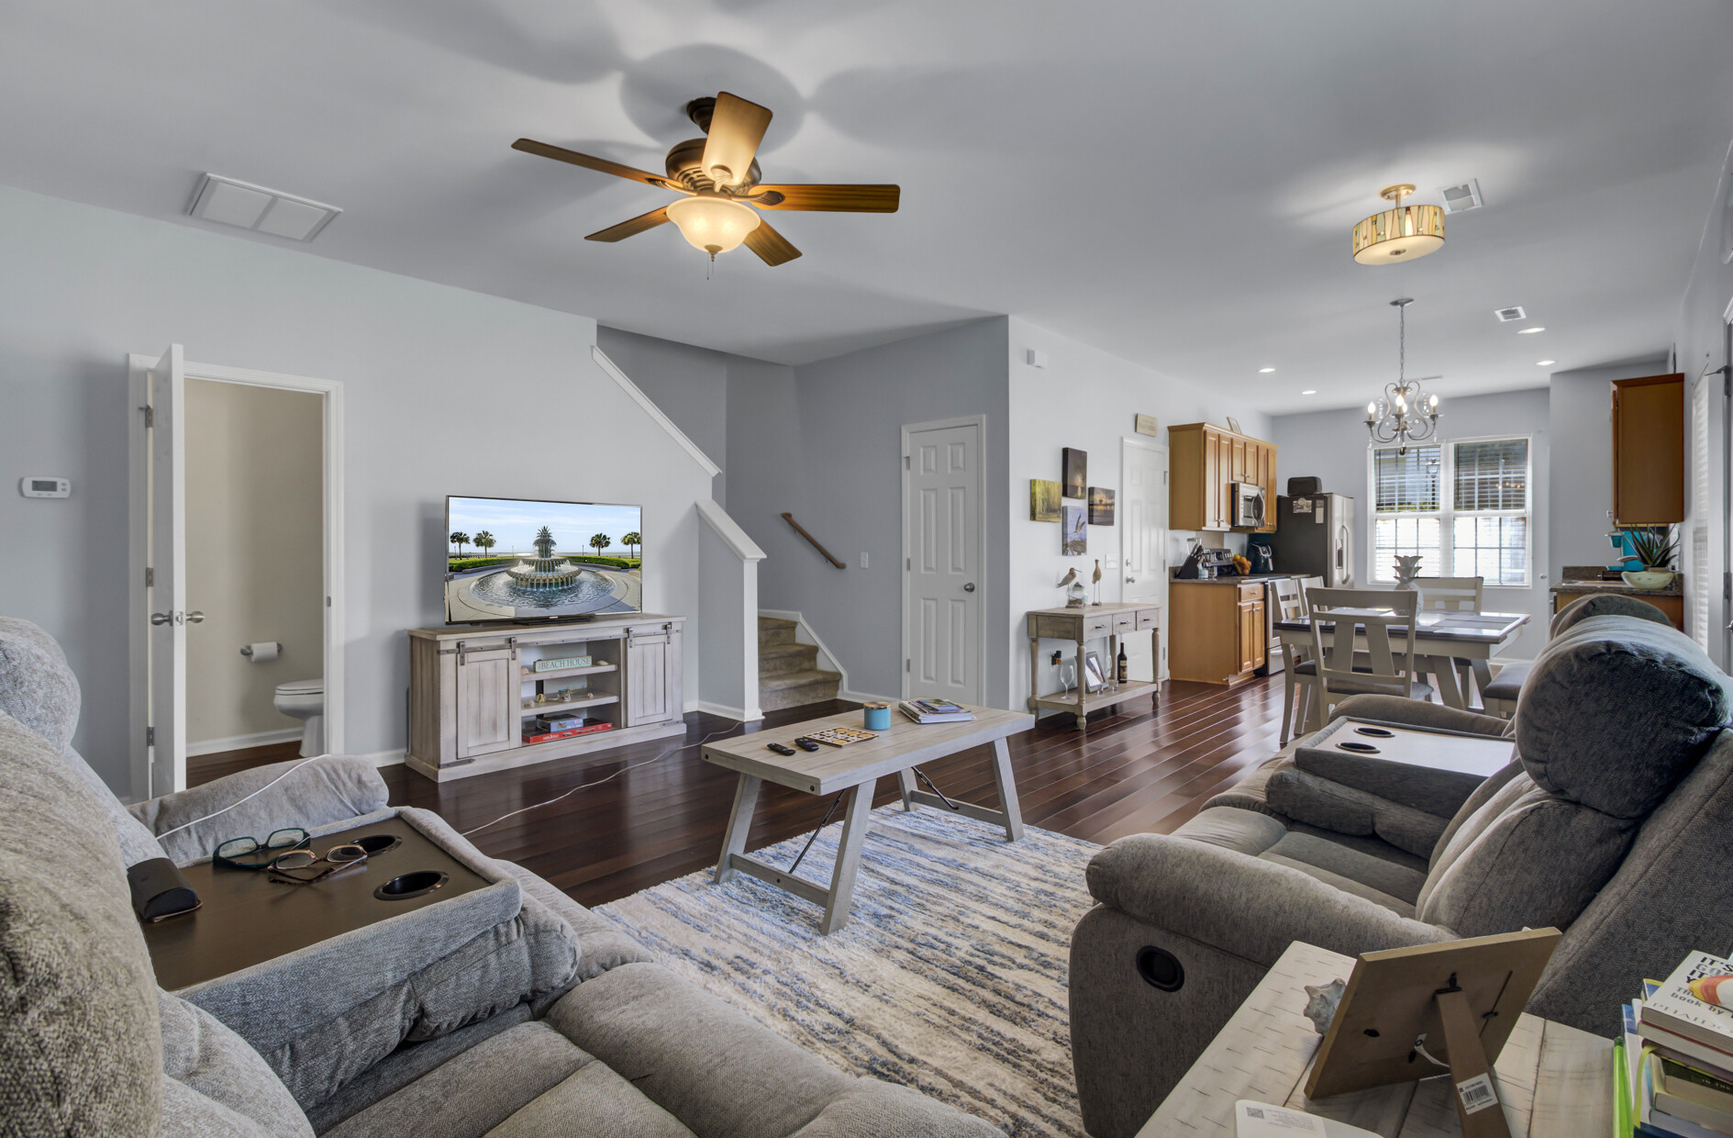
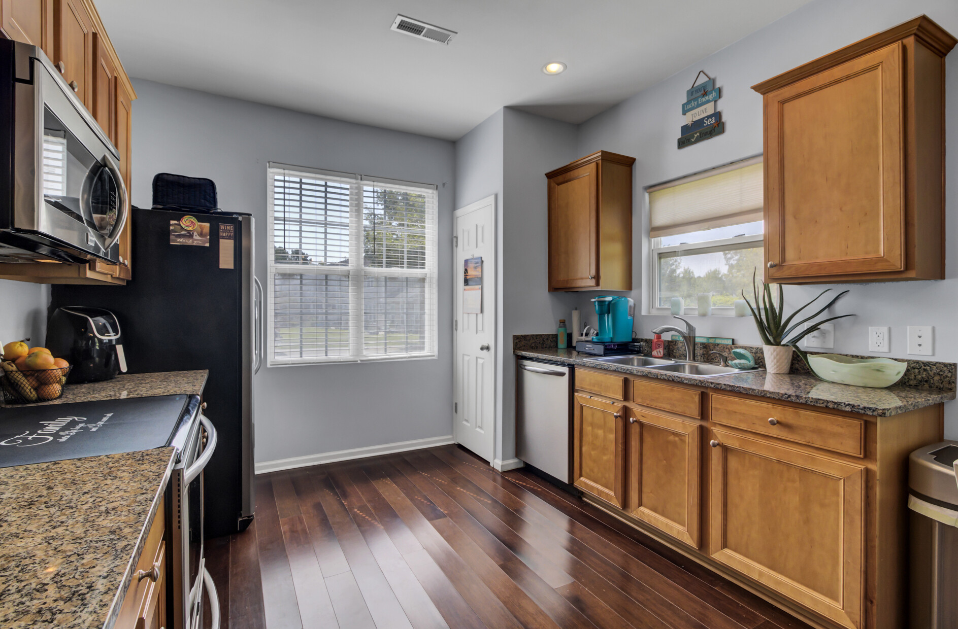



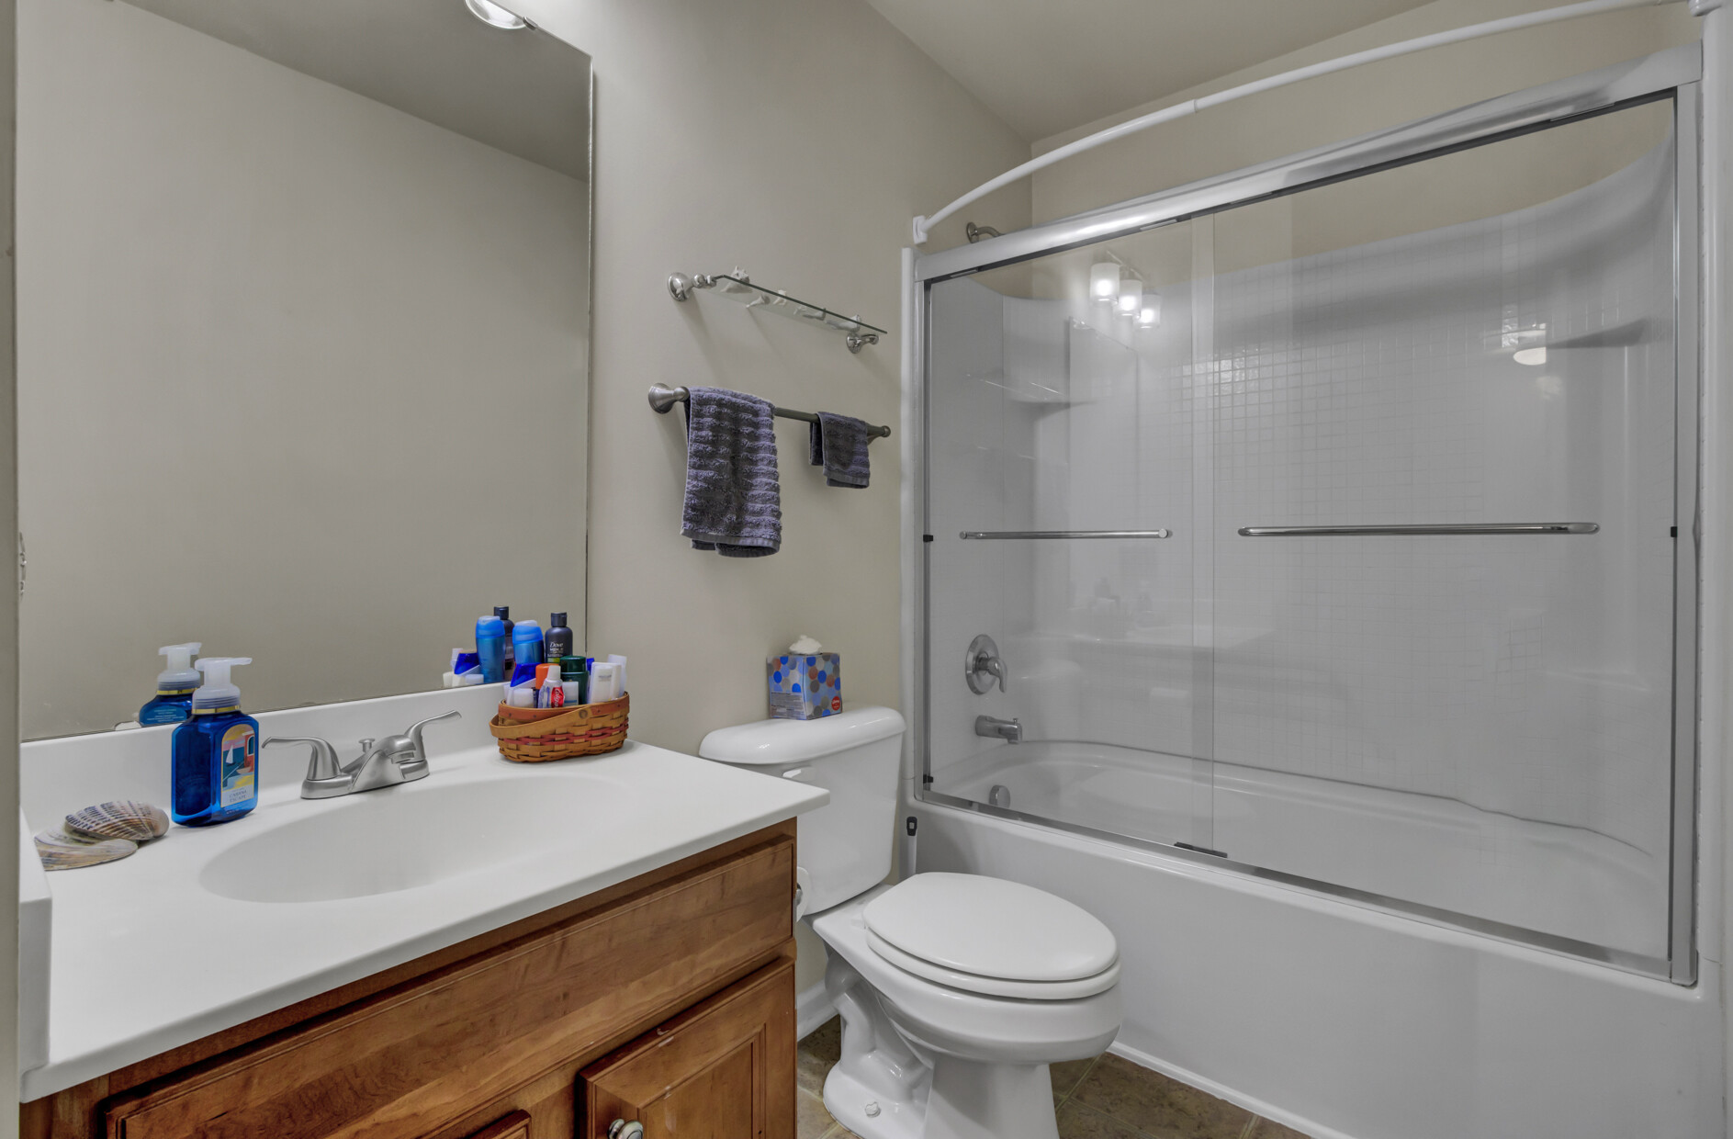


PRICE REDUCED!
Video Tour
1050 Bennington Drive
Cain Crossing | Charleston, SC 29492 | MLS# 23019195 | $415,000
Send your buyers to this Open House Sunday, Jan. 21st!
Awesome end unit in Cain Crossing with DUAL PRIMARY SUITES! Sellers are motivated so they dropped the price on this turn - key townhome. Cain Crossing is located off Clements Ferry Road and offers amenities like a pool, playground, and dog area. Students are zoned for the newer Phillip Simmons Schools and location is convenient to both Mt. Pleasant and Daniel Island.
Take a video tour of the property!
Ellen O'Neil
Broker/Owner, ABR, e-PRO, CNE
Charleston Realtor of Distinction
(843) 300-8530
www.EllenONeilProperties.com

