Slide 1
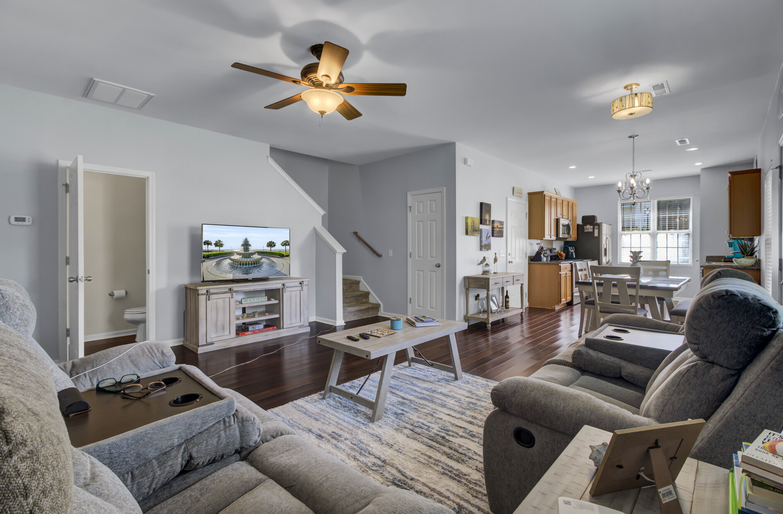
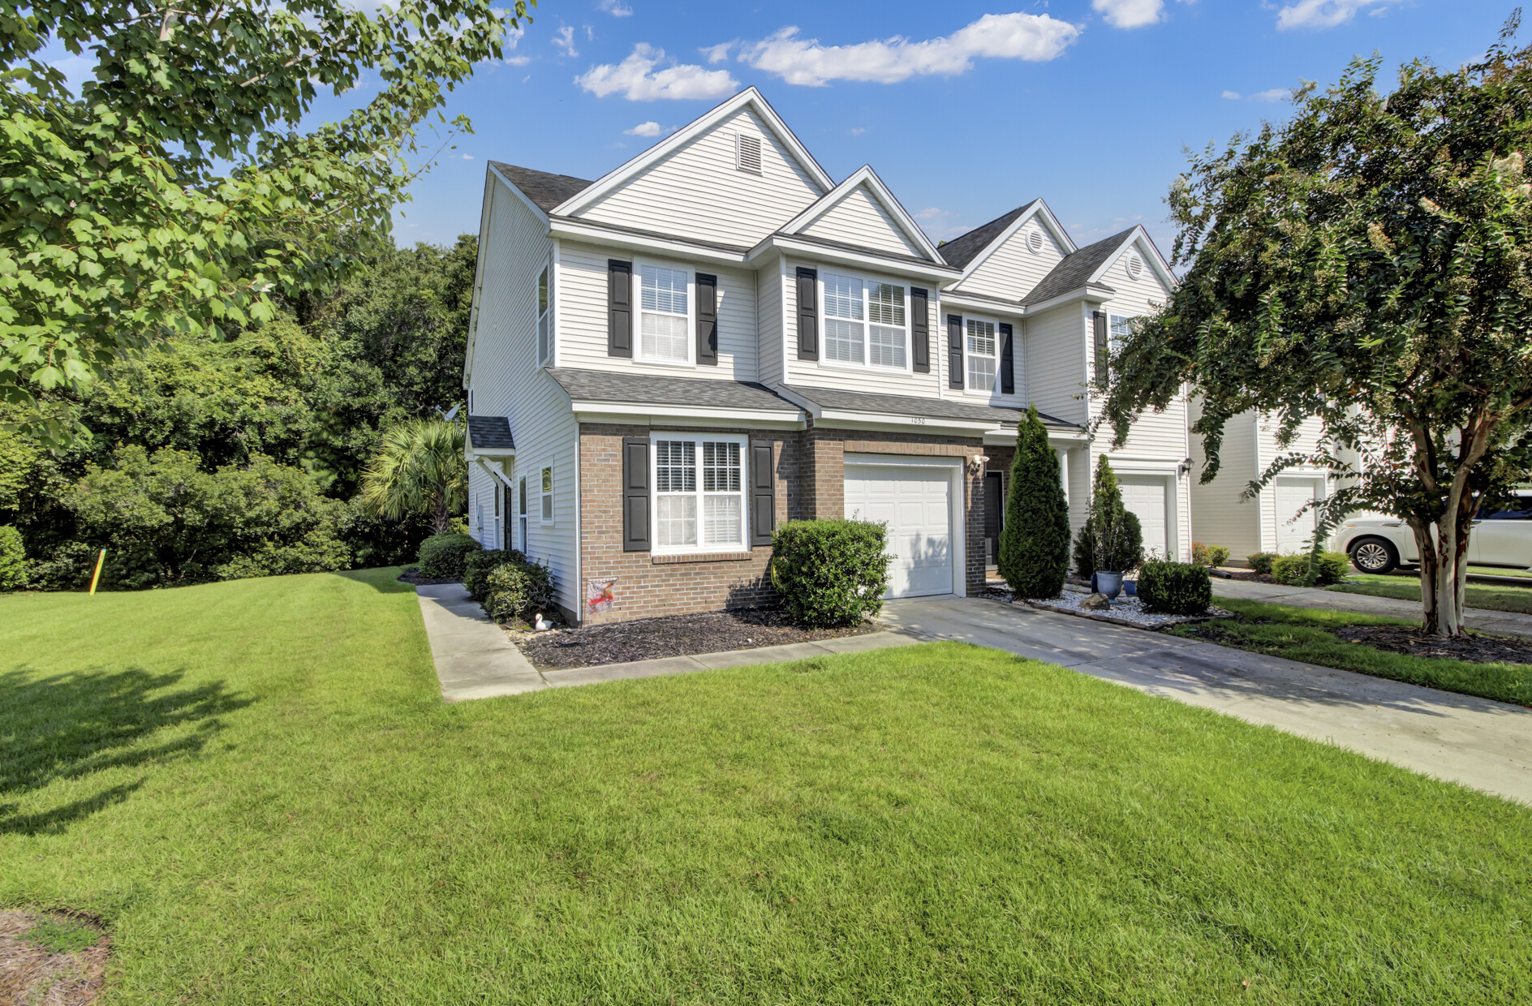
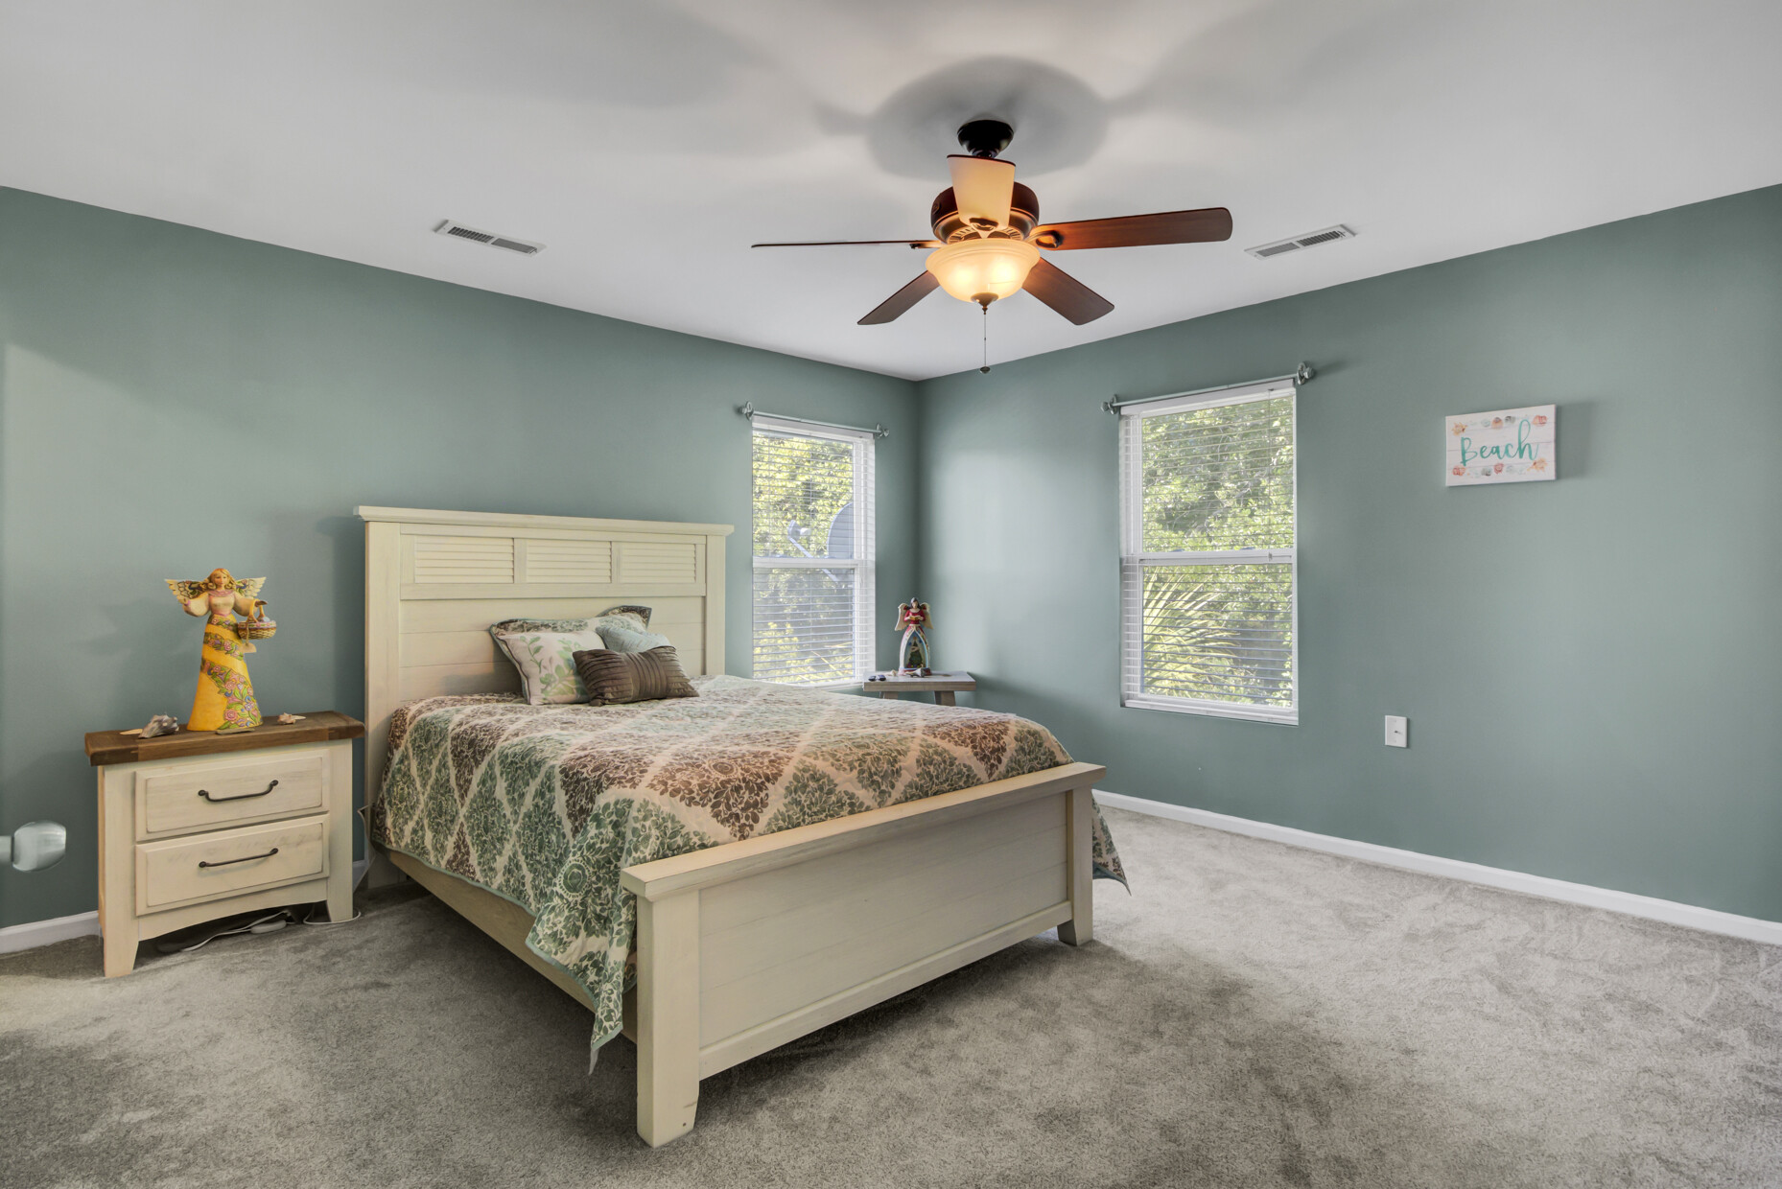
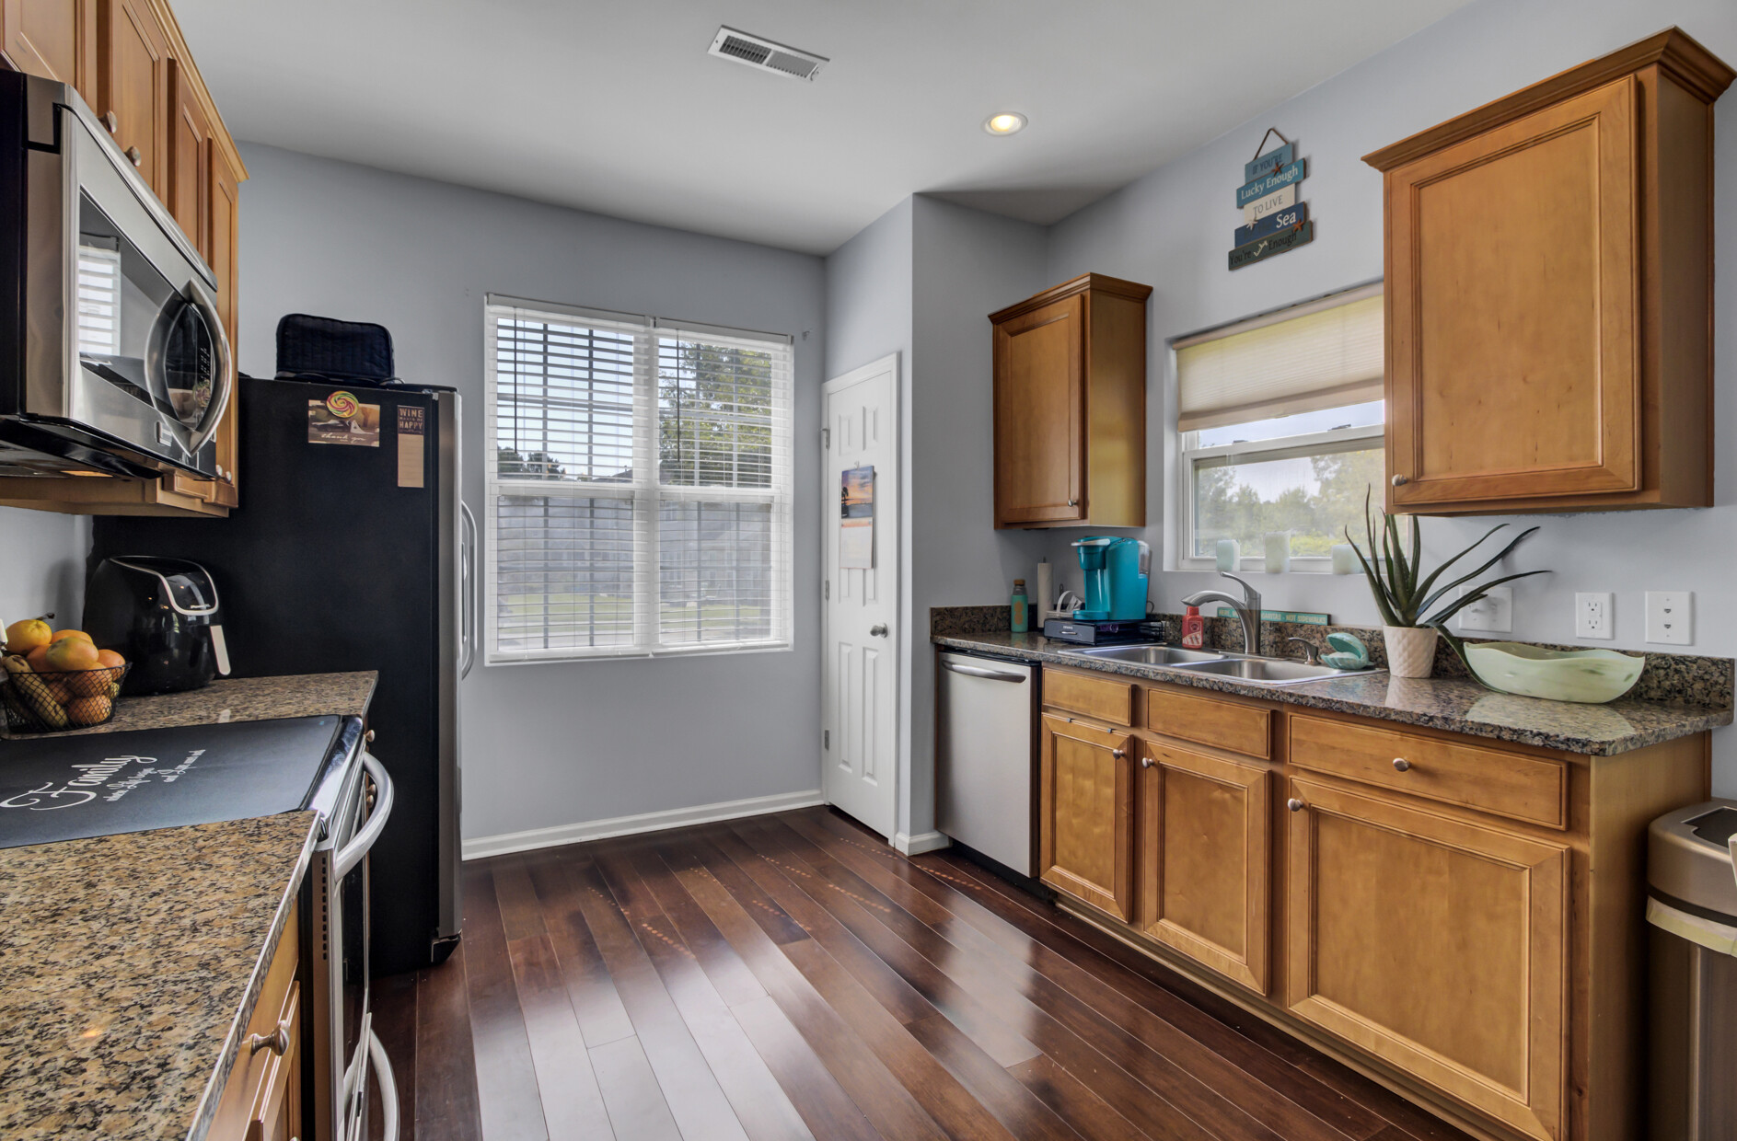
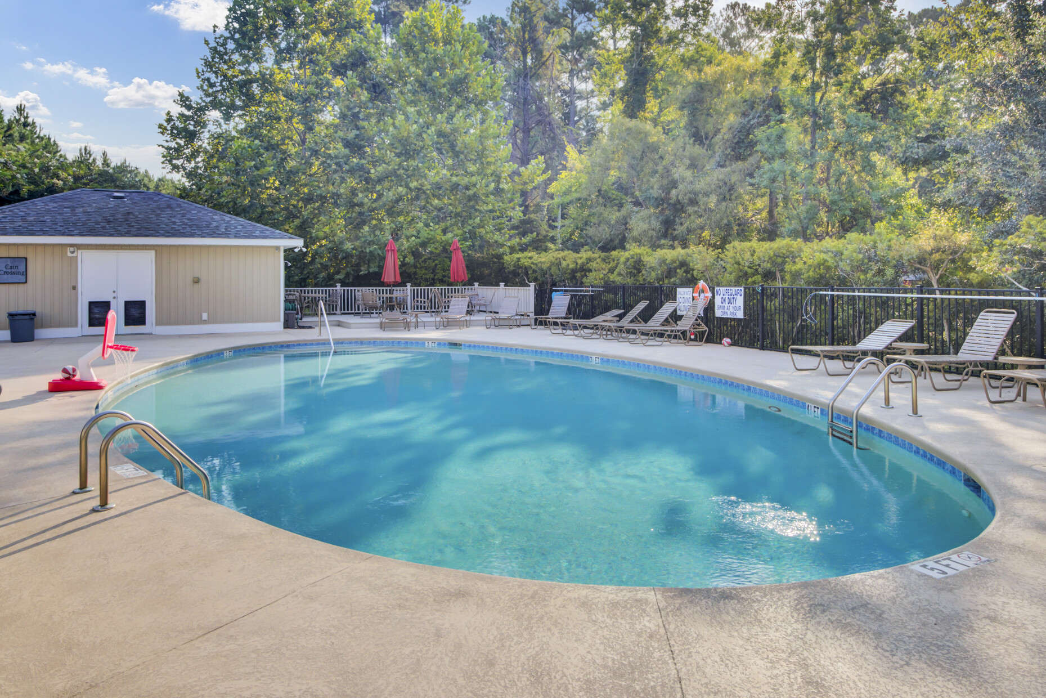




Hot New Listing!
Open House Sunday Sept 3rd from 11-2
1050 Bennington Drive
Cain Crossing
Charleston, SC 29492
MLS# 23019195 | $455,000
Video Tour
Hard to find end unit with DUAL PRIMARY SUITES in sought after Cain Crossing Townhome Community.
Beautiful finishes in this immaculate home in a community with amenities.
Unbeatable location- nestled between Mt Pleasant and Daniel Island.
Call Ellen with questions and schedule your tour while this opportunity exists!
Take a video tour of the property!
Ellen O'Neil
Broker/Owner, ABR, e-PRO, CNE
Charleston Realtor of Distinction
(843) 300-8530
www.EllenONeilProperties.com

