Slide 1

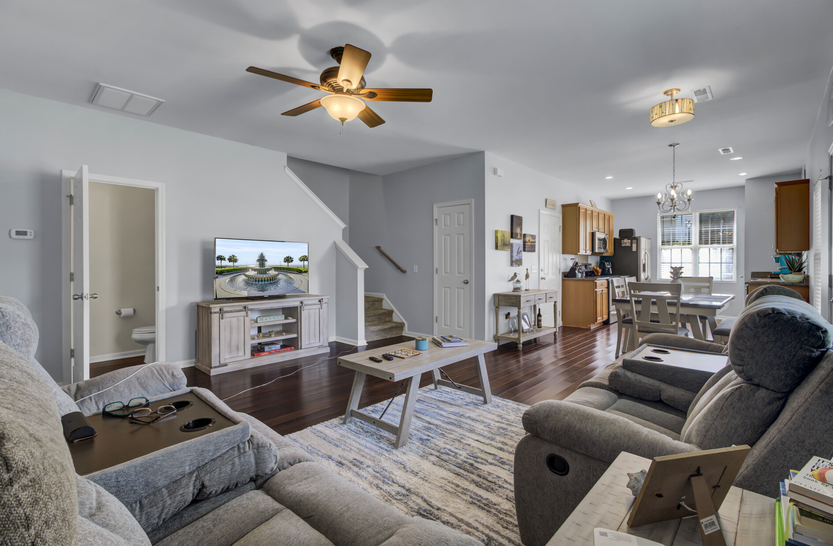
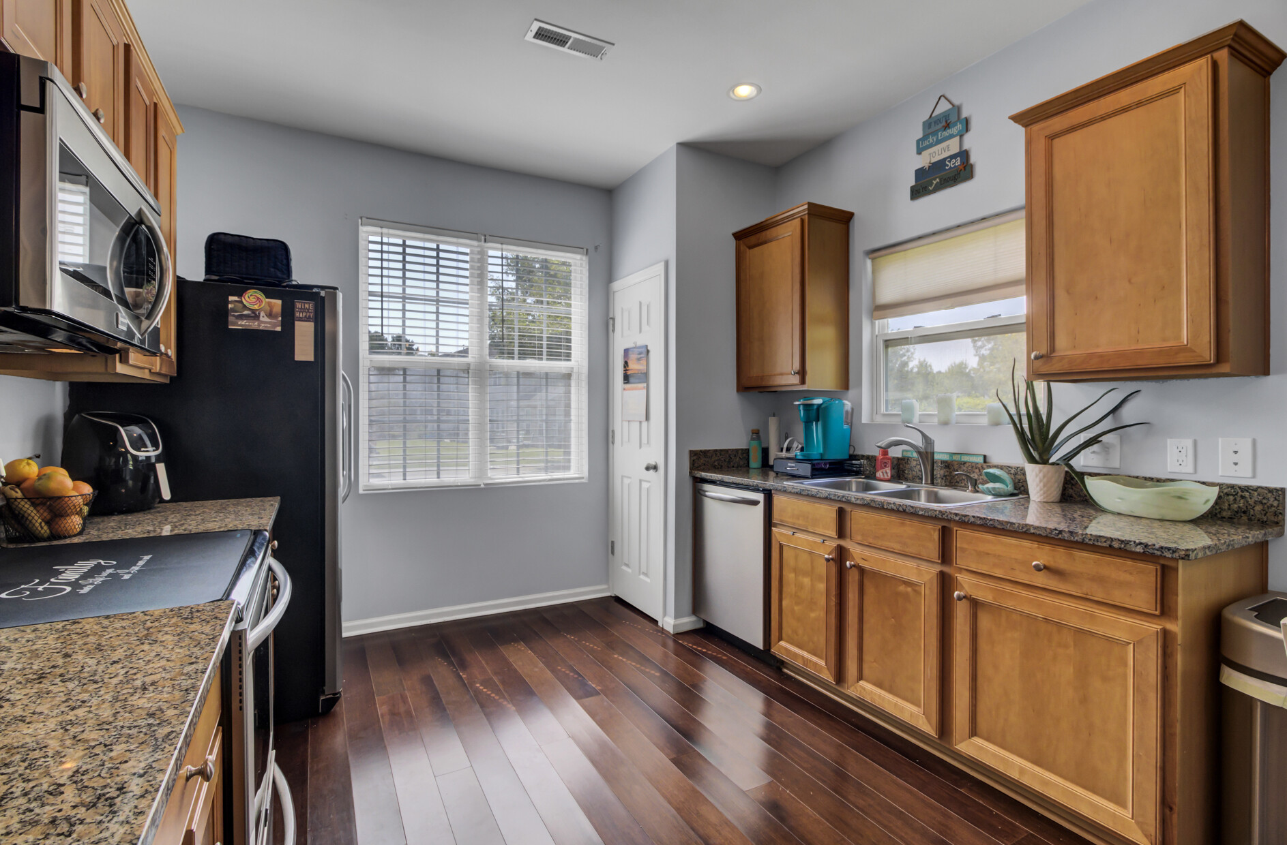

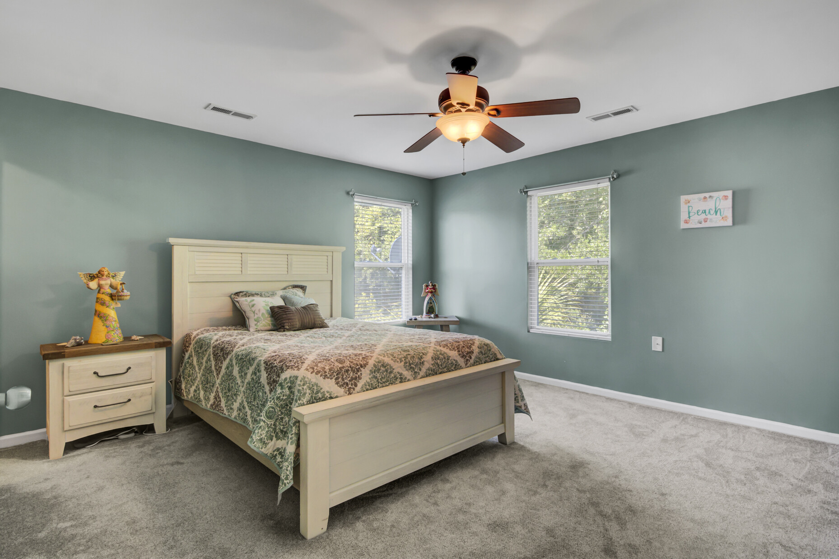

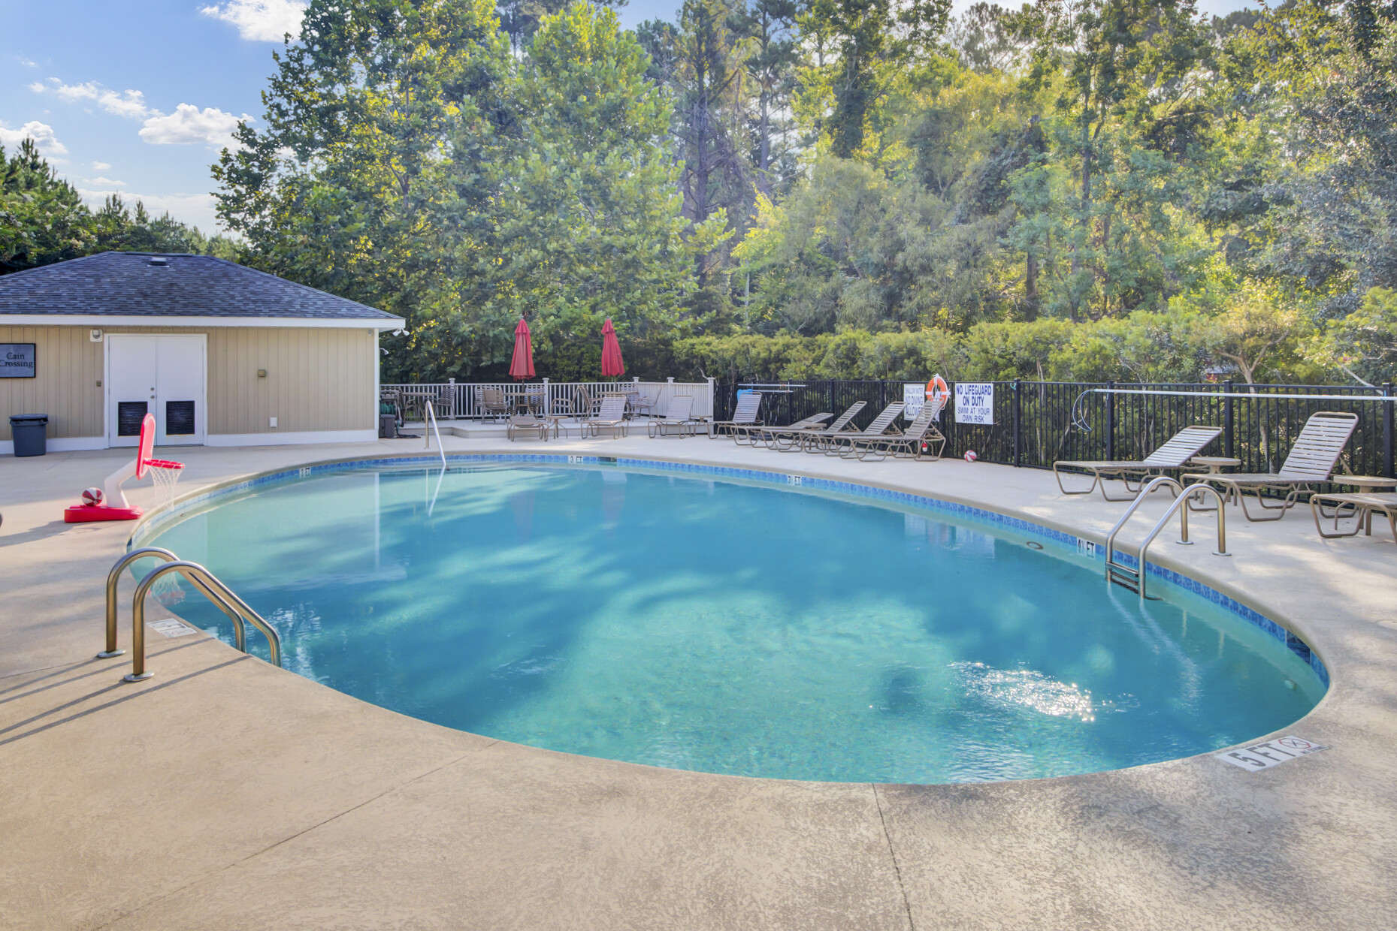


PRICE REDUCED!
Video Tour
1050 Bennington Drive
Cain Crossing | Charleston, SC 29492 | MLS# 23019195 | $439,900
Rates have dipped just in time to make this HOLIDAY DREAM COME TRUE! A Rare find- Dual Primary End Unit in Cain Crossing!
This turn key townhome is ready for new owners. Price has been reduced and this is a prime location (nestled between Daniel Island and Mt. Pleasant in the Phillip Simmons School zone).
Community amenities include a pool, play area, doggie play area… HOA fees are only $193 a month. Don’t wait! Have your clients pop into the open house and they can call you to write their offer.
Take a video tour of the property!
Ellen O'Neil
Broker/Owner, ABR, e-PRO, CNE
Charleston Realtor of Distinction
(843) 300-8530
www.EllenONeilProperties.com

