Slide 1

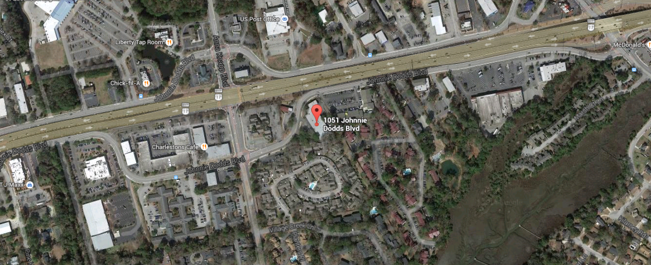
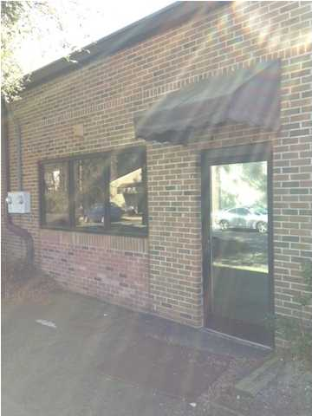
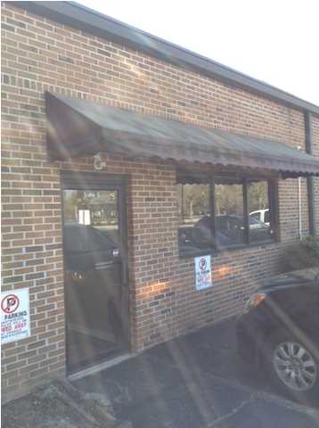
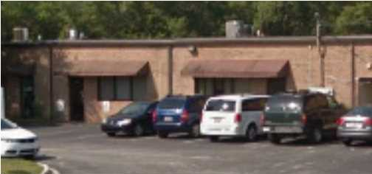
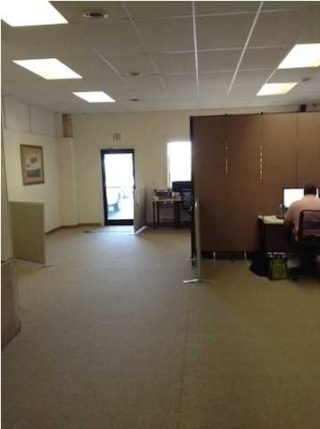
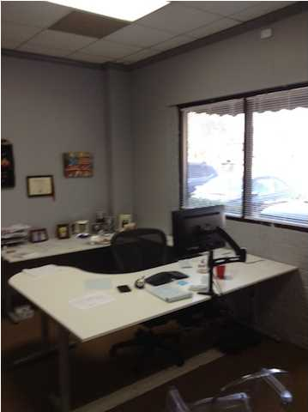

CENTRAL MOUNT PLEASANT LOCATION
COMMERCIAL/OFFICE FLEX SPACE
2,147 square feet for sale and price has been reduced to $369,000. This space is set up with two offices off one side and a larger office off to the left, each with direct access to the rear parking area. There is also a large open area that is equipped with counter space and a sink. This is a very flexible space that is presently set up as office use. Parking is just outside the door and the property is adjacent to Crickentree Plaza. Landlord will pay the property taxes. Tenant will pay $1.85 psf which included common area charge and insurance run by the regime association. This center has been revitalized with a good tenant mix recently.
Acres: 0.050
Address: 1051 N JOHNNIE DODDS BLVD
Area: CHS-Mt.Pleasant South of IOP Connector
Building Square Feet: 2147
Category: details
City: MOUNT PLEASANT
County: Charleston
Listing ID: 1410206
Listing Price: $369,000

