Slide 1
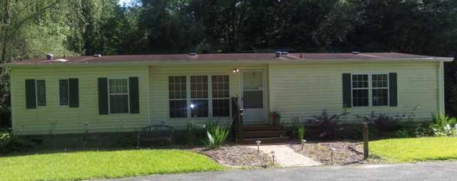
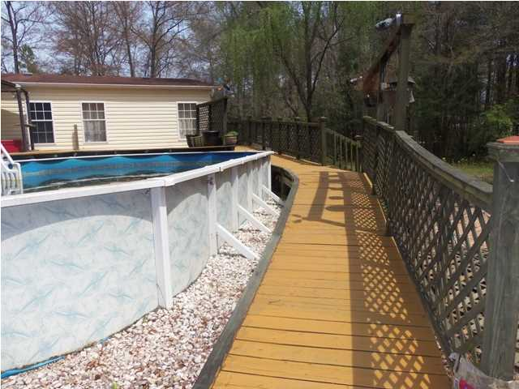
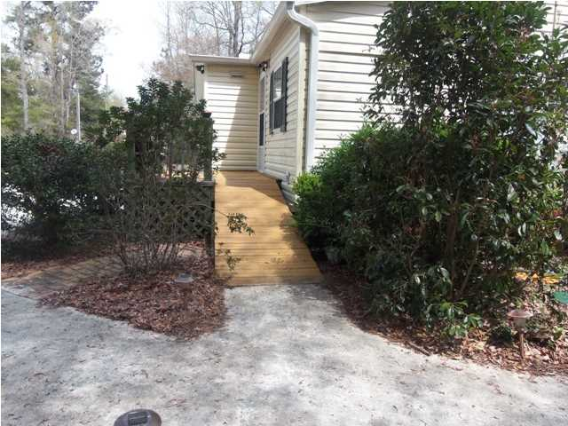
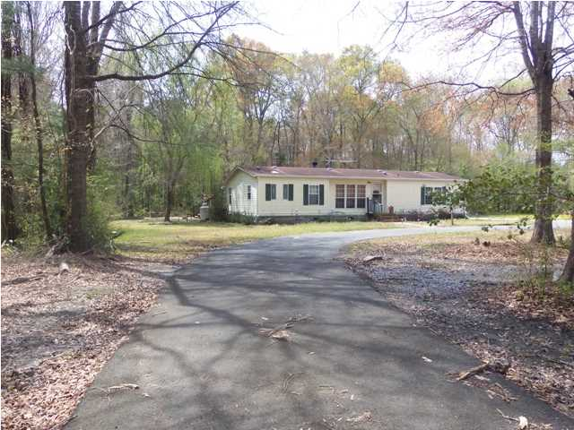
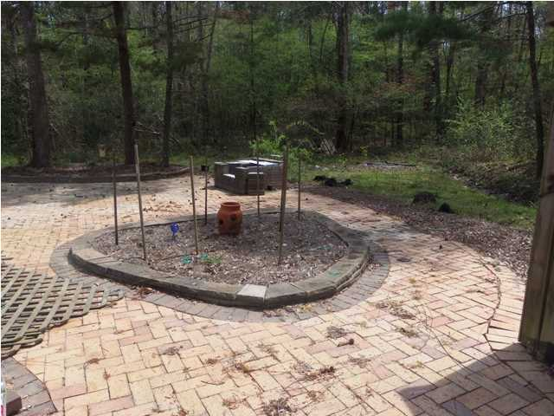
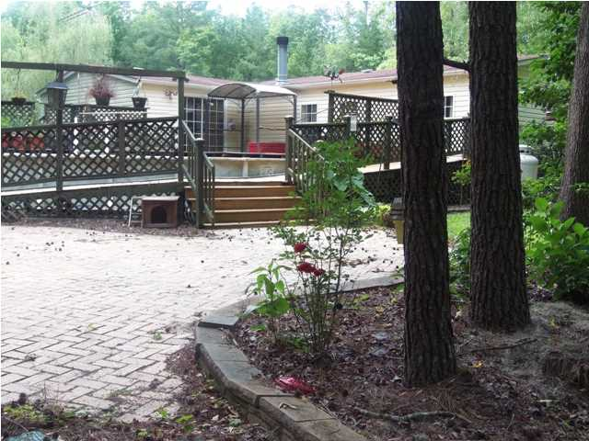
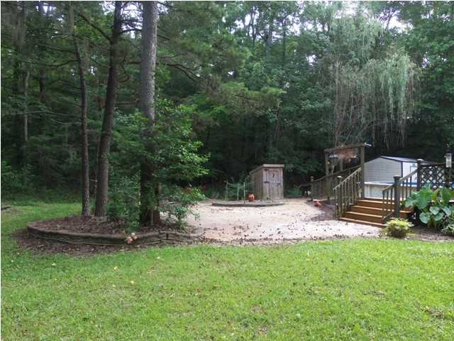
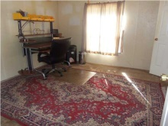
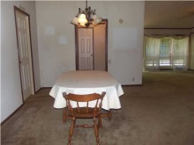
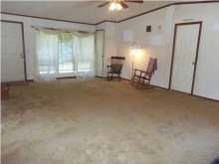
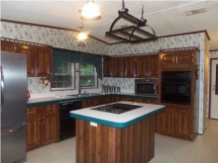
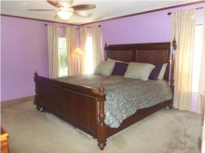
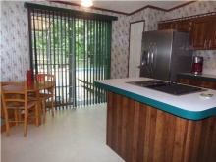
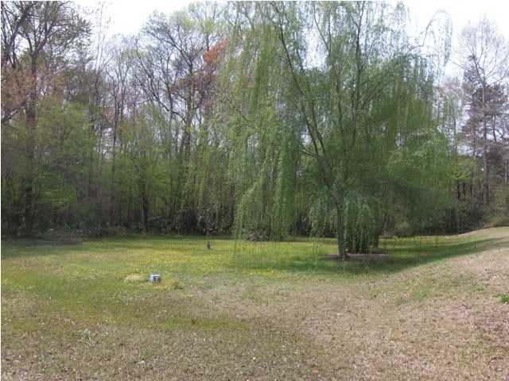
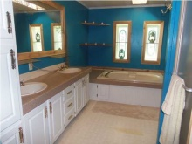
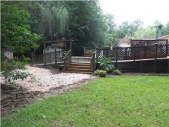


1051 Sandy Run Cir
Summervale Acres
Summerville, SC
MLS# 1302714 ~ $159,000
Great Country Property
This country property greets you with a large circle drive. When you step out of your vehicle, you quickly notice the peacefulness and privacy. The property has almost 5 acres of land, mostly wooded and is right off a paved road...only minutes away from hwy 16 (Jedburg Rd.) and 15 minutes from Downtown Summerville. This 3 bed, two bath double wide manufactured home is in good condition. When you walk into this home you will notice the open floor plan that invites comfort. There is an inviting remote controlled gas fireplace in the living room. The bedrooms have spacious walk in closets. The home features ceiling fans, a laundry room and pantry. The kitchen includes a GE grill style stove, a stainless steel side by side refrigerator, a hanging pot rack and a sliding glass door that leads out to the deck. When you walk out of the kitchen, you step onto a spacious and creatively designed deck that houses an above ground pool and grill area. The deck area is tastefully designed. It is completely handicap accessible and the deck descends around the pool. It is also described as a "wrap around" ramp. There is a 12 x 24 (approx.) siding storage building that co-ordinates with the siding on the home. The back yard also has a custom-built fire pit and an oyster pit. Mature trees and flowering shrubs surround this home. Exterior sensory and motion lights are set in place. The grounds have custom built French drains.The wooded acreage backs up to a small creek. (Sandy Branch Creek) If this sounds like something you have been looking for come see for yourself! *Home is in overall good shape. The owner requests to be sold as is.*
Cheri Hamner
M - 843-364-4325
O - 843-261-7115
cheri.hamner@agentownedrealty.com

