Slide 1
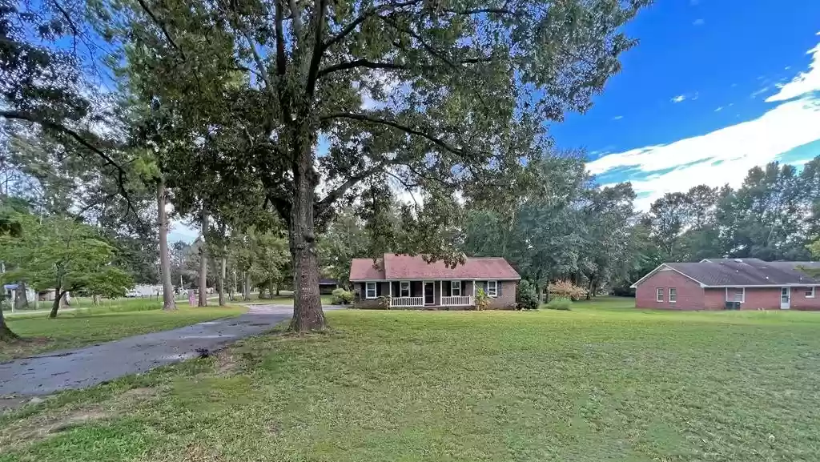
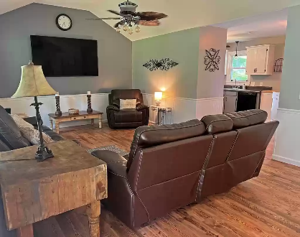
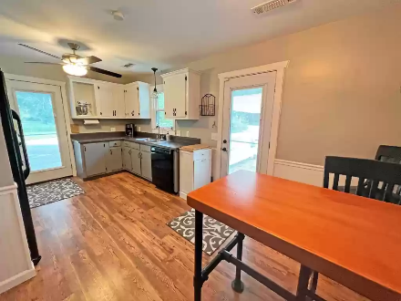
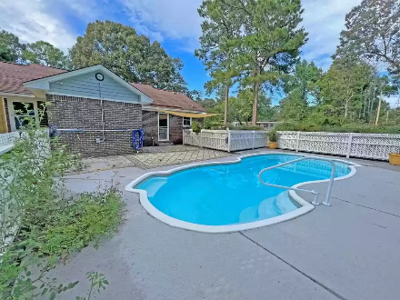


Waterview Under 250k
1051 Doyle St
Manning, SC 29102 ~ MLS# 152791 ~ $245,000
Lake Living at its best. Waterview from the front yard/porch. This brick ranch style home has been updated and is ready for you. Offering 3 bedrooms and 2 baths, large living room, and inground pool. This home sits out side of manning just off Hwy 260. The access to the lake is just mins down the road at private landings or Alex Harvin public landing. Relax in the pool on those steamy afternoons or sit in the shade under the large trees.
Lake Homes Realty, LLC
Elloree, SC 29047
www.SCLakeLife.com
Kristie Anderson
(803) 387-9459
kristie@sclakelife.com

