Slide 1
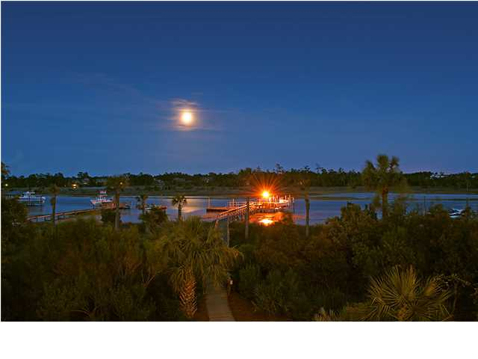
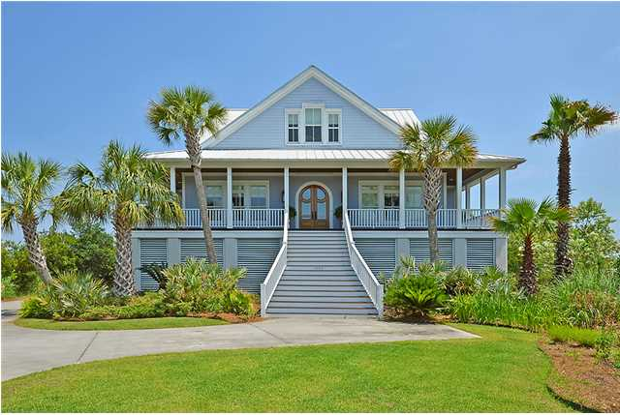
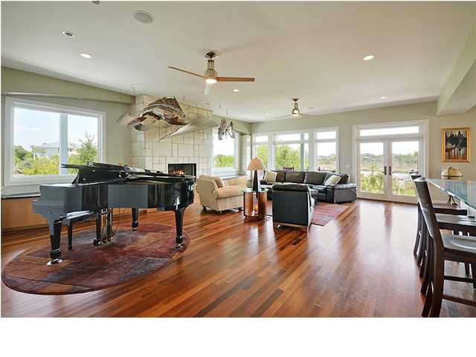
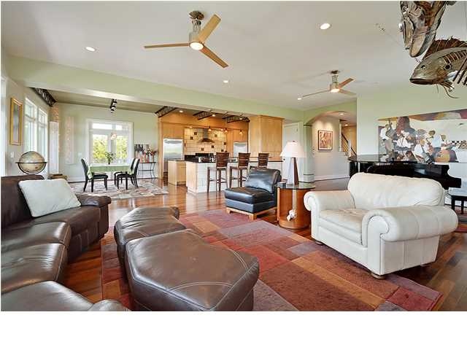
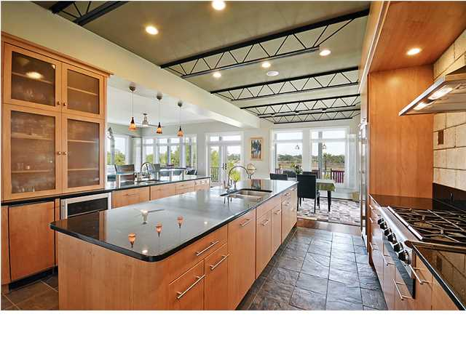
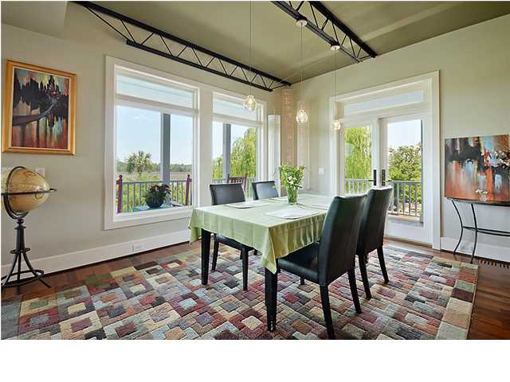
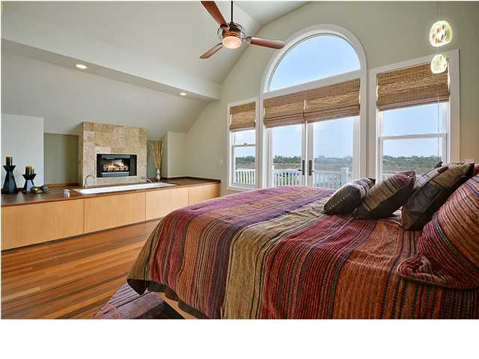
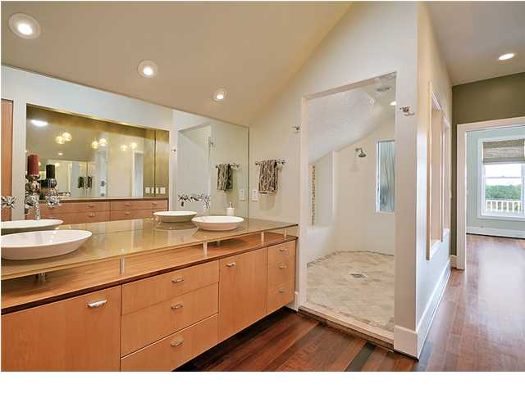
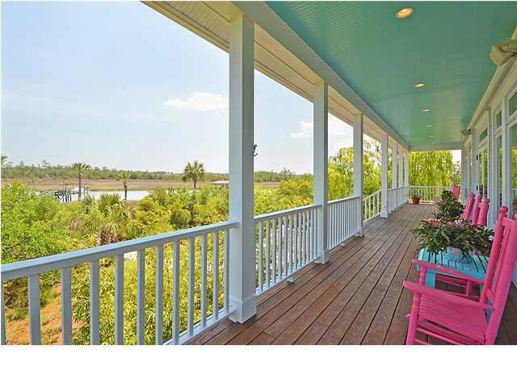
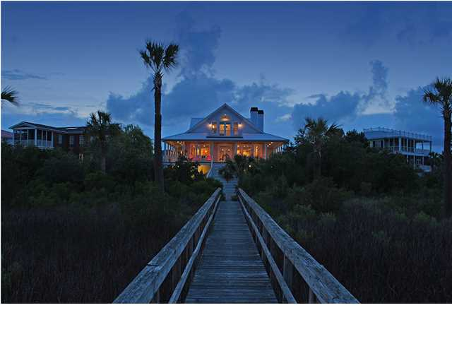

Price Reduced!
Postcard Perfection
1053 Rivershore Rd ~ Charleston ~ MLS# 1414358 ~ $1,495,000
Have you ever looked in a Better Homes and Garden magazine and thought "this looks too good to be true?" That's the feeling you'll get when you pull up to this riverfront home that offers close to 4,500 square feet of living area. Surrounded by lush landscaping on the .58 acre lot, you can enjoy the breeze from the many palm trees while sitting on the wrap around front porch or the back porch that looks to the water. Step through the custom, solid wood front door to find simply stunning Brazilian walnut hardwood floors and an open floor plan that you'll fall in love with. Archways between rooms and high ceilings create an inviting space. The top of the line kitchen features a Sub Zero refrigerator, a Sub Zero ice maker, a Sub Zero freezer, a six burner gas cooktop, two dishwashers, a built-in wine cooler, a warming drawer, granite counters, a center island and a breakfast bar. This exquisite space has an eat-in area and opens to the great room where there is a gorgeous fireplace, built-in surround sound, recessed lighting and windows everywhere that look out to the water. The light and bright feel continues into the master bedroom on the second floor where a palladian window pours sun into this room with its cathedral ceiling. Imagine waking up every morning and stepping out onto your own private deck and looking out to the peaceful water. Envision relaxing each night in the garden tub in your bedroom right in front of the fireplace. The en-suite bath is nothing short of amazing with a basin sink dual vanity and a massive walk-in shower. From the back porch, take a stroll down to your private dock and boat lift. If water activities float your boat, you can't get any closer to the action than this! This home has many other great features including upstairs and downstairs washer/dryer connections, a gas water heater, a water-filtration system for the whole house, an outdoor shower, gas grill hook-ups, and a deluxe musicians room. Bermuda shutters beautifully adorn the Marvin windows with high impact glass. This home also boasts the green features of foam insulation and bio-swales for the gutters and yard French drain system. Dog owners will love the invisible dog fence that spans the entire perimeter of the yard and even beyond the dock for those pups that can't resist the water. From the pictures you'll agree this home looks like a model home out of a magazine, but come by to see that it's the real deal.
Call or email for details: (843) 654-7777 or Matt@MattOneillTeam.com

