Slide 1
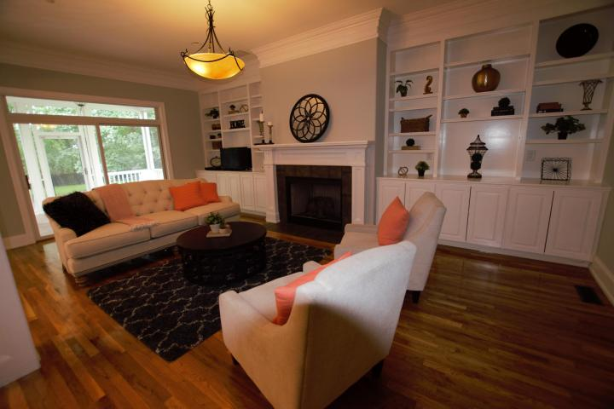
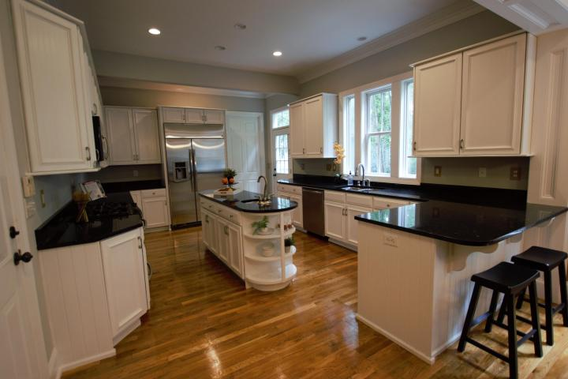
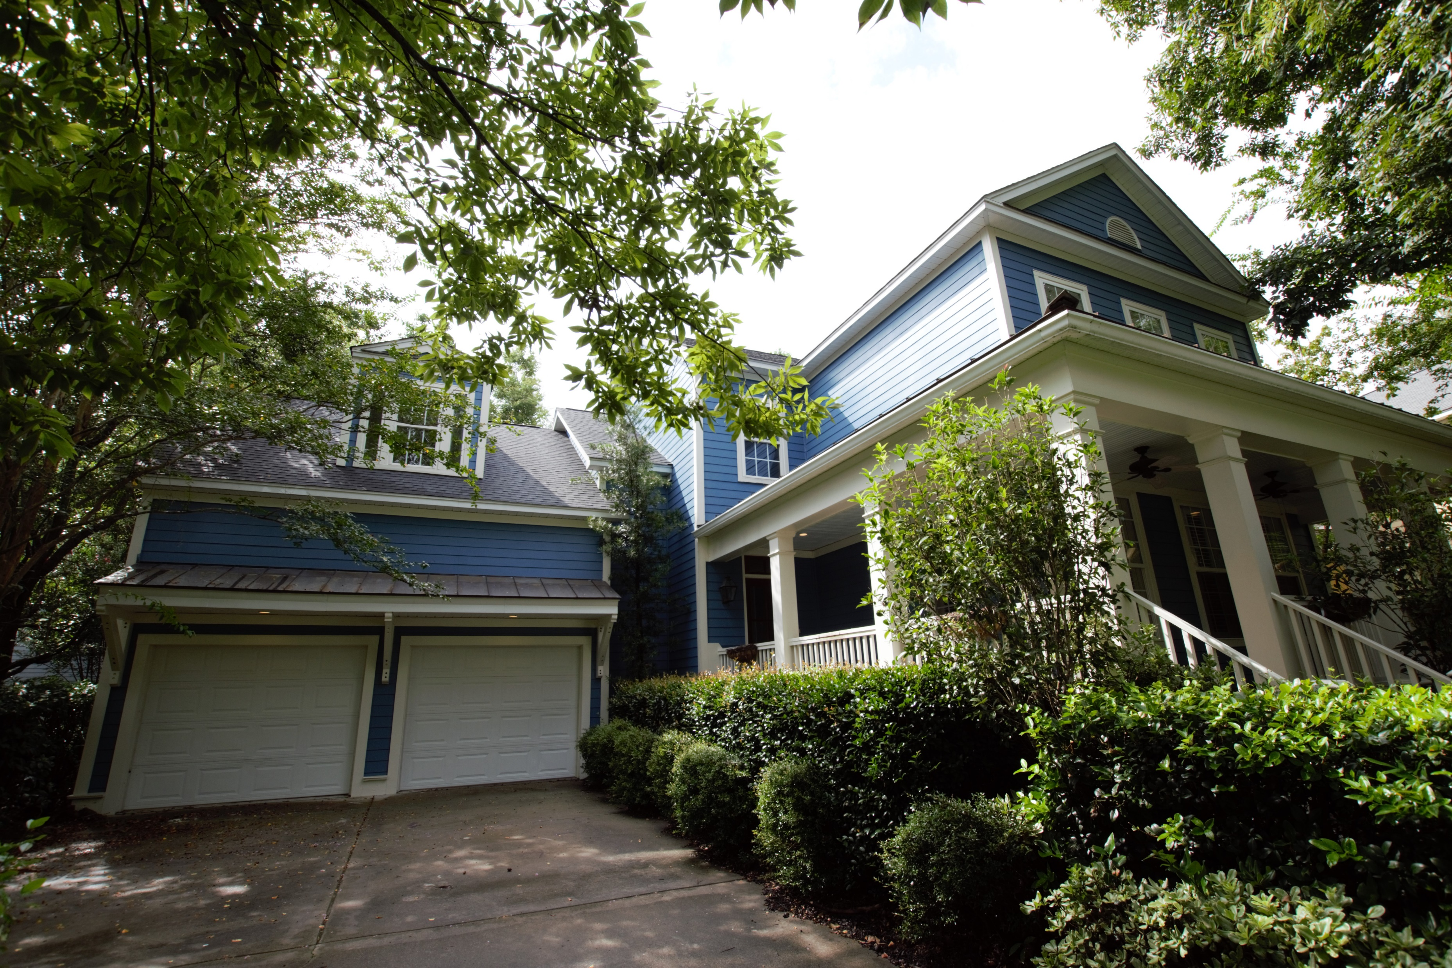
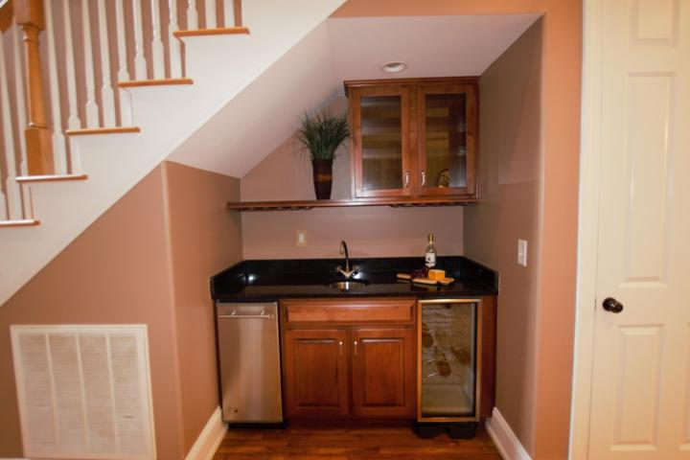
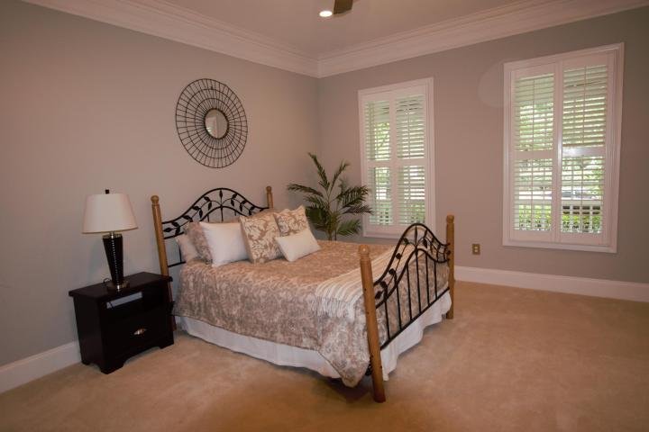
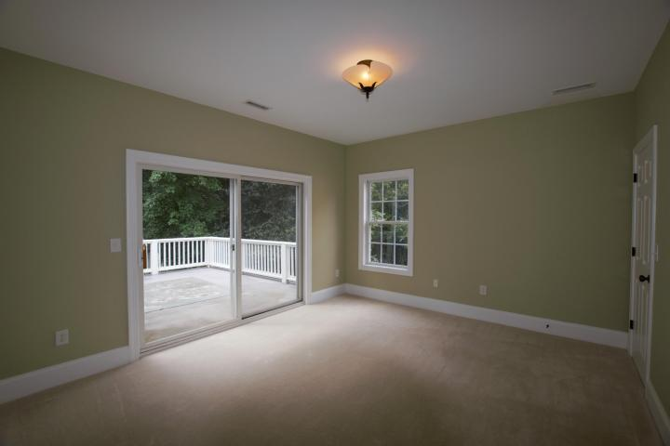
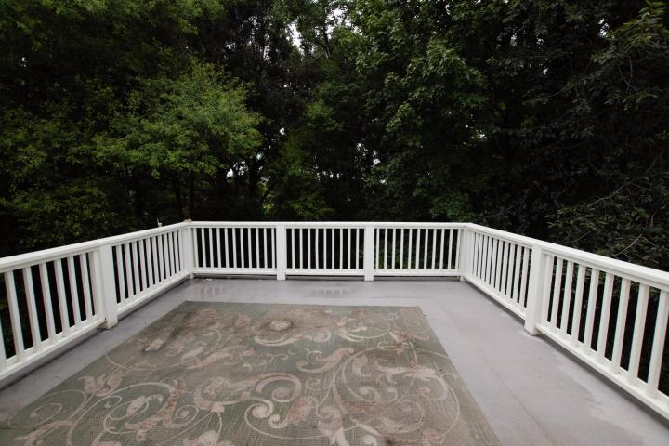
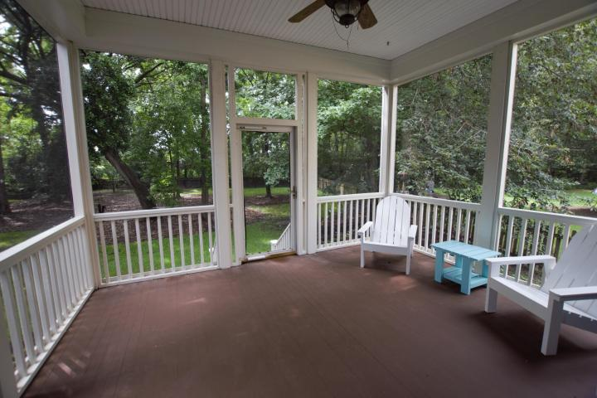
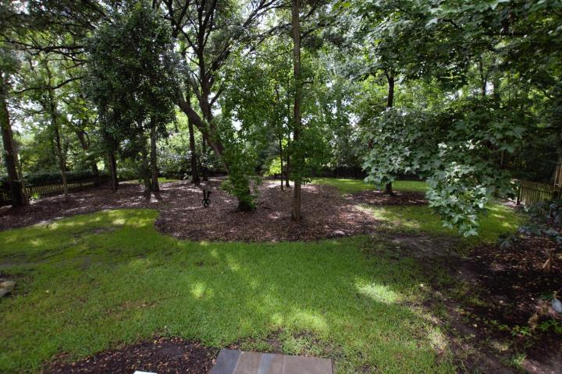
1054 Blakeway Street
Daniel Island ~ Charleston, SC 29492
MLS# 17021132 ~ $749,000
Welcome Home!
Welcome home to 1054 Blakeway St. Spacious, open floor plan, home on Daniel Island's own Rainbow Row. This five bedroom, 3.5 bath is filled with extras and quality workmanship. A full front porch welcomes you home and invites you to unwind. As you enter, gleaming, newly refinished hardwood floors and a distinctive Quoizel pendant style chandelier mark the entry.
Downstairs you'll find a great room with built in bookcases and gas fireplace. High ceilings on both floors give an extra spacious feel. Close to everything Daniel Island has to offer; highly rated schools, shopping, restaurants and more. Extra large fenced backyard gives the kids plenty of room to play. Community offers neighborhood pools, tennis courts and more!
Green area directly across offers a pleasant place to walk your dog!
Christopher Watson
(843) 471-0956
chris@chriswatson.com
Harbourtowne Real Estate
672 Marina Drive, Ste 110 | Daniel Island, SC 29492

