Slide 1
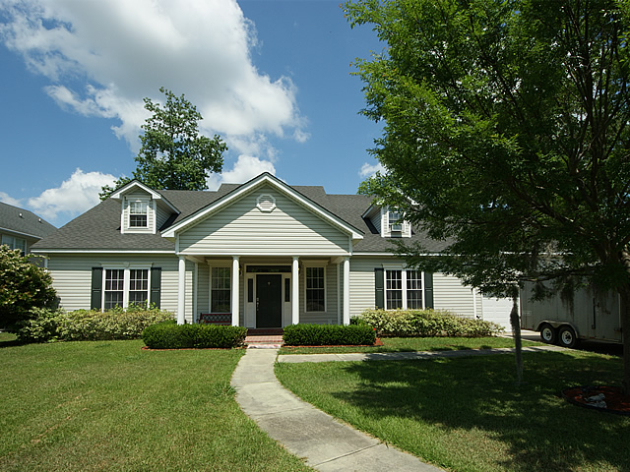
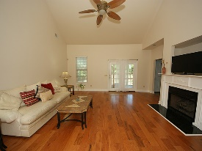
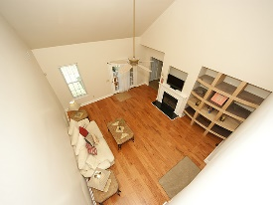
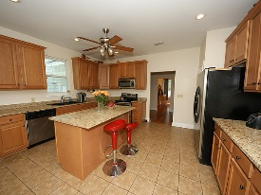
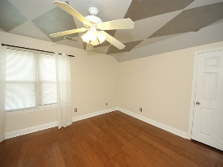
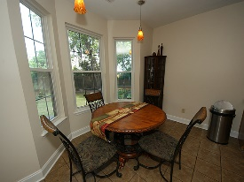
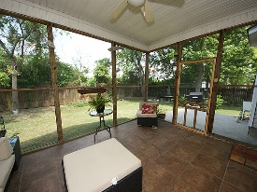
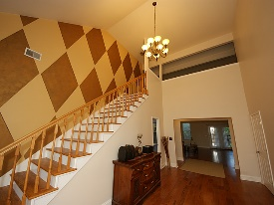
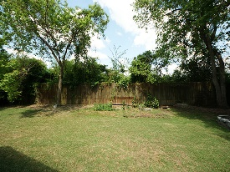
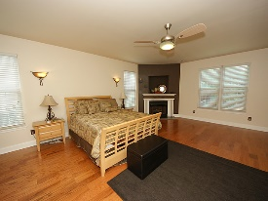
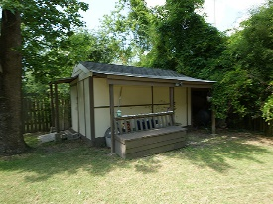

1054 Dominion Drive Dominion Hills Hanahan, SC 29410 MLS# 16005178 $369,000
$15,000 Reduction
– Location – Location –
This Spacious move-in ready 5 Bedroom 5 bath Newer home is located in Dominion Hills. 5 miles to Park Circle and just 7 miles to - Daniel Island, Boeing, and Tanger.
The Large Kitchen with Island has granite counters and Stainless Steel appliances, the Eat in Nook with pendant lighting offers a nice view of the backyard.
The roomy (750sq) Master suite is located on the first floor, with large walk in closet(s), updated bathroom and gas fireplace. The second floor has 3 bedrooms, 2 full baths an office and a game room. The FROG has a 1/2 bath and a closet and could be a mother-in-Law suite.
Extras include all Hardwood floors, a 12x16 Storage shed with electric, and a oversized 2 car garage with a/c. This home has closet(s) and storage. Located 10 minutes from public boat landing.
Home is in the sought after Berkeley School District and Walking distance to Hanahan High School and no HOA so park your boat or RV in the large driveway. This Home is NOT on the marsh but has some views from the Kitchen and Frog.
Buyers closing costs covered if you use our lender. Sale of home includes a one year AHS Warranty
Gerri Sandford
(843) 817-8762
gsandford29455@gmail.com

