Slide 1
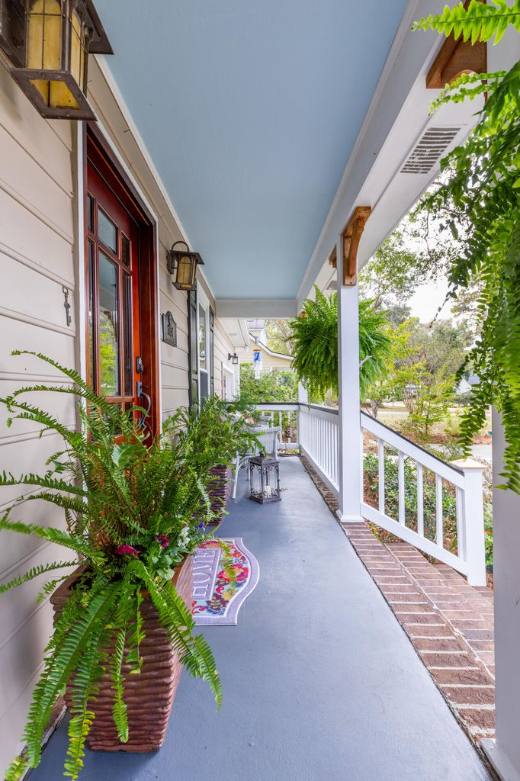
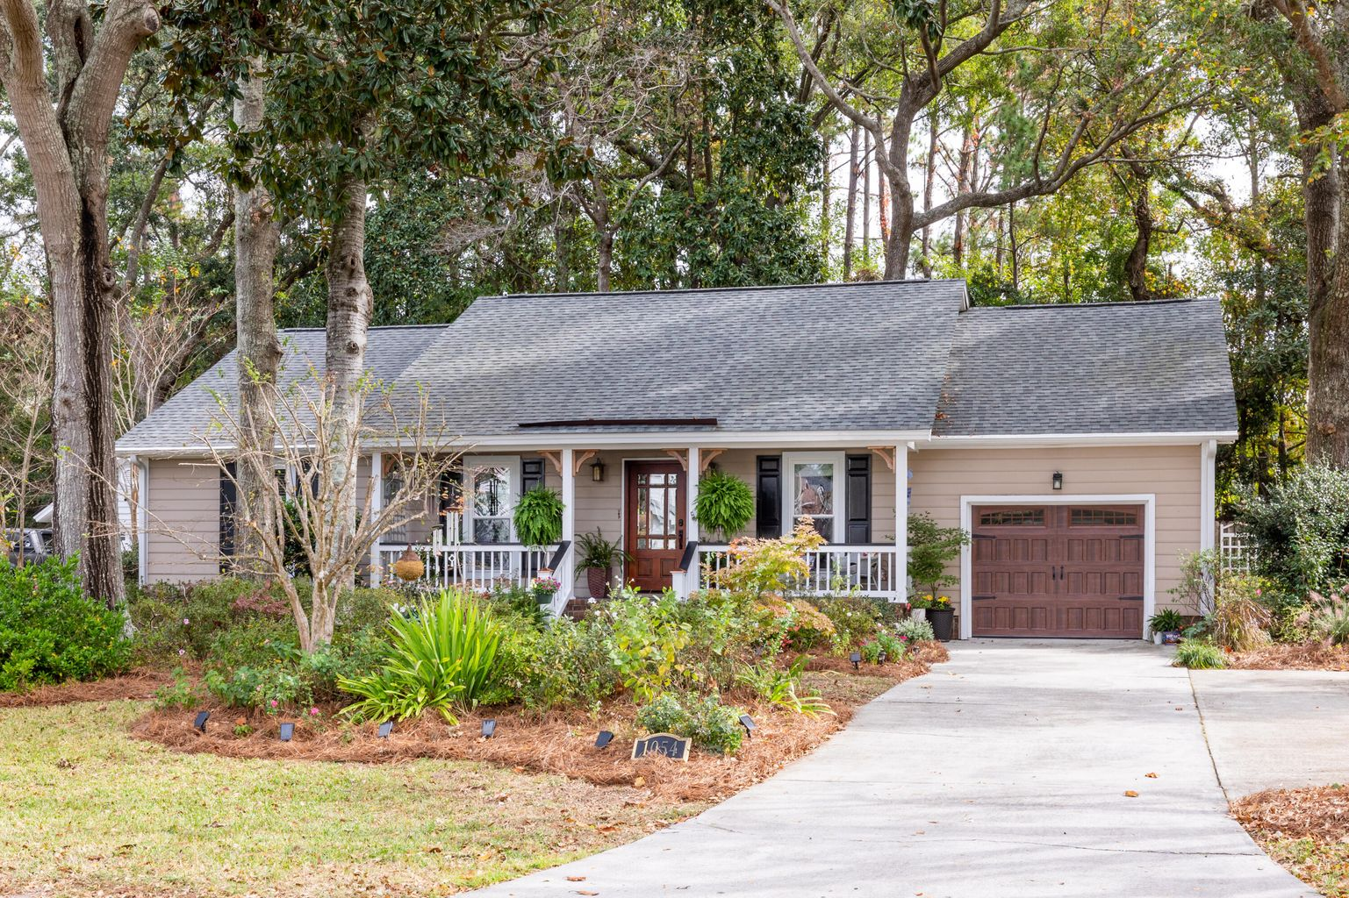
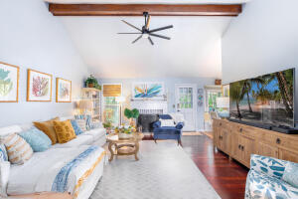
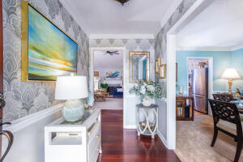
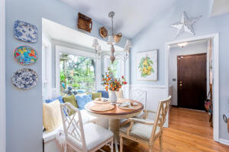
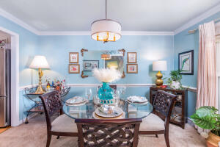
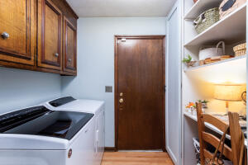
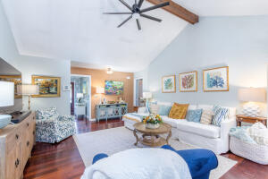
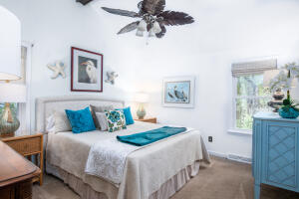
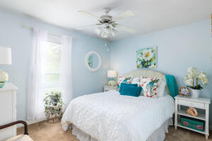
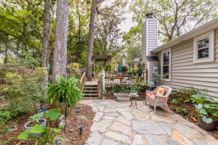



Welcome Home to 1054 Blue Marlin Drive!
Harbor Woods III | Charleston, SC 29412 | $550,000
3 Bedrooms | 2 Bathrooms | 1,394 sf
This stunning home is in one of James Island's most highly desired neighborhoods, Harbor Woods III. This home is a must see and features a number of well thought out upgrades, all while keeping the charm of a true "island house". The backyard features a large deck and beautiful gardens and landscaping.
Additional features include but are not limited to: fresh paint throughout, Roof (2018), transferable termite bond, crawlspace encapsulation with dehumidifier and ADA compliant shower and bathroom in primary.
X flood zone, insurance not required. No HOA. This location can't be beat, you're near several amazing dining options and 7 miles away from both Folly Beach and the peninsula!
Celeste Shumate Jones
Realtor
843-345-9387
welcomingyouhomecharleston@gmail.com

