Slide 1
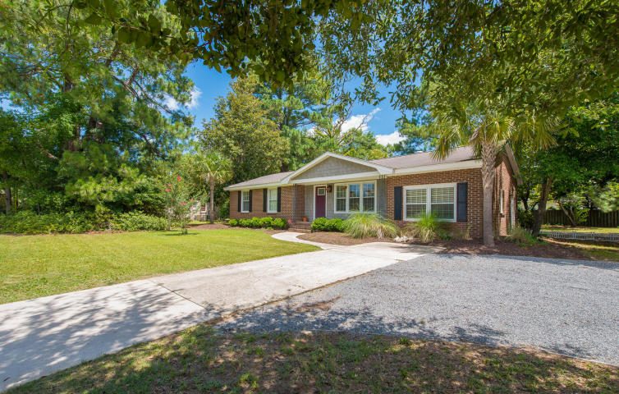
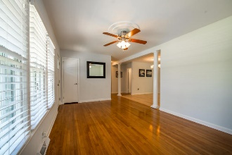
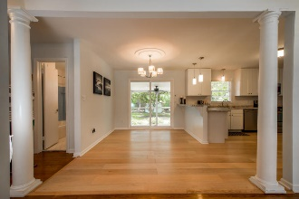
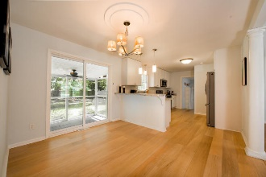
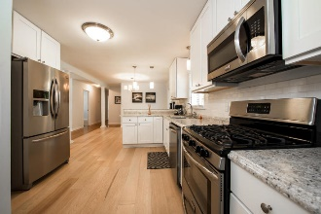
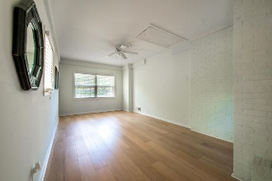
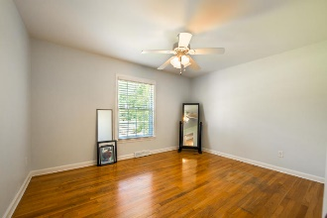
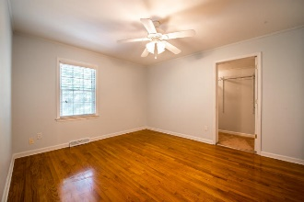
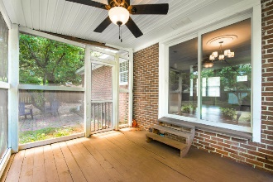
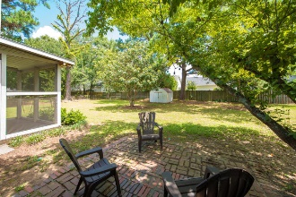
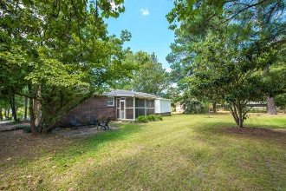


17 Timmerman
Byrnes Downs
Charleston, SC 29407
MLS# 16022572 · $2,500/mo
3 Bedrooms | 2 Full Baths | 1,233 Sq Dt
Priced To Sell & Will Not Last Long!!!
1058 Harbor View Road
Lawton Bluff · Charleston · MLS# 17012065 · $275,000
3 Bedrooms | 2 Full Baths | 1,550 Sq Ft
Renovated, move-in ready home in the heart of James Island! Close to the Connector, Ellis Fish Camp, and the Harris Teeter on Harbor View. Spacious 3 bedroom, 2 bath ranch style home with 1550 square feet sits on nearly half an acre of high ground with a huge, almost completely fenced-in back yard, with nice large screened in porch off the back. Updates since 2015 include upgrades in master suite, new fixtures in both master and guest bath, new flooring in kitchen and den, new kitchen countertops, new appliances, new paint, and landscaping Home has been well maintained and professionally cleaned. Construction on Harbor View Road near the home is now complete, so there are new sidewalks and turning lanes and traffic flow is smooth and easy. Seller pays $900 a year for flood insurance.
Nikki Jones | nikki@petigruproperties.com | (843) 442-5880
Petigru Properties, Inc · 792 Folly Road Suite 5 · Charleston, SC 29412

